Slide 1

End Organ Complications: Pulmonary Hypertension
Gregory Kato, MD
Sickle Cell Center of Excellence
Department of Medicine, Division of Hematology-Oncology
Heart, Lung and Blood Vascular Medicine Institute
University of Pittsburgh School of Medicine

Slide 2
Disclosures
Current research support from Bayer
Past research support from AesRx
Consultation for CSL Behring, Mast, Novartis, Bioverativ, Global Blood Therapeutics

Slide 3
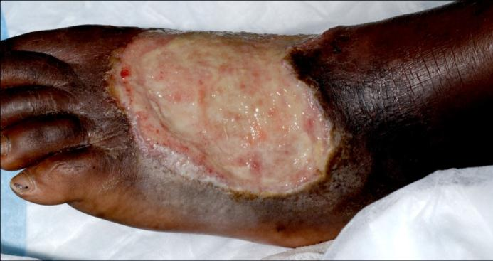
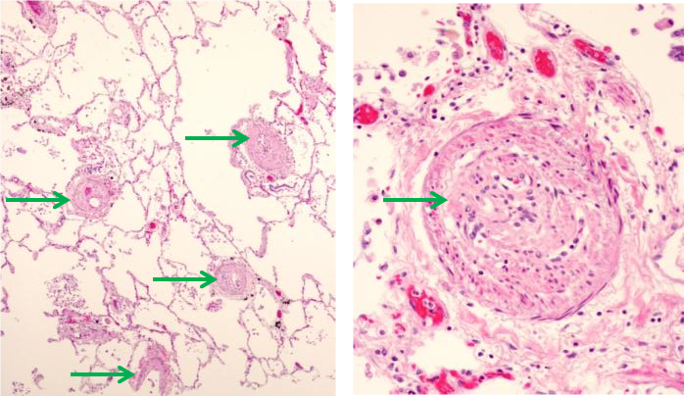
46 year old African American woman with sickle cell anemia with leg and foot ulcers for many years
Pain crisis twice a year
Progressive dypnea on exertion
Diagnosed PAH, treated with sildenafil with clinical improvement
Died during pain crisis complicated by sepsis

Slide 4
Pulmonary hypertension
What causes PH in SCD?
How do we screen for PH?
How do we diagnose PH?
What is associated with PH?
How do we treat PH?

Slide 5
Pulmonary hypertension
What causes PH in SCD?
How do we screen for PH?
How do we diagnose PH?
What is associated with PH?
How do we treat PH?

Slide 6
Factors associated with sickle cell PH
Related to SCD
Unrelated to SCD
Intravascular Hemolysis
Relative Hypertension
Aging
Platelet Activation
Pulmonary
Hypertension
High
Triglycerides
Iron Overload
Low apoA-I
Low HDL-C
Diastolic Dysfunction
Autoimmune Disease
High viscosity?
HIV
Inflammation?
Uric Acid?

Slide 7
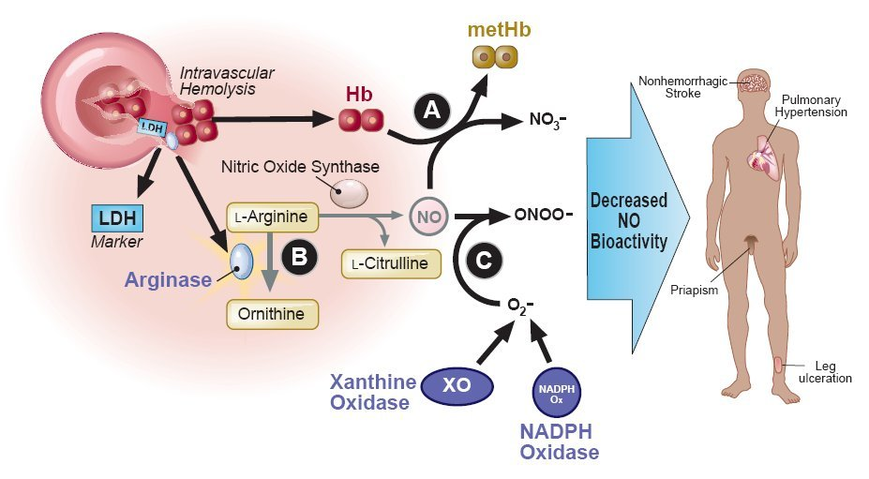
Intravascular Hemolysis in SCD
Kato GJ, Gladwin MT, Steinberg MH. Blood Rev. 2007; 21:37-47.
Copyright © 2007 Elsevier Inc.

Slide 8
Spectrum of Hemolytic Associations
Spectrum
Stroke, nephropathy, gallstones
Kato GJ, Gladwin MT, Steinberg MH. Deconstructing sickle cell disease: reappraisal of the role of hemolysis in the development of clinical subphenotypes. Blood Rev. 2007 Jan;21(1):37-47. PMID: 17084951; PMC2048670.

Slide 9
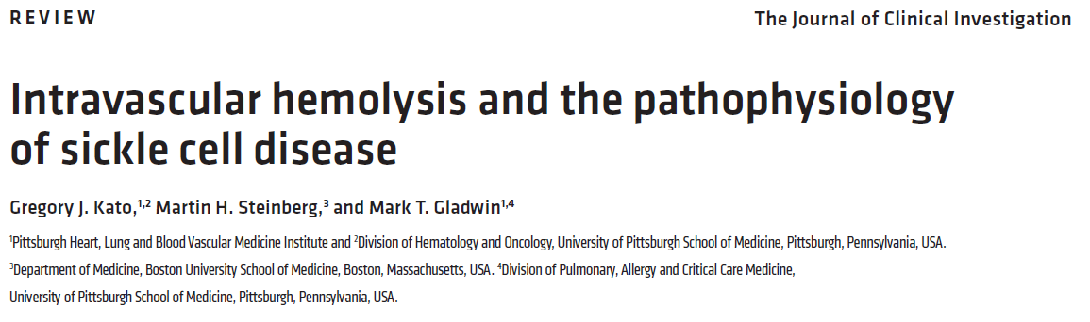
Updated Review of Evidence
Kato GJ, Steinberg MH, Gladwin MT. Intravascular hemolysis and the pathophysiology of sickle cell disease. J Clin Invest. 2017 Mar 1;127(3):750-760. PMID: 28248201; PMC5330745.

Slide 10
Pulmonary hypertension
What causes PH in SCD?
How do we screen for PH?
How do we diagnose PH?
What is associated with PH?
How do we treat PH?

Slide 11
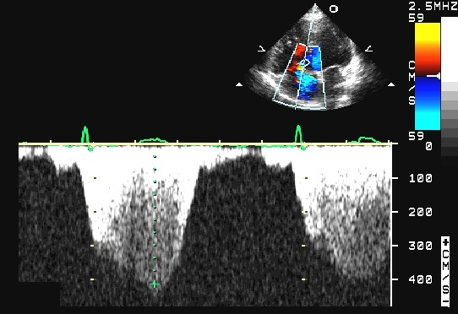
TRV in SCD Screening
Peak TR velocity 4.1 m/s
Peak gradient 67mm Hg
Est. RVSP 72mmHg

Slide 12
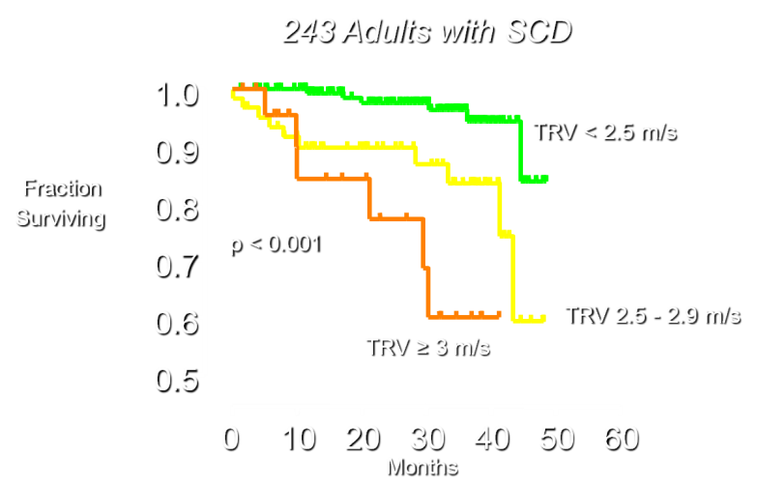
TRV Predicts Risk of Death at NIH
Parallel mortality findings from:
UNC Chapel Hill
Duke
Einstein
Machado et al., Advances in Pulmonary Hypertension 2007
Copyright ©2012 by Pulmonary Hypertension Association

Slide 13
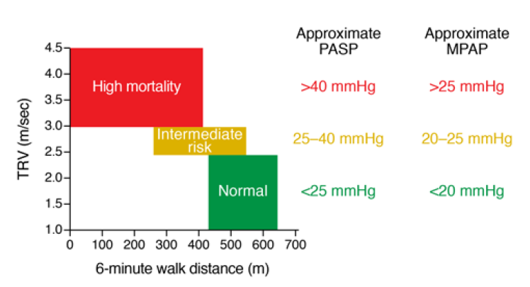
TRV as a marker of risk
Kato GJ, Steinberg MH, Gladwin MT. Intravascular hemolysis and the pathophysiology of sickle cell disease. J Clin Invest. 2017 Mar 1;127(3):750-760. PMID: 28248201; PMC5330745.

Slide 14
Association of Elevated TRV in SCD
Cath-proven pulmonary hypertension
Early mortality in adults with SCD
Future reduced 6MWD in children
Systemic hypertension
Proteinuria and chronic kidney disease
Kato GJ, Steinberg MH, Gladwin MT. Intravascular hemolysis and the pathophysiology of sickle cell disease. J Clin Invest. 2017 Mar 1;127(3):750-760. PMID: 28248201; PMC5330745.

Slide 15
NT-proBNP and risk of PH
NT-proBNP >160 pg/mL
Higher risk:
  TRV >2.5 m/s
  Cath-proven PH
  Diastolic dysfunction
  Low 6MWD
  Mortality
Machado RF, Anthi A, Steinberg MH, Bonds D, Sachdev V, Kato GJ, Taveira-DaSilva AM, Ballas SK, Blackwelder W, Xu X, Hunter L, Barton B, Waclawiw M, Castro O, Gladwin MT; MSH Investigators. N-terminal pro-brain natriuretic peptide levels and risk of death in sickle cell disease. JAMA. 2006; 296:310-8.

Slide 16
Pulmonary hypertension
What causes PH in SCD?
How do we screen for PH?
How do we diagnose PH?
What is associated with PH?
How do we treat PH?

Slide 17
Diagnosis of PH
Definitive clinical diagnosis of PH always involves right heart catheterization
Important management information
Pulmonary arterial vs. venous hypertension

Slide 18
Classification of PH in SCD
PAH
High mPAP
High PVR
PVH
High mPAP
High PCWP
CTEPH
High mPAP
Abnormal V/Q
Or CTA

Slide 19
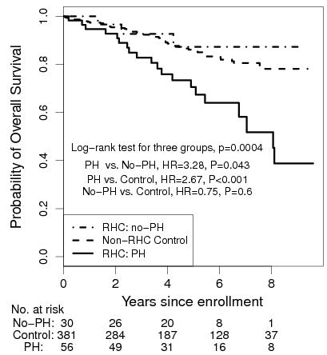
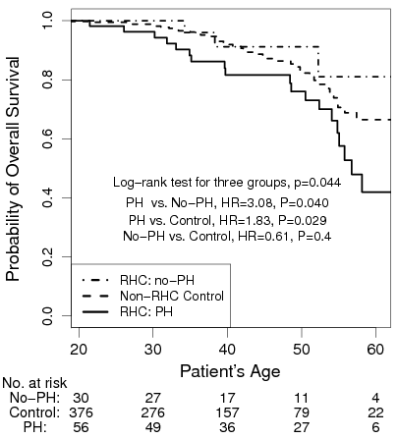
PH and Early Mortality
No PH
No PH
Control
Control
PH
PH
Mehari A, Gladwin MT, Tian X, Machado RF, Kato GJ. Mortality in adults with
sickle cell disease and pulmonary hypertension. JAMA. 2012;307:1254-6.

Slide 20
Three right heart cath studies
Three right heart cath studies with varied selection criteria
  Paris – Parent NEJM 2011
  Brazil – Fonseca Eur J Haematol 2012
  USA – Mehari JAMA 2012
High TRV prevalence 27 – 40%
PH prevalence 6 – 11%
PH associated with ulcers (not VOC or ACS)
  Older age
  Markers of hemolysis (low Hb, high AST, LDH)
  Markers of liver dysfunction (alk phos, direct bilirubin)
  Markers of renal dysfunction (creatinine and others)
  Functional impairment (6MWD, NYHA class, NT-proBNP)
  Increased mortality

Slide 21
Findings in SCD PH vs others | NIH | Parent et al. | Fonseca et al.
Exclusions | None | Lung, liver, renal disease | None
Prevalence of TRV≥2.5 m/s | 32% | 27% | 40%
Prevalence of mPAP≥25 mmHg | 11% | 6% | 10%
Age | Older | Older | Older
History of leg ulcers | Yes | Yes | Yes (sig only w TRV)
History of frequent VOC or ACS | No | No | No
NT-proBNP | High | High
Hemoglobin | Low | Low | Low
LDH | High | High | High
AST | High | High | High
Alkaline phosphatase | High | High
Direct bilirubin | High | High
Creatinine | High | High | High
6MWD | Low | Low | Low
NYHA functional class | High | High
Mortality | High | High | High

Slide 22
Prevalence of PH by TRV Group
84 SCD Adults with Right Heart Catheterization at NIH
TRV (m/sec) | PH | No PH | PH Prevalence
2.5 – 2.9 | 9 | 14 | 39%
≥3 | 46 | 14 | 77%
TRV has better positive predictive value when used with:
Higher TRV cutoff or 6 minute walk distance or NT-proBNP
It performs better than TCD velocity to predict risk of stroke in SCD
Mehari et al., JAMA 2012; 307:1254-6. Similar results in Parent et al., A hemodynamic study of pulmonary hypertension in sickle cell disease. N Engl J Med. 2011; 365:44-53.

Slide 23
Pulmonary hypertension
What causes PH in SCD?
How do we screen for PH?
How do we diagnose PH?
What is associated with PH?
How do we treat PH?

Slide 24
Characteristics of PH patients
 | Pulmonary Hypertension (n=55) | No Cath (n=447) | p
Age, y | 41 (13) | 35 (12) | <.001
AST, U/L | 49 (25) | 41 (22) | .01
LDH, U/L | 475 (234) | 339 (151) | <.001
Uric acid, mg/dL | 6.7 (1.9) | 6.0 (2.1) | .01
Hemoglobin, g/dL | 9.0 (1.7) | 9.6 (1.9) | .02
Hematocrit, % | 26 (5) | 28 (6) | .02
TRV, m/s | 3.3 (0.5) | 2.3 (0.5) | <.001
6-Minute walk distance, m | 358 (113) | 486 (88) | <.001
Direct bilirubin, mg/dL | 0.4 (0.3-0.8) | 0.4 (0.3-0.5) | .02
Creatinine, mg/dL | 0.8 (0.6-1.1) | 0.7 (0.5-0.9) | .02
C-reactive protein, mg/L | 0.41 (0.40-0.76) | 0.42 (0.20-0.79) | .009
Ferritin, ng/mL | 804 (232-1667) | 378 (107-1235) | .007
NT-proBNP, pg/mL | 177 (83-530) | 58 (29-123) | <.001
Mehari et al., JAMA 2012; 307:1254-6. Copyright © 2012 American Medical Association

Slide 25
Associated Complications
Systemic HTN
High
TRV
Protein-uria
STROKE, CKD, PH, DEATH

Slide 26
Pulmonary hypertension
What causes PH in SCD?
How do we screen for PH?
How do we diagnose PH?
What is associated with PH?
How do we treat PH?

Slide 27
Treatment of PH
Must be done by a pulmonologist or cardiologist experienced in PH
  Preferably with SCD experience
Drugs
  Endothelin receptor antagonists
  Riociguat
  Prostacyclin analogs

Slide 28
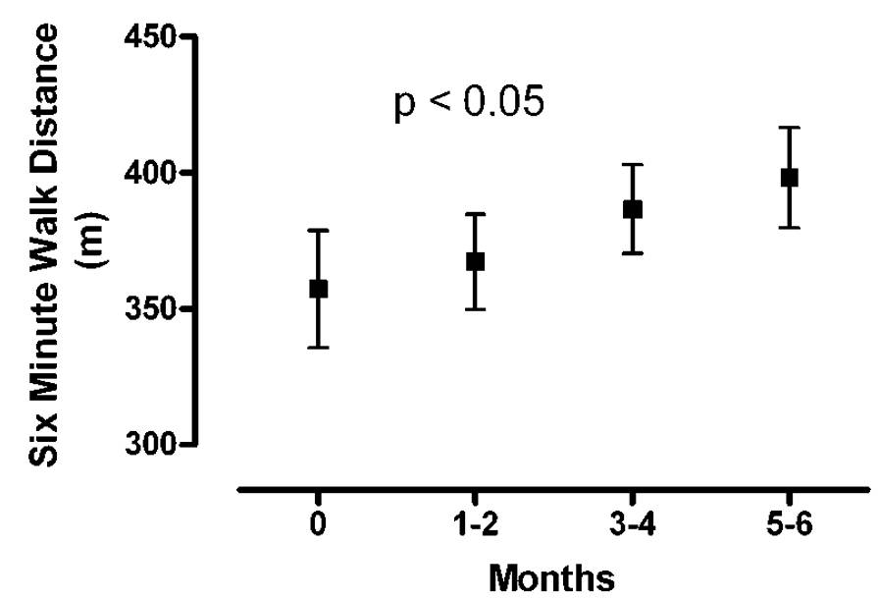
Endothelin receptor antagonists
Bosentan, ambrisentan, macitentan
Some case series data
No SCD-specific adverse events reported
Anecdotal improvement of SCD leg ulcer
Minniti CP, Machado RF, Coles WA, Sachdev V, Gladwin MT, Kato GJ. Endothelin receptor antagonists for pulmonary hypertension in adult patients with sickle cell disease. Br J Haematol. 2009; 147:737-43.
Lionnet F, Bachmeyer C, Stankovic K, Tharaux PL, Girot R, Aractingi S. Efficacy of the endothelin receptor blocker bosentan for refractory sickle cell leg ulcers. Br J Haematol. 2008; 142:991-2.

Slide 29
Riociguat
Oral tablets TID
Soluble guanylyl cyclase stimulator
FDA approved
  pulmonary arterial hypertension
  chronic thromboembolic pulmonary hypertension
Under investigation for SCD
Weir NA, Conrey A, Lewis D, Mehari A. Riociguat use in sickle cell related
chronic thromboembolic pulmonary hypertension: A case series. Pulm Circ. 2018; 8:2045894018791802.

Slide 30
STERIO-SCD
Safety, Tolerability and Efficacy of Riociguat in Adults with Sickle Cell Disease
Investigator-initiated, industry-funded
Sponsor is University of Pittsburgh
Funded by Bayer Pharmaceuticals
PI’s Gregory Kato and Mark Gladwin
Hypertension, elevated TRV or nephropathy
ClinicalTrials.gov Identifier: NCT02633397

Slide 31
Prostacyclin analogs
Epoprostenol
Iloprost
Treprostinil
IV, SC infusion or inhaled
Weir NA, Saiyed R, Alam S, Conrey A, Desai HD, George MP, Keeley JH, Klings ES, Mehari A, Taylor JG 6th, Minniti CP, Kato GJ. Prostacyclin-analog therapy in sickle cell pulmonary hypertension. Haematologica. 2017; 102:e163-e165.

Slide 32
Sildenafil
PDE5 inhibitor
FDA approved for pulmonary arterial hypertension
Initially promising in case series
Multicenter randomized controlled trial terminated early due to increased VOC
Machado RF, Barst RJ, Yovetich NA, Hassell KL, Kato GJ, Gordeuk VR, Gibbs JS, Little JA, Schraufnagel DE, Krishnamurti L, Girgis RE, Morris CR, Rosenzweig EB, Badesch DB, Lanzkron S, Onyekwere O, Castro OL, Sachdev V, Waclawiw MA, Woolson R, Goldsmith JC, Gladwin MT; walk-PHaSST Investigators and Patients. Hospitalization for pain in patients with sickle cell disease treated with sildenafil for elevated TRV and low exercise capacity. Blood. 2011; 118:855-64.

Slide 33
Summary
Sickle cell disease is a strong risk factor for pulmonary hypertension
PH shortens life expectancy dramatically
Associations with intense hemolysis, leg ulcers, nephropathy
Standard PH therapies have a role in management

Slide 34
Recommendations
NT-proBNP annually
Echocardiogram q3-5 years as adult
  More frequently if TRV 2.4 or higher
PH specialist should consider right heart cath
  TRV 3 or higher, refer to specialist
  TRV 2.5-2.9 with dypnea, desaturation, NT-proBNP >160, 6MWD<500m, refer to specialist
  Consider pulmonary vasodilator therapy and intensify sickle cell therapy (hydroxyurea, chronic transfusion)

Slide 35
Detailed recommendations
Gordeuk VR, Castro OL, Machado RF. Pathophysiology and treatment of pulmonary hypertension in sickle cell disease. Blood. 2016; 127:820-8.
Klings ES, Machado RF, Barst RJ, Morris CR, Mubarak KK, Gordeuk VR, Kato GJ, Ataga KI, Gibbs JS, Castro O, Rosenzweig EB, Sood N, Hsu L, Wilson KC, Telen MJ, Decastro LM, Krishnamurti L, Steinberg MH, Badesch DB, Gladwin MT; American Thoracic Society Ad Hoc Committee on Pulmonary Hypertension of Sickle Cell Disease. An official American Thoracic Society clinical practice guideline: diagnosis, risk stratification, and management of pulmonary hypertension of sickle cell disease. Am J Respir Crit Care Med. 2014; 189:727-40.

Slide 36
Acknowledgments
University of Pittsburgh
Maria Kapetanaki, PhD
Oluwabukola Gbotosho, PhD
Deva Sharma, MD
Samit Ghosh, PhD
Solomon Ofori-Acquah, PhD
Valerie Schrott, MS
Grant Bullock, MD, PhD
Mark Gladwin, MD
Yingze Zhang, PhD
Enrico Novelli, MD
Laura De Castro, MD
Charles Jonassaint, PhD
NHLBI
Xunde Wang, MD
Shoaib Alam, MD
Alem Mehari, MD
James Taylor, MD
Jim Nichols, RN
Laurel Mendelsohn, MS
Eduard van Beers, MD, PhD
Nalini Raghavachari, PhD
Nargues Weir, MD
Yanqin Yang, PhD
University of Illinois-Chicago
Victor Gordeuk, MD
University of Indiana
Roberto Machado, MD
Albert Einstein University
Caterina Minniti, MD
Boston University Medical Center
Elizabeth Klings, MD
Emory University
Claudia Morris, MD
Notes:
Thank you for your attention!

Slide 37
Backup slides

Slide 38
SCD Endophenotypes
Clinical Features | Effect of Hyperhemolysis | Effects of ∝ thalassemia | Protection by HbF
Pain or dactylitis | Reduced risk | Increases risk | Protective
Acute chest syndrome | Neutral | Increases risk | Protective
Leg ulcers | Increases risk | Reduces risk | Equivocal
Osteonecrosis | Reduced risk | Increases risk | Equivocal
Priapism | Increases risk | Reduces risk | Not protective
Nephropathy | Increases risk | Reduces risk | Not protective
Cerebrovascular | Increases risk | Reduces risk | Infants: Not protective Adults: Possibly
Cholelithiasis | Increases risk | Reduces risk | Protective
Retinopathy | Neutral | Equivocal | Possibly protective
↑TRV or ↑SBP | Increases risk | Equivocal | Not protective
Mortality | Increases risk | Protective | Protective

Slide 39
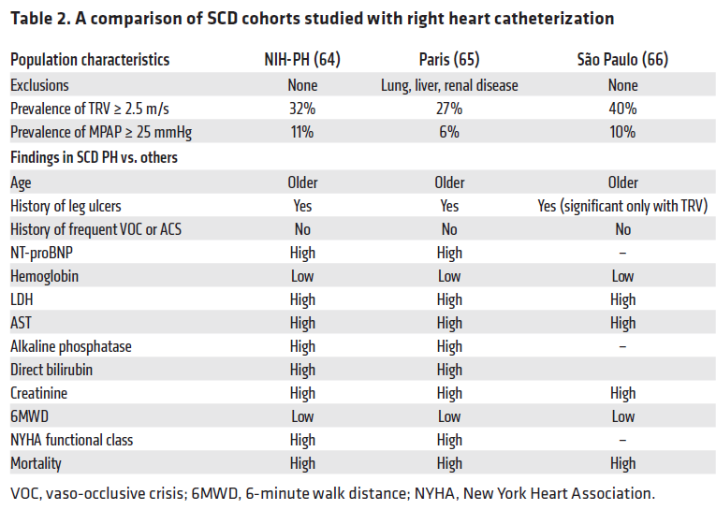
Kato GJ, Steinberg MH, Gladwin MT. Intravascular hemolysis and the pathophysiology of sickle cell disease. J Clin Invest. 2017 Mar 1;127(3):750-760. PMID: 28248201; PMC5330745.

Slide 40
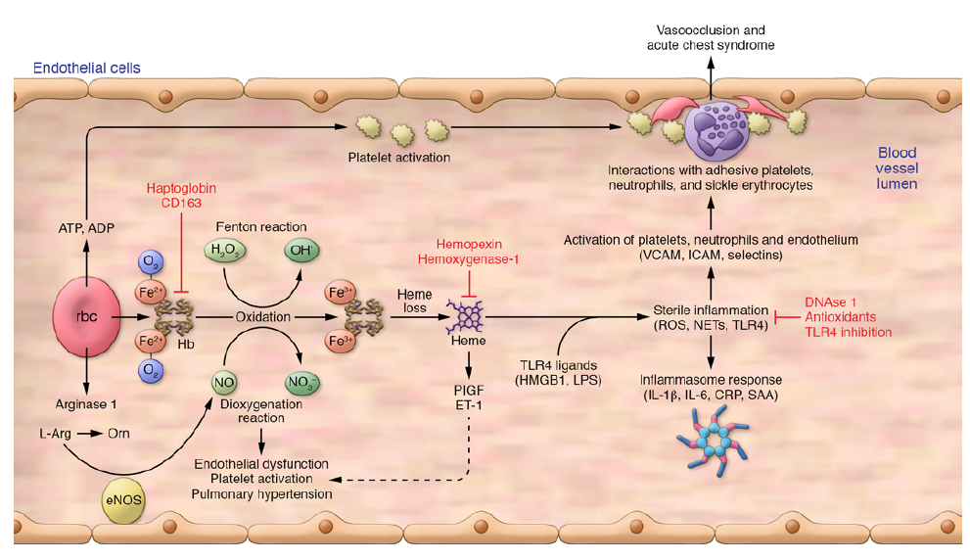
Consequences of Intravascular Hemolysis
Kato GJ, Steinberg MH, Gladwin MT. Intravascular hemolysis and the pathophysiology of sickle cell disease. J Clin Invest. 2017 Mar 1;127(3):750-760. PMID: 28248201; PMC5330745.

Slide 41
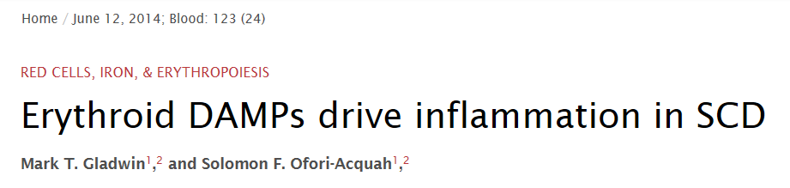
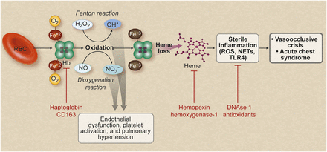

Slide 42
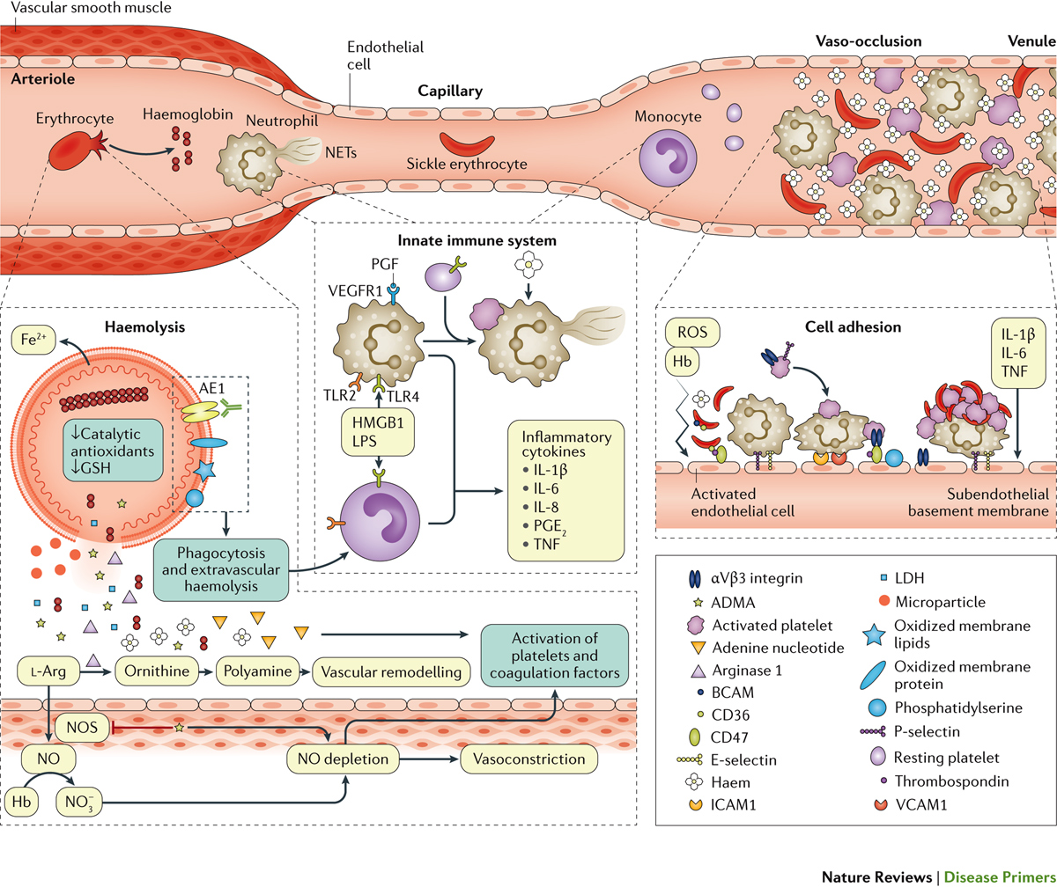
Kato, G. J. et al. (2018) Sickle cell disease, Nat. Rev. Dis. Primers doi:10.1038/nrdp.2018.10

