Slide 1
Sickle Cell and the Eye
Adrienne W. Scott, MD
August 15, 2018

Slide 2
Disclosures
Allergan, Inc. (Consultant)
No financial interest in this subject matter

Slide 3
All patients have retinopathy
HbSS pts can have advanced staged retinopathy
HbSC worse retinopathy and highest risk of vision loss
Male sex, older age, visual symptoms and floaters associated with retinopathy
Multi-disciplinary approach required

Slide 4
Sickle Cell Disease
Retro-orbital and Orbital Involvement
Orbital bone infarction
Orbital compression syndrome
Fever, lid edema, facial pain
Schundeln et.al, Journal of Pediatrics, 2014.

Slide 5
Conjunctival Comma Vessels

Slide 6
Salmon Patch Hemorrhage
Image Courtesy of the American Society of Retina Specialists (ASRS) image Bank

Slide 7
Sickle Cell Retinopathy
Goldberg staging (AJO 1971)
Stage I: peripheral arteriolar occlusions
Stage II: peripheral arteriolar-venular anastomoses
Stage III: neovascular and fibrous proliferation
Stage IV: vitreous hemorrhage
Stage V: retinal detachment
Notes:
Stages 1-3 are asymptomatic and we want to monitor and maybe do laser photocoagulation
Stages 4-5 we definitely want to laser to prevent progression and loss of vision.
Tx similar to diabetic retinopathy. Potentially can use VEGF inhibitors for SCR as well

Slide 8
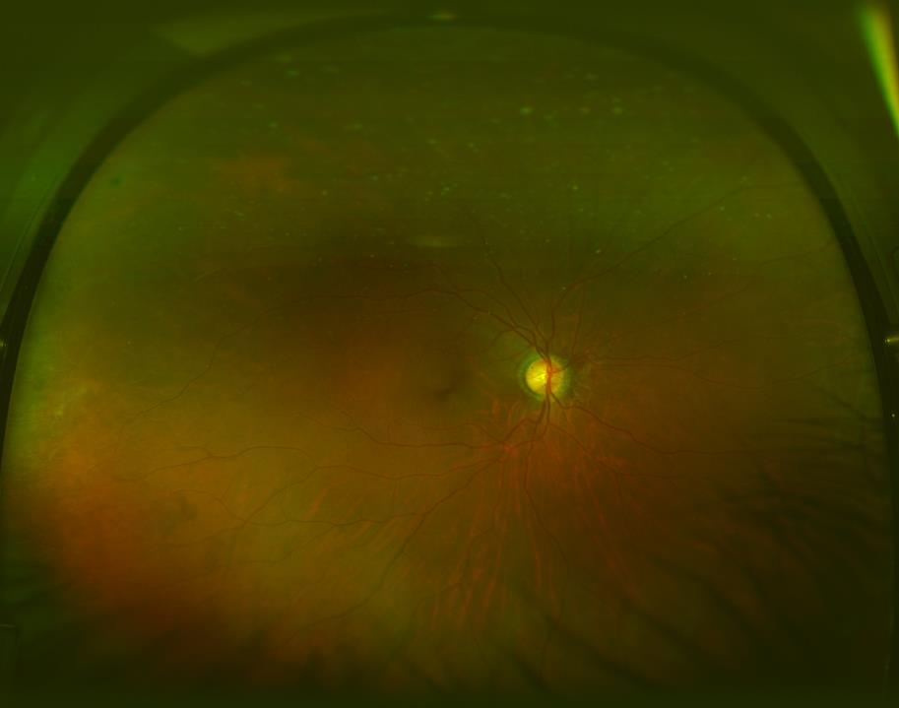
Stage I: peripheral arteriolar occlusions

Slide 9
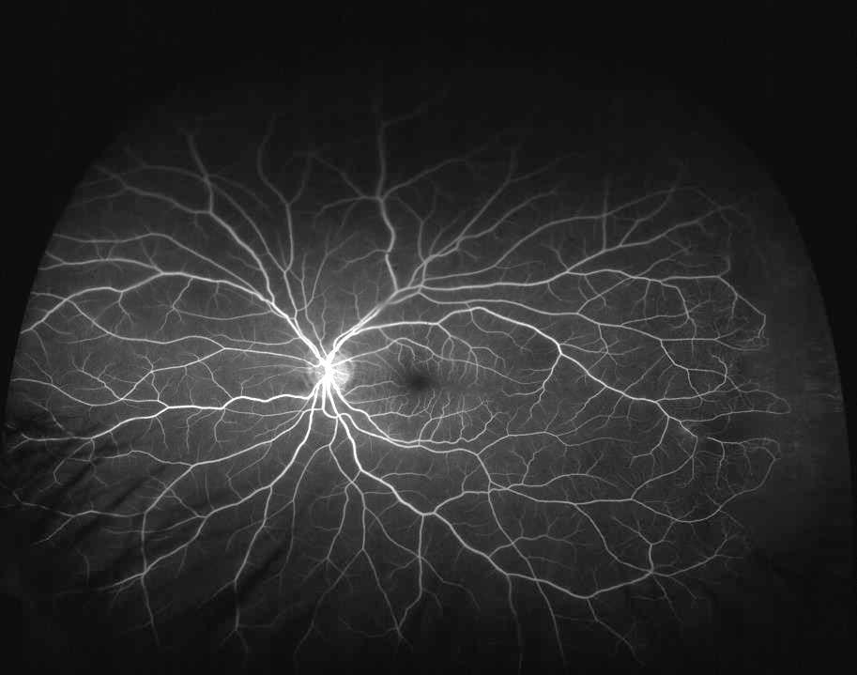
Stage II: arteriolar-venular anastomoses
Notes:
But change in frequency of follow up?

Slide 10
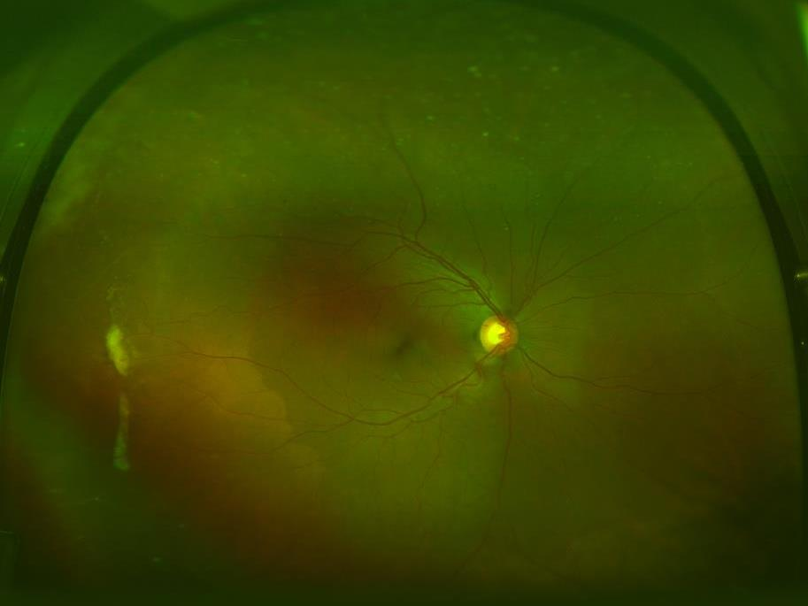
Stage III: peripheral fibrous proliferation

Slide 11
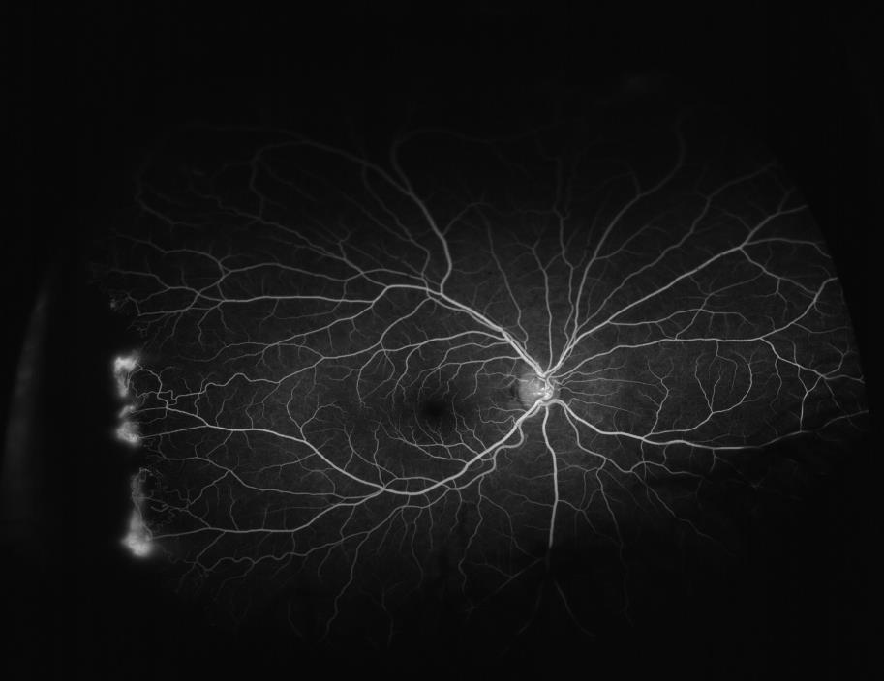
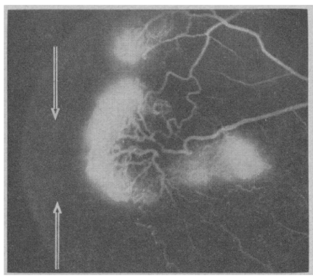

Slide 13
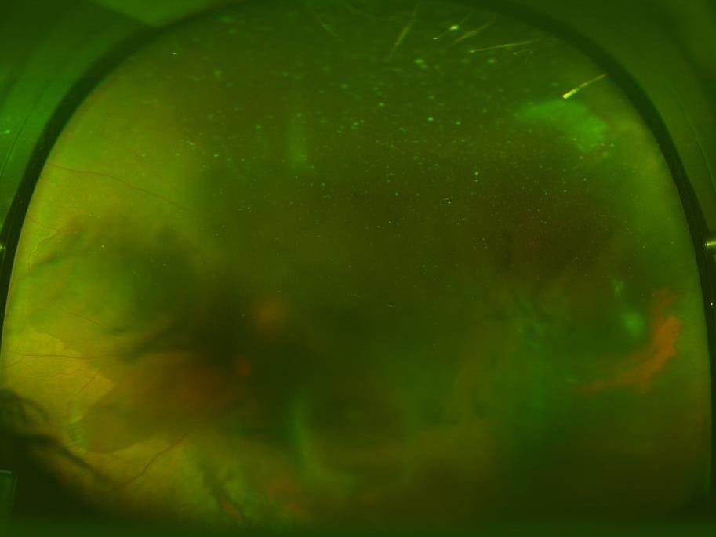
Stage IV: vitreous hemorrhage

Slide 14
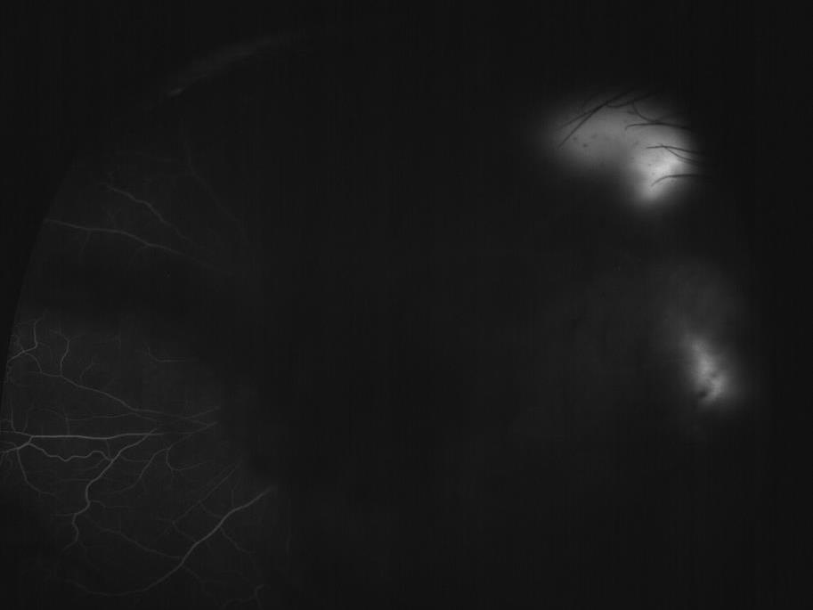
Stage IV: vitreous hemorrhage
Seafans visible despite vitreous heme
Notes:
Still no change in management with the added imaging (recommend laser OU, PPV OS if VH doesn’t clear)

Slide 15
Stage V: vitreous hemorrhage
Combined TRD/RRD

Slide 16
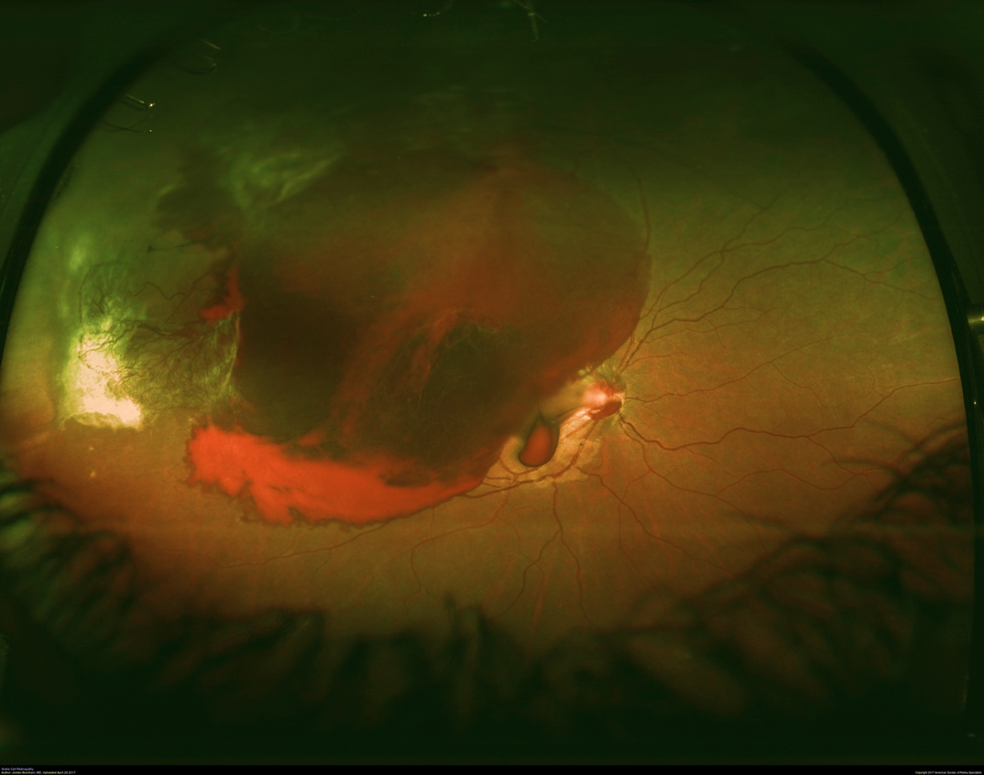
Image Courtesy of the American Society of Retina Specialists (ASRS) image Bank

Slide 17
Sickle Cell Maculopathy
Numerous macular abnormalities possible
Hairpin venular loops
Microaneurysmal dots
Foveal avascular zone irregularities
Macular ischemia does not develop neovascularization
Many patients with abnormalities but no visual consequence

Slide 18
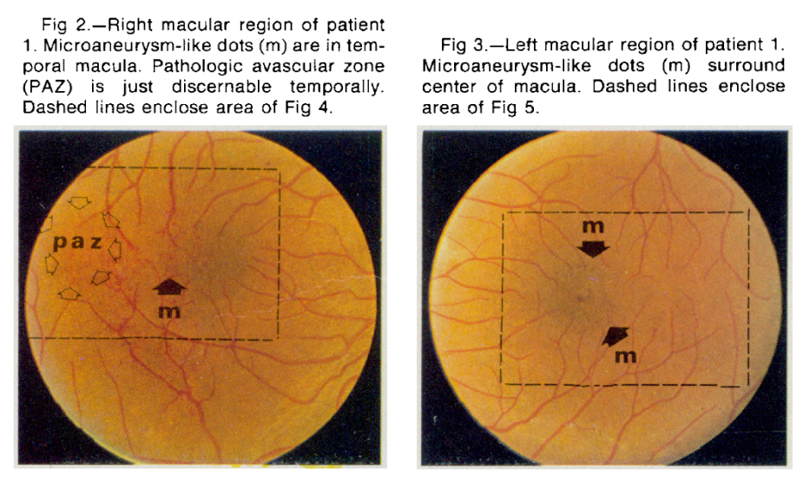

Slide 19
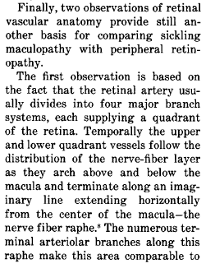
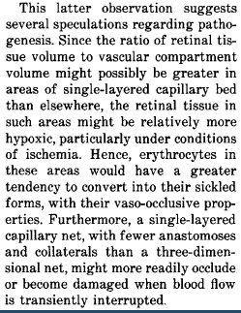
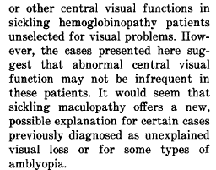
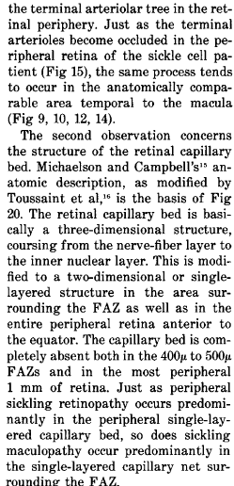
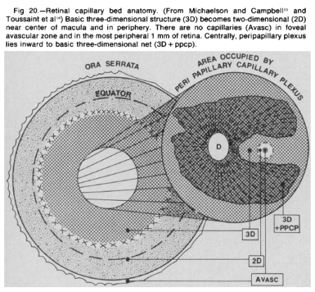
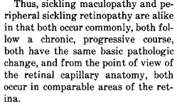
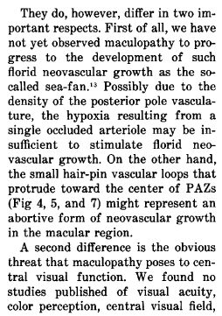

Slide 20
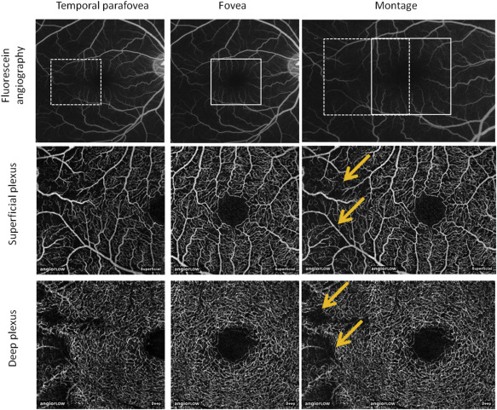
Multimodal Imaging in SCR
Notes:
Figure 1. Example images, 29-year-old man with sickle hemoglobin SC. (First column) 3 × 3 mm optical coherence tomography angiography (OCT-A) scans temporal to fovea (dotted box, Top left). (Second column) OCT-A scans centered on fovea (solid box, Top middle). (Third column) Montage of first 2 columns. Yellow arrows point to areas of flow loss. (HAN)

Slide 21
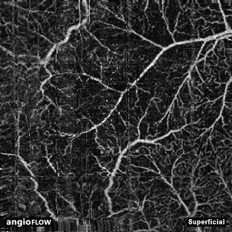
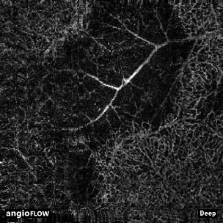
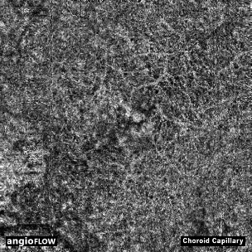
Multimodal Imaging in SCR

Slide 22
Case
29 year old AAM
CC: Referral from hematology for screening of sickle cell retinopathy
Visually asymptomatic

Slide 23
Case
PMH
Hb SS
Pain crises requiring hospitalization 2-3x/year
Acute vascular necrosis of right hip, status post hip replacement 2010
Multiple prior episodes of acute chest syndrome, last 2012
Prior right lower leg DVT on anticoagulation

Slide 24
Case
Sickle cell treatment
Treated with transfusion therapy until age 15
Started on hydroxyurea in early 20s
On chronic narcotics

Slide 25
Case
POH
None known; no prior eye examination
SH
Former cigarette smoker (quit 2014), works as restaurant host
FH
Both parents with sickle cell trait, otherwise unknown (adopted)

Slide 26
Case
Meds
Warfarin
Hydroxyurea
Oxycodone
Fentanyl patch
Celecoxib
Allergies
No known drug allergies

Slide 27
Exam
Va 20/32 ph 20/20 OD, 20/20 OS
IOP normal
SLE: normal OU
DFE: peripheral arteriolar occlusions and sunburst lesions OU, no seafans, vitreous hemorrhage or retinal detachment

Slide 28
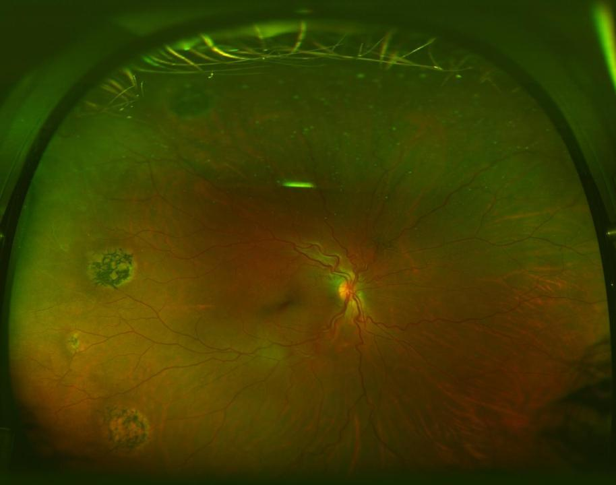
Notes:
Showing only right eye for the sake of time

Slide 29
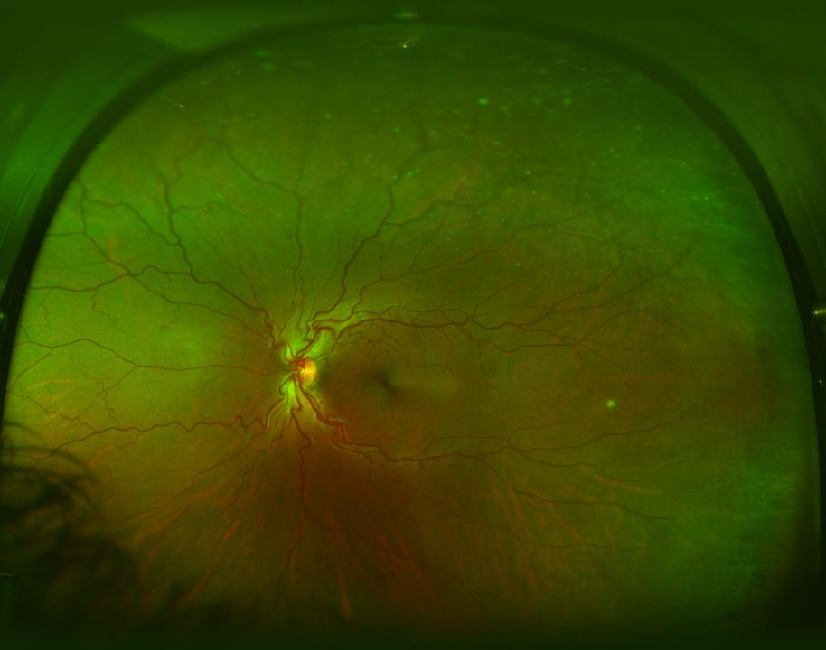

Slide 30
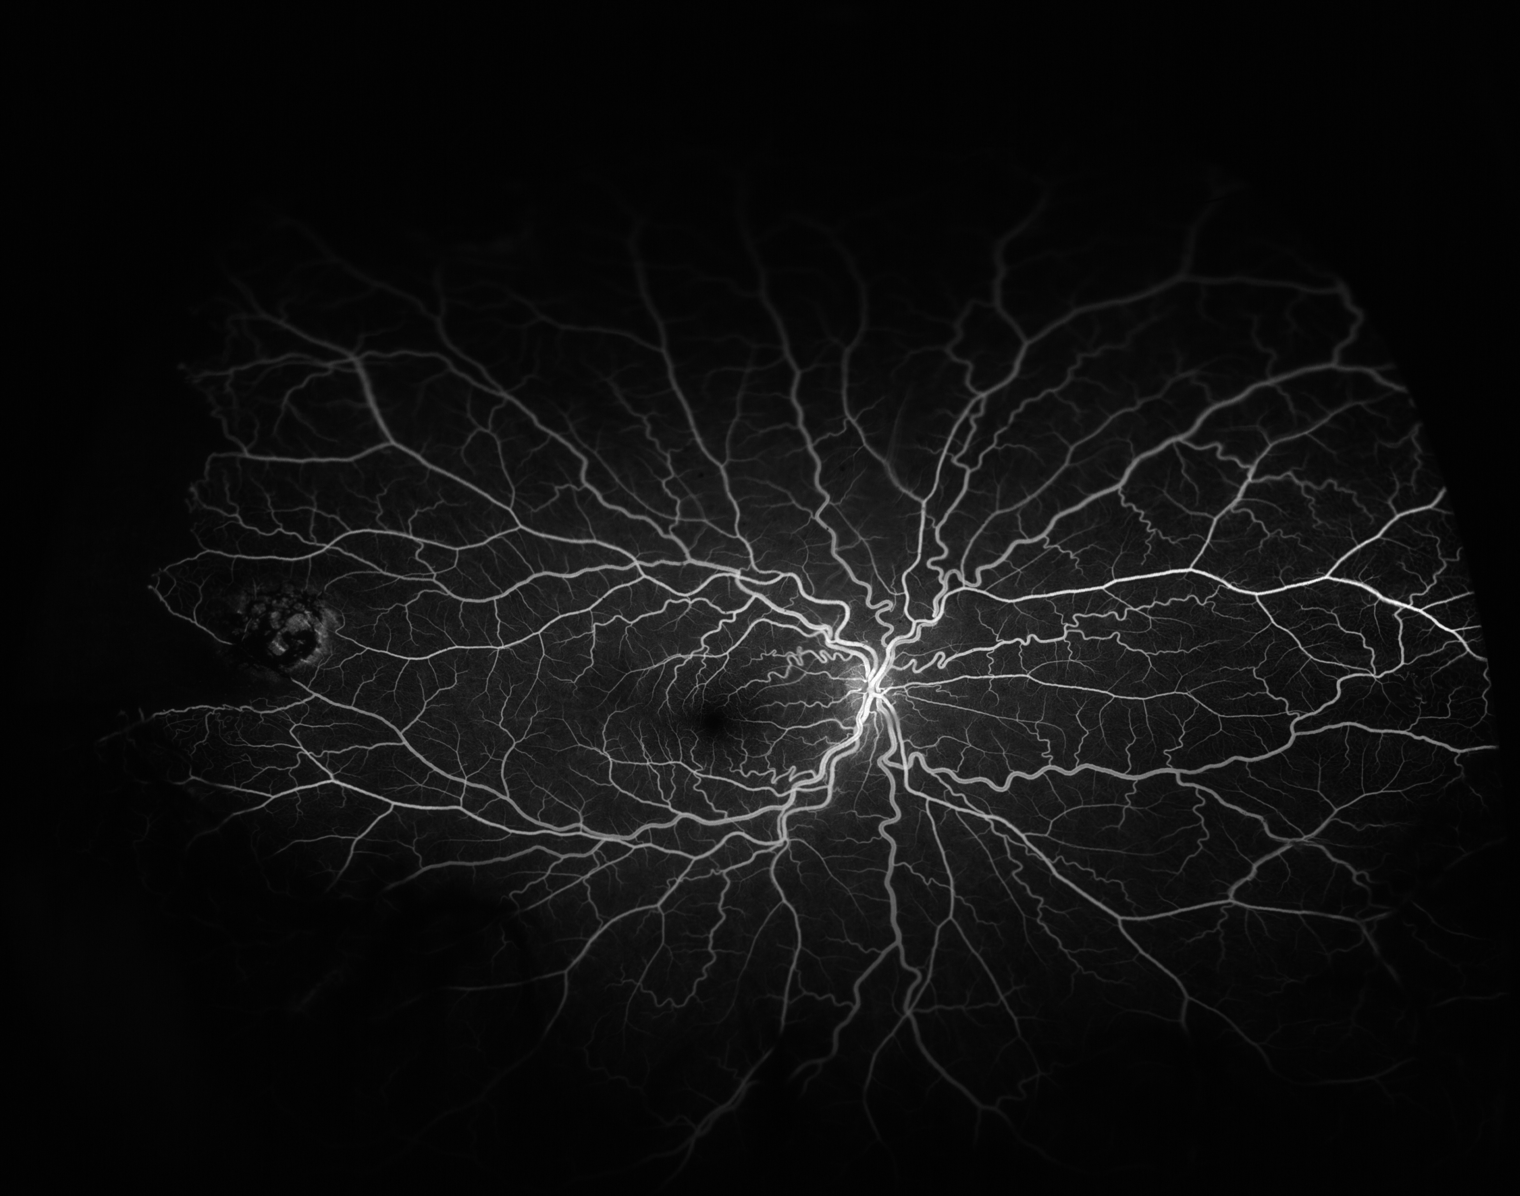
0:30

Slide 31
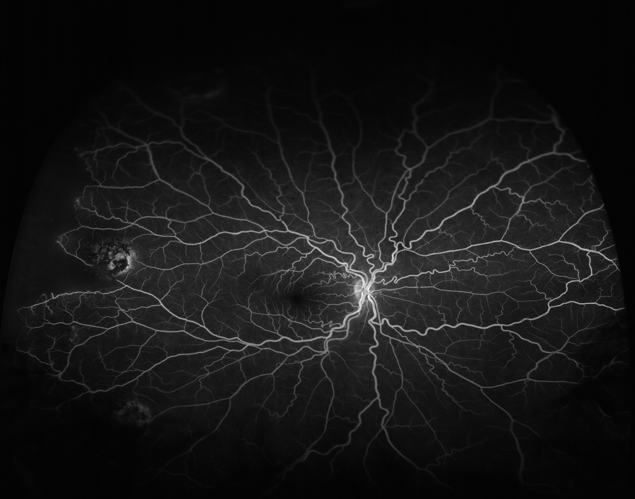
5:00

Slide 32
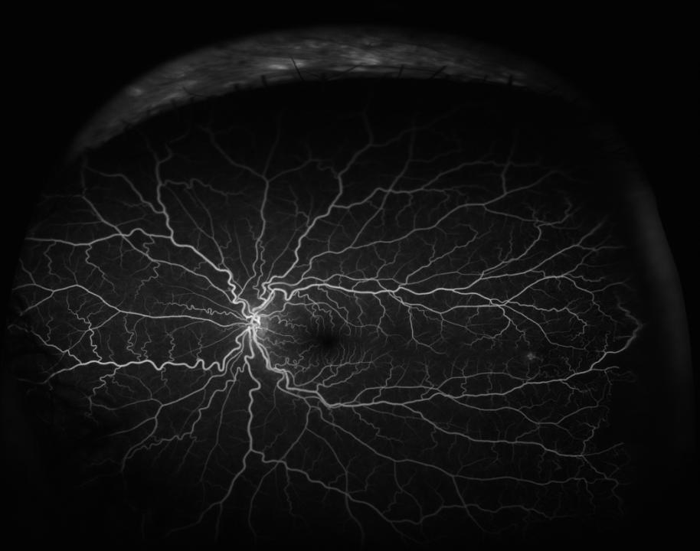
1:40

Slide 33
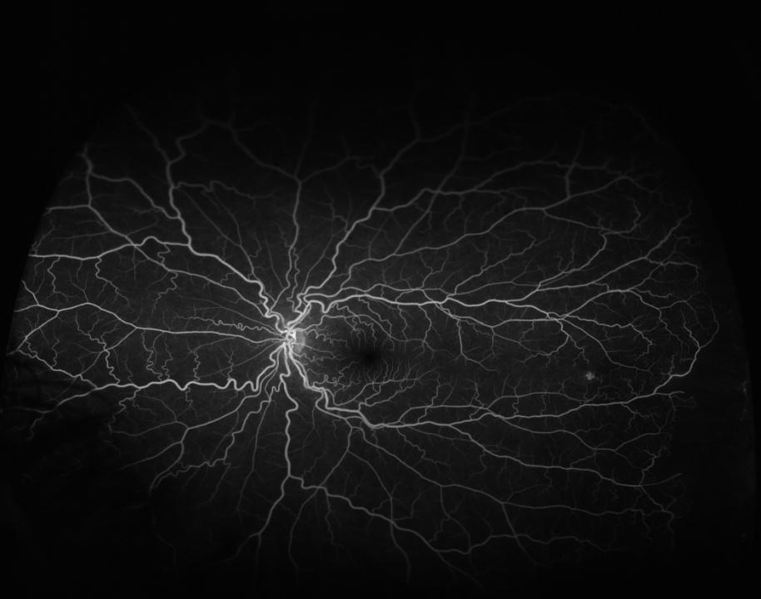
4:50

Slide 35
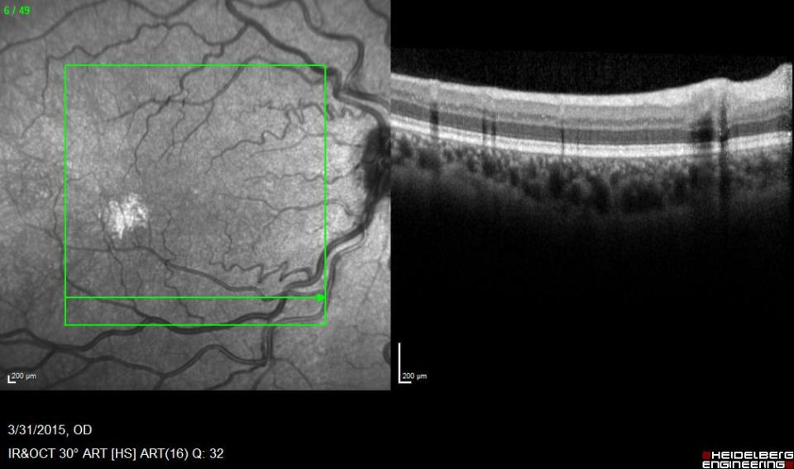

Slide 36
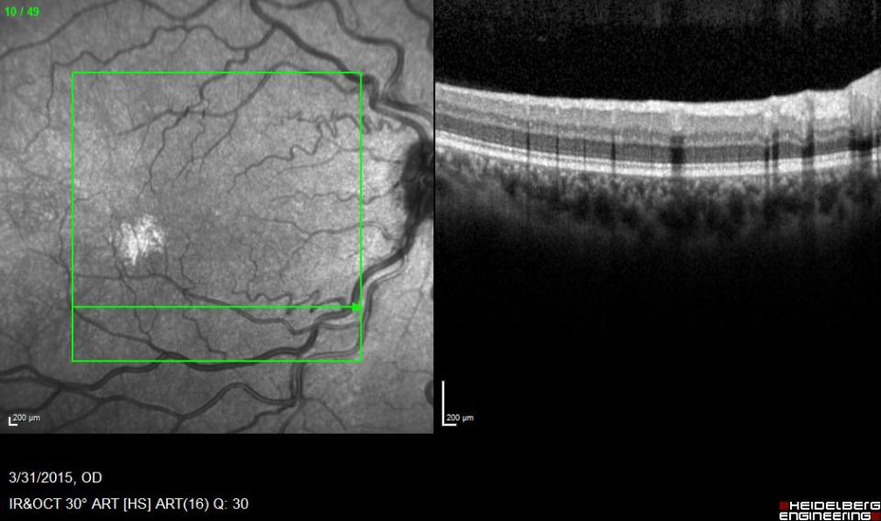

Slide 37
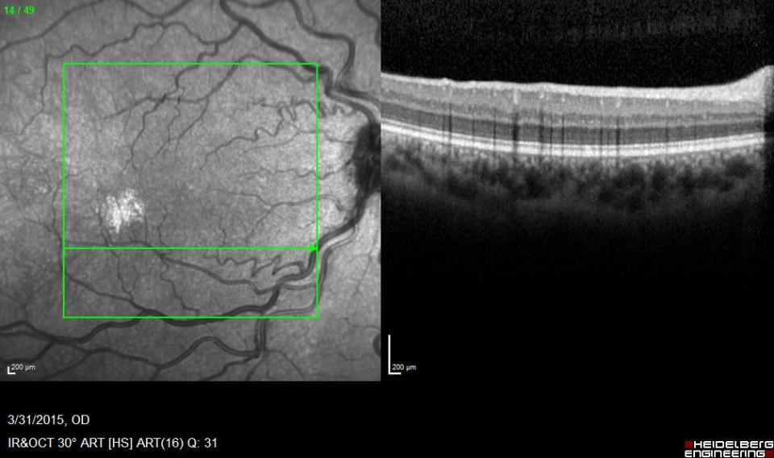

Slide 38
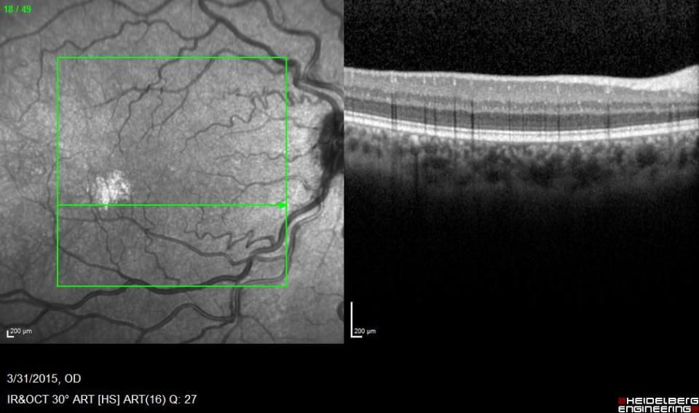

Slide 39
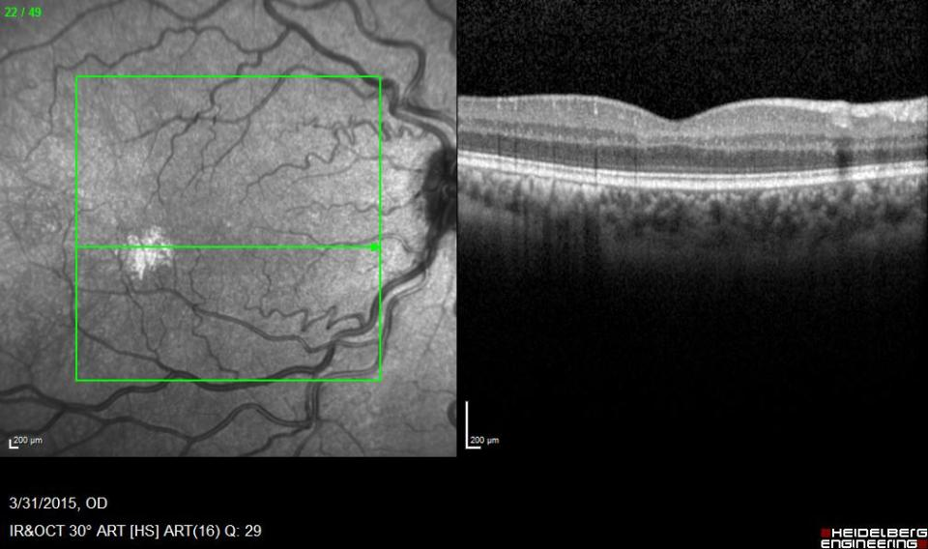

Slide 40
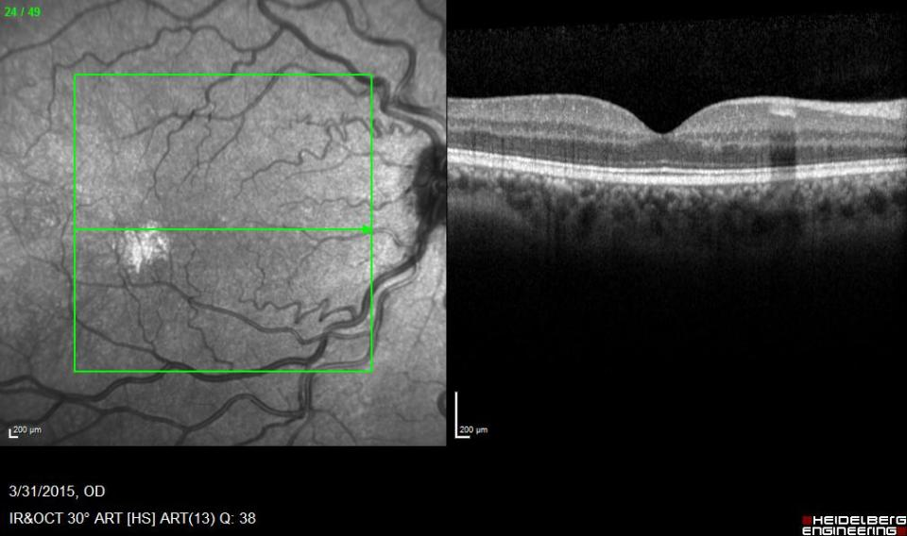

Slide 41
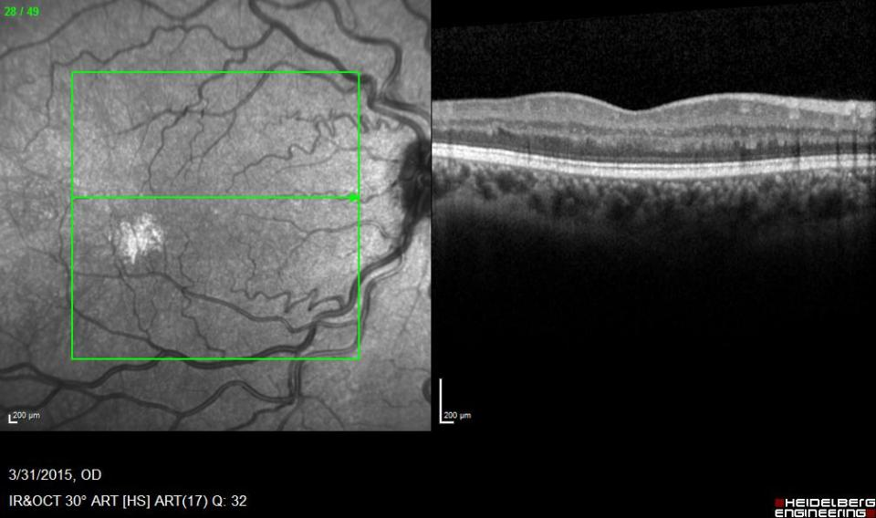

Slide 42
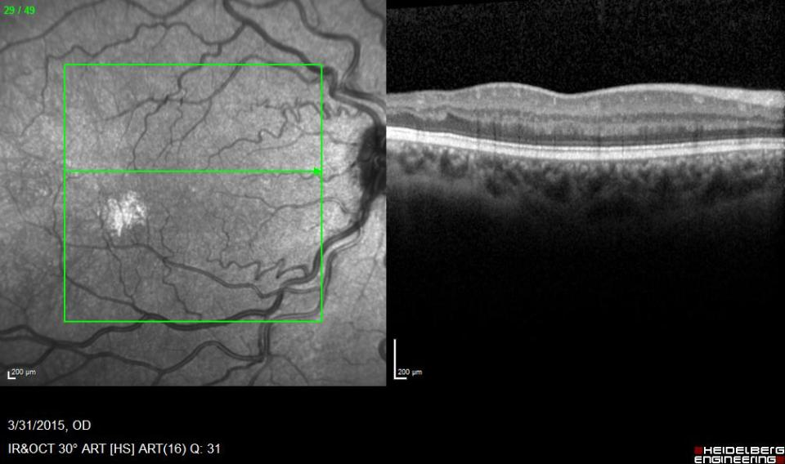

Slide 43
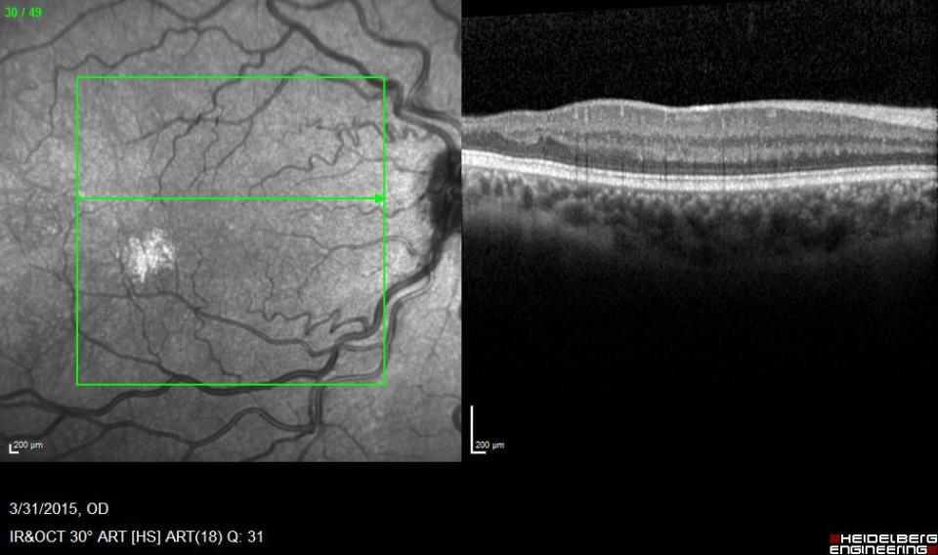

Slide 44
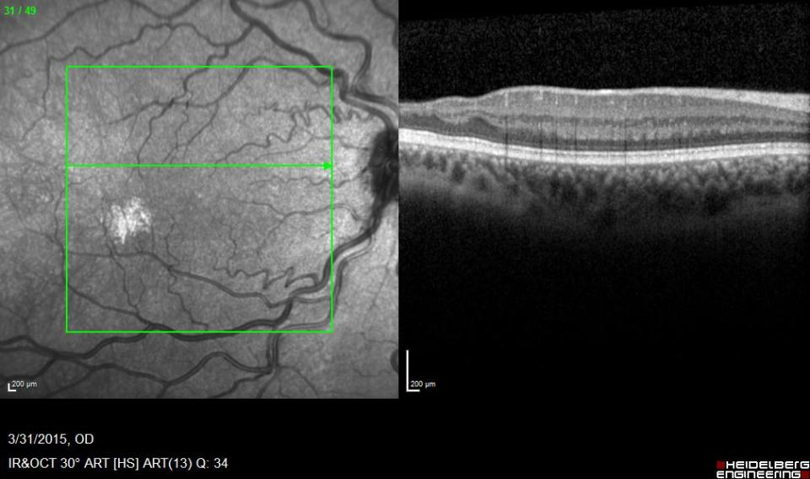

Slide 45
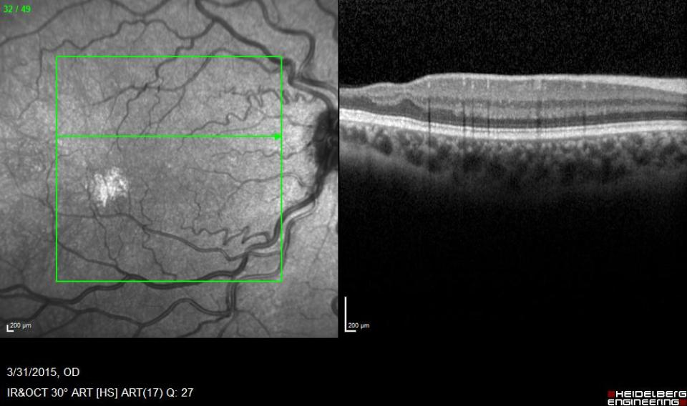

Slide 46
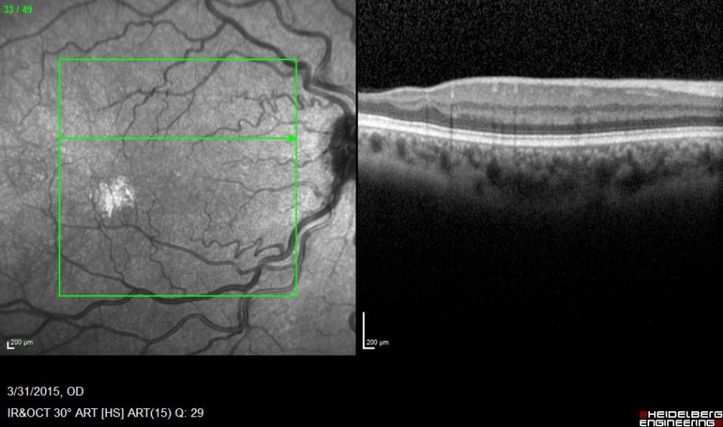

Slide 47
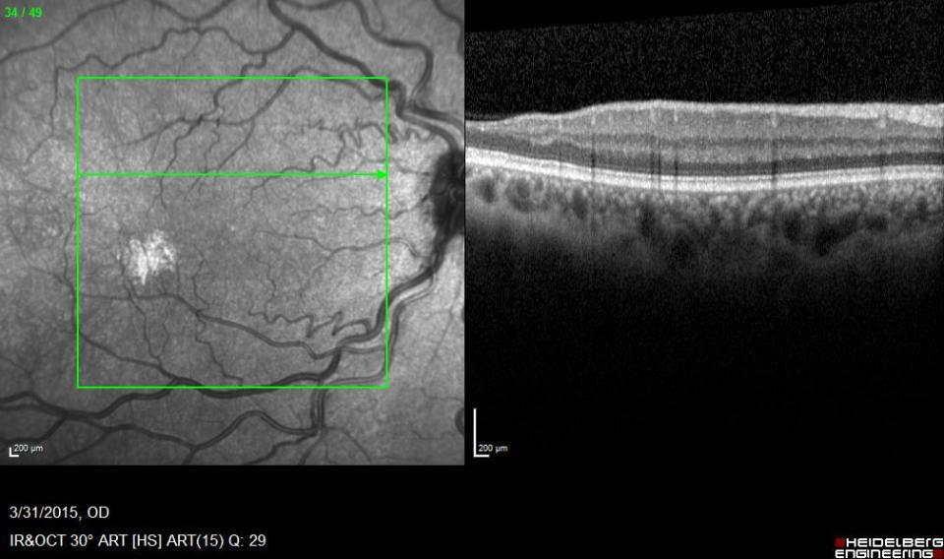

Slide 48
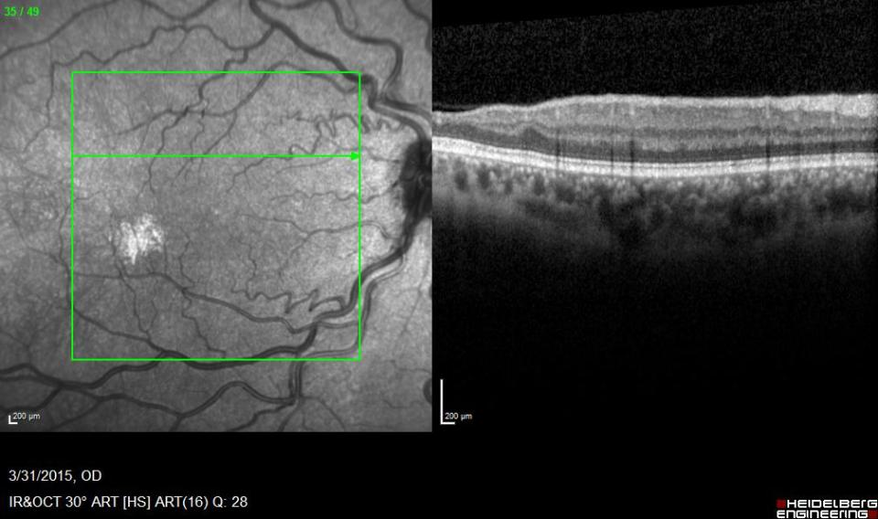

Slide 49
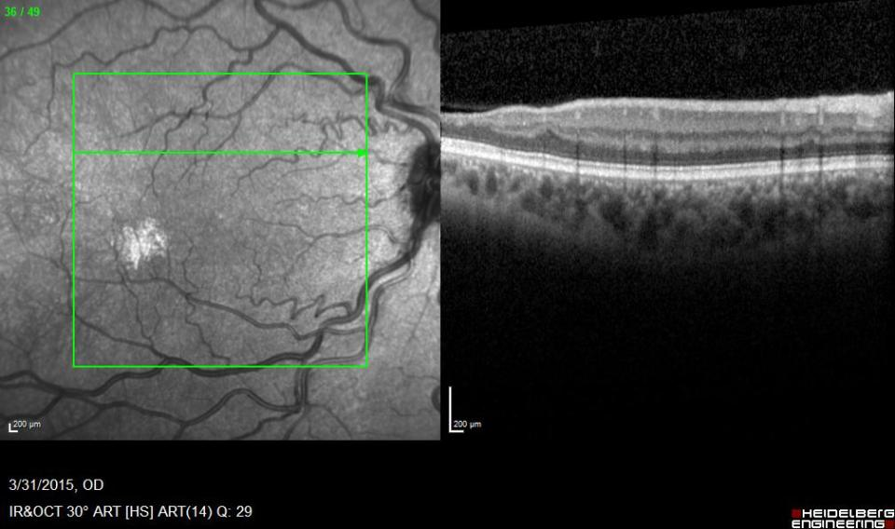

Slide 50
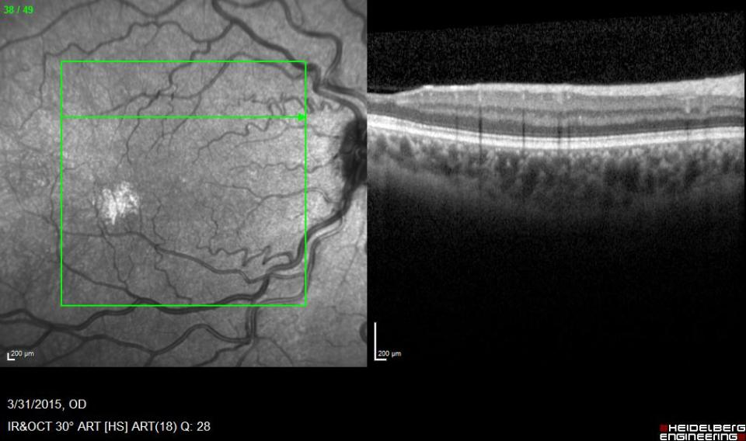

Slide 51
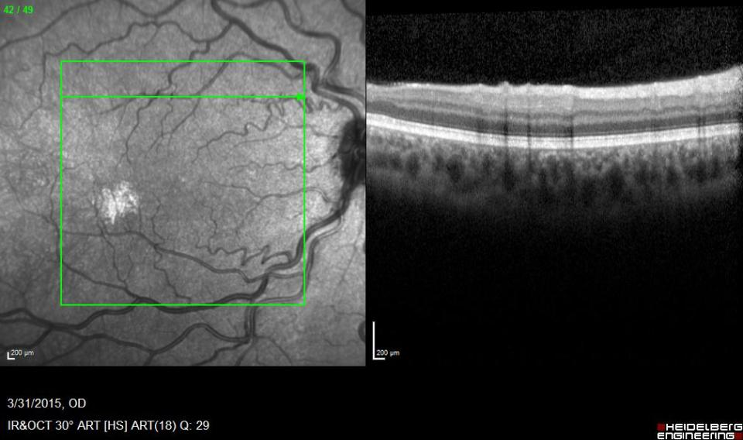

Slide 52
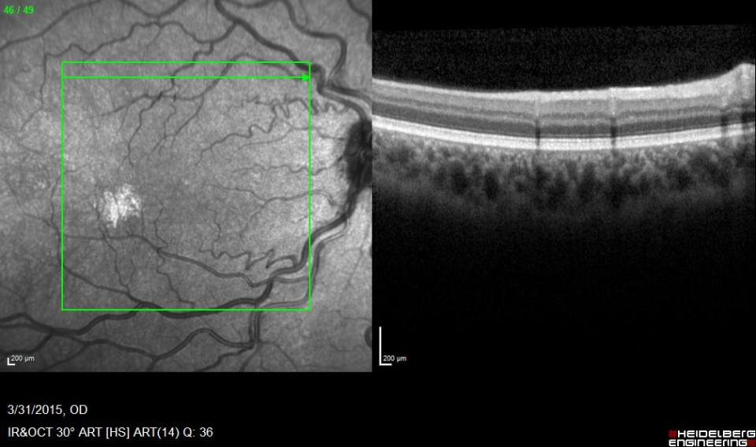

Slide 54
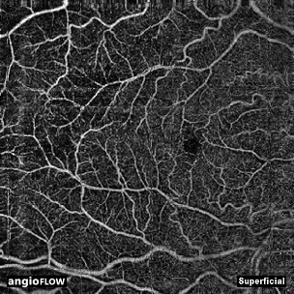

Slide 55
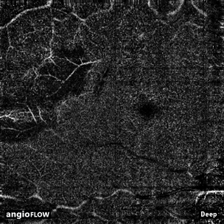

Slide 56
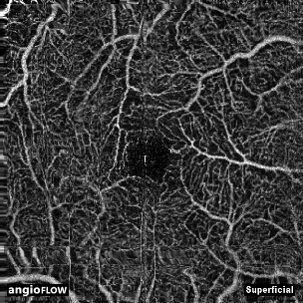

Slide 57
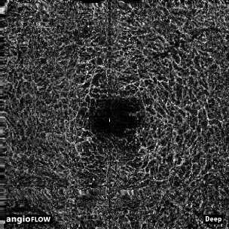

Slide 58
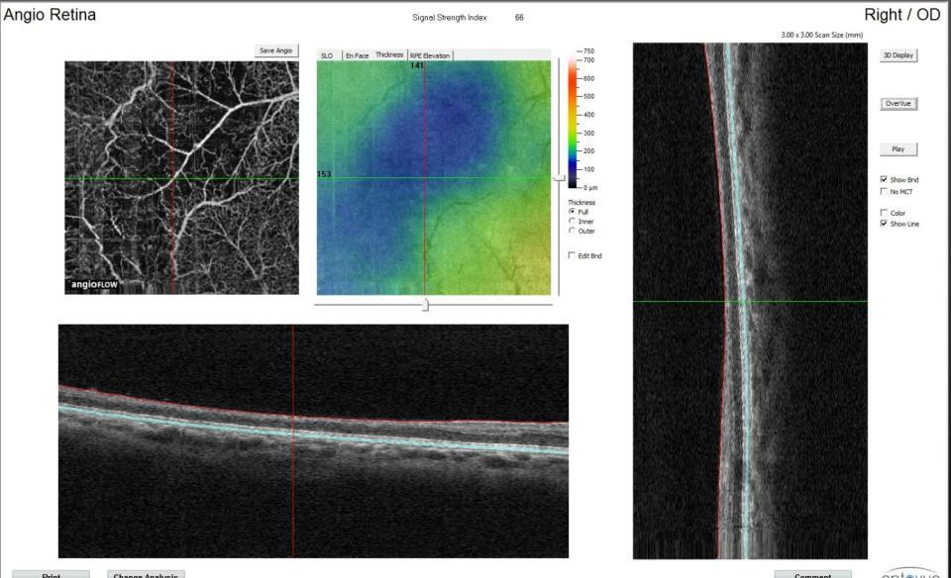

Slide 62
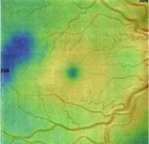
A
B
C
D
E
F
G
H

Slide 63
Observations
Loss of deep > superficial plexus vessels
Correlates to area of retinal thinning
Not well visualized on fluorescein angiogram
Patient is asymptomatic

Slide 64
Notes:
Largest case series to date
44% of eyes with thinning

Slide 68
Cause of macular thinning?
Areas of thinning likely represent ischemia
Vascular abnormalities not always readily apparent
Recent association with primary acute middle maculopathy
Suspicion for deep capillary plexus as area of ischemia

Slide 69
OCT Angiography
Advantages over FA
Avoids hassle (e.g. starting IV) and risks (nausea, hives, anaphylaxis) of fluorescein dye
Greater resolution of retinal vasculature
Faster image acquisition overall (few seconds per scan vs. 5-15 minutes for FA)
Ability to digitally segment vasculature of retinal layers
Visualizes radial peripapillary capillary network and deep retinal plexus better

Slide 70
OCT Angiography
Disadvantages versus FA
Subject to artifact, especially motion artifact
Possibly more susceptible to media opacity
Scans take several seconds (vs. fraction of a second for an individual frame of FA)
Does not include information regarding flow (e.g. does not evaluate filling times)
Does not evaluate leakage
Several current limitations to OCT-A, including compromise between noise vs. resolution, detail vs. scan area

Slide 71
Case 2
29F
Hb SS
20/20 OU
No retinopathy
A
B
C
D
E

Slide 72
A
OD
OS
Case 3
24M
Hb SS
20/20 OU
Stage III OU
B
C
D

Slide 73
Take Home Points
Macular vascular abnormalities occur relatively frequently in sickle cell disease patients
Macular thinning is common (44%) on SD-OCT of sickle cell patients
Clinical exam or FA may not visualize vascular abnormalities in areas of thinning
OCT-A shows dropout of the deep retinal plexus corresponding to areas of macular thinning
OCT-A visualizes the deep retinal plexus better than FA and may provide a more sensitive method of identifying macular vascular abnormalities in sickle cell patients
Further study is needed to determine the clinical significance of these findings and their relationship to sickle cell genotype, degree of systemic disease, severity of retinopathy

Slide 74
Prevalence of Retinopathy in Patients with Sickle Cell Disease Study
Who will get sickle cell retinopathy? What systemic findings are associated with sickle cell retinopathy?
Study: Single center, retrospective, chart review of patients with known sickle cell disease diagnosis seen at the Johns Hopkins Sickle Cell Center for Adults (SCCA) from 2003 to 2015

Slide 75
Retrospective study in African-descent population in Paris, France
Severity of retinopathy associated with SC genotype, low fetal hemoglobin, high hemoglobin, pulmonary and otic involvement
Similar studies in Miami, FL; Kingston, Jamaica; Bamako, Mali

Slide 76
Methods
Single center, retrospective, chart review
Patients with known sickle cell disease diagnosis seen at the Johns Hopkins Sickle Cell Center for Adults (SCCA)
Patient list generated from SCCA REDCap database
Of those, patients with baseline hematology visit between 1/1/2003 and 12/31/2015 (n = 1810)
Of those, patients with a retina visit prior to 12/31/2015 (n = 296)
Retina visit must be within one year of a hematology visit

Slide 77
Methods
Patient demographic information
Findings from most recent retina specialist visit: visual acuity, visual symptoms, exam description
Medical history relevant to sickle cell retinopathy as suggested by literature:
Lab results: genotype, Hemoglobin, Fetal hemoglobin
History of systemic sickle cell disease symptoms and complications
Treatments: Hydroxyurea, transfusion, anticoagulants

Slide 78
Patient Population Characteristics
Number of patients | 296
Age (years), mean (SD) | 34.1 (12.2)
Female sex, no (%) | 161 (54.4%)
Sickle genotype, no (%)
SS | 202 (68.2)
SC | 66 (22.3)
B-thal | 19 (6.4)
Other | 9 (3.0)

Slide 79
Disease Prevalence by Genotype
 | Total | ND | NSR | PSR
 | No. (%) | No. (%) | No. (%) | No. (%)
Cohort | 296 (100) | 77 (26.0) | 131 (44.3) | 88 (29.7)
SS | 202 (68.2) | 56 (27.7) | 100 (49.5) | 46 (22.8)
SC | 67 (22.6) | 13 (19.4) | 18 (26.9) | 36 (53.7)
S Beta 0 Thalassemia | 5 (1.7 | 3 (60.0) | 1 (20.0) | 1 (20.0)
S Beta + Thalassemia | 14 (4.7) | 3 (21.4) | 7 (50.0) | 4 (28.6)
SS with HPFH | 4 (1.4) | 2 (50.0) | 2 (50.0) | 0
S Leopore | 1 (0.3) | 0 | 0 | 1 (100)
SS with Alpha Thalassemia | 1 (0.3) | 0 | 1 (100) | 0
Unknown | 2 (0.7) | 0 | 2 (100) | 0

Slide 80
Univariate Analysis
 | Cohort (n = 296) |  |  |  | SS (n = 202) |  |  |  | SC (n = 67)
 | ND (n = 77) | NSR (n = 131) | PSR (n = 88) |  | ND (n = 56) | NSR (n = 100) | PSR (n = 46) |  | ND (n = 13) | NSR (n = 18) | PSR (n = 36)
Characteristic | No. (%) | No. (%) | No. (%) | p | No. (%) | No. (%) | No. (%) | p | No. (%) | No. (%) | No. (%) | p
Age, mean [SD] | 29.1 [9.0] | 32.5 [11.3] | 40.8 [13.3] | <0.001 | 27.3 [7.6] | 31.9 [11.1] | 38.8 [12.2] | <0.001 | 34.4 [9.9] | 36.3 [14.5] | 42.9 [14.3] | 0.092
Visually Symptomatic | 18 (23.4) | 38 (30.6) | 48 (57.1) | <0.001 | 12 (21.4) | 25 (26.6) | 19 (43.2) | 0.047 | 3 (23.1) | 7 (41) | 25 (73.5) | 0.003
Floaters | 11 (14.5) | 28 (21.4) | 3 (35.6) | 0.005 | 7 (12.7) | 18 (18.0) | 12 (26.7) | 0.2 | 3 (23.1) | 6 (33.3) | 15 (41.7) | 0.47
Baseline Hemoglobin, median [IQR] | 9.1 [7.6, 10.4] | 9.4 [7.9, 10.8] | 10.1 [8.5, 11.1] | 0.044 | 8.4 [7.0, 9.5] | 8.7 [7.6, 9.7] | 8.7 [7.3, 10.0] | 0.5 | 12 [10.4,12.8] | 11.3 [10.7, 12.0] | 10.9 [10.3, 12.1] | 0.82
Fetal Hemoglobin, median [IQR] | 6.2 [1.5, 14.5] | 5.1 [1.5, 10.2] | 2.3 [1.4, 7.0] | 0.014 | 7.6 [2.8, 15.7] | 5.7 [1.6, 11.1] | 5.1 [1.9, 10.4] | 0.3 | 1.4 [1.2, 3.3] | 1.4 [0.0, 1.6] | 1.4 [1.1, 1.8] | 0.74
Anticoagulation | 5 (6.5) | 19 (14.5) | 18 (20.5) | 0.032 | 4 (7.1) | 13 (13.0) | 12 (26.1) | 0.025 | 1 (7.7) | 4 (22.2) | 5 (13.9) | 0.59
Notes:
These are the factors that had significant correlations for whole-cohort and for SS and SC. It makes sense that retinopathy increases as patients get older, and that Visual symptoms increase as retinopathy increases. We also see association with higher anticoagulant use, higher hgb, and lower hbf which suggests that hematological management makes a difference, but it’s also interesting that we don’t see significant results for hydroxyurea or chronic transfusion. Why is this happening?
Didn’t find associations for other systemic findings typically associated with sickle cell disease, which we are surprised by. Maybe our sample size is too small.
One-way ANOVA for age. Kruskall-Wallis test for Hgb and Hbf. Chi-square or Fisher’s exact tests for others. P values are among all three disease gro

Slide 81
Results: Univariate Analysis (cont.)
Significant associations with age, visual symptoms in all three groups
Significant associations with floaters, baseline hemoglobin, fetal hemoglobin, anticoagulant use in whole cohort
Borderline significant association with male sex in whole cohort and SS patients

Slide 82
Limitations
Limited number of patients
Number of eligible SC patients especially small in our patient population
Small number of eligible patients
1810 total patients in database, 296 (16.4%) fulfilled study criteria
Limited number of sickle patients with eligible retina exam in history

Slide 83
Conclusions
Older age associated with retinopathy across all analyses, consistent with similar reports in literature (5)
Male sex associated with retinopathy in SS disease, consistent with consensus in literature (2,4,5,7)
Visual symptoms and floaters associated with retinopathy
Patient-reported visually symptomatic status correlates with disease severity
Notes:
These are the results that we expected: older patients have worse retinopathy, males have worse retinopathy. Nobody else has said anything about correlation between visual sx and floaters and retinopathy, but that seems obvious. Is this significant enough to report?

Slide 84
Sickle Cell Disease and the Eye
Most patients have good vision
Can present with acute severe vision loss
Unclear systemic factors that correlate or predict vision loss
Refer patients for retinal exam, annual screening age 10
Multi-disciplinary approach

Slide 85
Acknowledgements
Ian C. Han, M.D.
Marguerite O. Linz
Johnny Duan

