Slide 1
The Burden of Venous Thromboembolism in Patients with Sickle Cell Disease
Ted Wun, M.D., Ann Brunson, M.S., Theresa Keegan, Ph.D., Richard White, M.D.
Center for Oncology Hematology Outcomes Research and Training (COHORT)
Division of Hematology Oncology, UC Davis School of Medicine
UC Davis Clinical and Translational Science Center

Slide 2
Disclosures of Potential Conflicts of Interest
Role | Sponsor
Steering Committee | Janssen, Pfizer
Research Support | Janssen, Pfizer NHLBI, NCATS
Employer | University of California
Off-label Use | None
Professional | American Society of Hematology (ASH) SCD Guideline Panel ASH SCD Registry Advisory Committee

Slide 3
Objectives
Summarize evidence for hemostatic system activation in sickle cell disease (SCD)
Review the literature demonstrating the increased incidence of venous thromboembolism (VTE) in patient with SCD
Describe data from California on incidence, risk factors, recurrence, and effect on mortality of VTE in SCD

Slide 4
Sickle Cell Disease is a Hypercoagulable State
A condition characterized by acceleration of coagulation reactions in vivo
A condition known to be associated with an increased risk of thrombosis

Slide 5
Hemostatic Biomarkers in SCD
Increased Levels
Platelet activation
Decreased Levels
Factor V
Platelet Aggregation
Phosphatidylserine-rich platelets and RBC
Thrombin-antithrombin complexes
Prothrombin fragment F 1.2
Plasmin-antiplasmin complexes
Fibrinogen and fibrin-fibrinogen complex
Fibrinopeptide A
D-dimer
Plasminogen activator inhibitor (PAI)
Factor IX
Protein C
Protein S
Factor XII
Prekallikrein
Kininogen
High molecular weight kininogen

Slide 6
VTE in Patients with SCD
Author | Study Design | Main findings
Stein et al. (2006) | Retrospective analysis of National Discharge Survey of ≈ 50M admissions | For patients < 40 years, 0.44% of SCD discharged with PE vs. 0.12% AA without SCD; DVT similar (0.44% vs. 0.40%)
Novelli et al. (2012) | Retrospective discharge data from Pennsylvania | Incidence of inpatient PE greater in SCD patients; PE prevalence similar between SCD and non-SCD AA; PE patients older, > LOS, sicker, and higher mortality

Slide 7
VTE in Patients with SCD
Author | Study Design | Main findings
Naik et al. (2013) | Cross-sectional study 404 patients at Johns Hopkins | Prevalence 25%; 18.8% not catheter-related; median age 29.9 years at VTE; increased TRJ increased risk; 25% recurrence; RR 3.63; 95% CI, 1.66-7.92 for death
Naik et al. (2014) | Retrospective analysis of 1523 patients > 15 years of age from the CSSCD | Cumulative incidence 11.3% at 40 years; PE > DVT (NS different); VTE associated with HR 2.32 [95% CI 1.20-4.46] for death

Slide 8
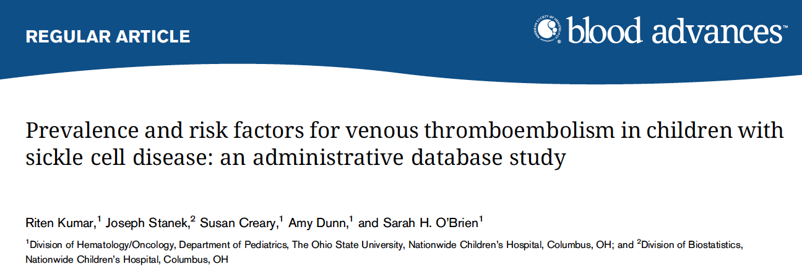

Slide 9
Risk factor for VTE in Children with SCD
History of stroke
Older age
Female sex
Central venous line
Chronic renal disease
ICU admission
Longer LOS

Slide 10
VTE in Pregnant Patients with SCD
Author, year | Data source | N (SCD vs. controls) | Controls | Rate of VTE | SCD OR (95% CI)
James, 2006 | AHRQ data (USA) | ? vs. 9M | All pregnancies | 1.72/1000 deliveries | 6.7 (4.4-10.1)
Villers, 2008 | AHRQ data (USA) | 17,952 vs. 16.76 M | Non SCD pregnancies |  | 2.5 [1.5-4.1]
Boulet, 2013 | Medicaid database | 1,526 vs. 333,348 | Race- matched pregnancies | 3.1% vs. 0.4% | 10.27 [6.33-16.67]
Porter, 2014 | Single Center Registry (USA) | 103 vs. 22,140 | Race- matched pregnancies | 2.9% of deliveries | 32.2 (9.7-107)
Seaman, 2014 | Pennsylvania hospital discharges | 212 | All pregnancies | 2.8% of deliveries | 1.5-5.0 fold greater
Costa, 2014 | Single Center (Brazil) | 60 vs. 192 | All pregnancies | 4/60 (6.7%) vs. 0/192 | -
Oteng-Ntim, 2014 | UK Obstetric Surveillance System | 109 |  | 6/109 (5.5%)
Thanks to Nigel Key, UNC

Slide 11
The California Sickle Cell Disease Cohort

Slide 12
Baseline Characteristics of California Sickle Cell Disease Patients, 1991-2013
Variables | All |  | Thrombosis Event |  | No Thrombosis Event |  | P-Value
 | N | % | N | % | N | %
All | 6,237 | 100.0% | 696 | 11.2% | 5,541 | 88.8%
Gender
Male | 2,948 | 47.3% | 282 | 40.5% | 2,666 | 48.1% | 0.0002
Female | 3,283 | 52.6% | 414 | 59.5% | 2,869 | 51.8% | 0.0001
Race/Ethnicity
Non-Hispanic White | 176 | 2.8% | 13 | 1.9% | 163 | 2.9% | 0.1068
Hispanic | 252 | 4.0% | 17 | 2.4% | 235 | 4.2% | 0.0231
African-American | 5,615 | 90.0% | 648 | 93.1% | 4,967 | 89.6% | 0.0041
Asian/Pacific Islander | 34 | 0.5% | 4 | 0.6% | 30 | 0.5% | 0.9105
Other/Unknown | 160 | 2.6% | 14 | 2.0% | 146 | 2.6% | 0.3268
SCD Severity
Less Severe | 3,583 | 57.4% | 225 | 32.3% | 3,358 | 60.6% | <.0001
Severe | 2,654 | 42.6% | 471 | 67.7% | 2,183 | 39.4% | <.0001
Brunson et al., BJH

Slide 13
Venous Thrombosis Amongst California Sickle Cell Disease Patients, 1991-2013
Variables | N | %
PE (± DVT) | 359 | 51.6%
Proximal LE DVT | 132 | 19.0%
Distal LE DVT | 28 | 4.0%
LE DVT NOS | 19 | 2.7%
Upper Extremity | 158 | 22.7%
Present on Admission
Yes | 522 | 75.0%
No | 77 | 11.1%
Unknown | 97 | 13.9%
Recurrent Thrombosis
Yes | 232 | 33.3%
Brunson et al., BJH

Slide 14
VTE in SCD
Sixty percent of VTE occurred ≤ 90 days of discharge from an inpatient admissions
Of the 158 with UE DVT, 65 (41%) had a code for central venous catheter placement prior to the DVT
Of the 414 women, 18 (4.4%) were either pregnant or within 6 weeks of delivery
Brunson et al., BJH

Slide 15
Cumulative incidence of first acute venous thromboembolism (VTE) among African-American sickle cell disease (SCD) patients compared to matched hospitalized African-American asthma patients, by SCD severity/average hospitalizations, California, 1991-2013
SCD patients with severe disease ( ); Asthma patients averaging ≥3 hospitalizations per year
( ); SCD patients with less severe disease ( ); Asthma patients averaging <3 hospitalizations per year ( ). African-American SCD patients matched 1:3 on sex, age (+/- 2 years), and year (+/- 2 years) and hospital frequency to African-American asthma patients.
Brunson et al., BJH

Slide 16
Multivariable* Cox Proportional Hazard Model for Incident Acute Venous Thromboembolism (VTE) among California Sickle Cell Disease (SCD) patients, 1991-2013
Variables | HR | 95% CI | P-Value
Gender
Male | REF
Female | 1.22 | (1.05, 1.43) | 0.0112
Race/Ethnicity
African-American | REF
Non-African American | 0.83 | (0.61, 1.12) | 0.2266
SCD Severity
Less Severe | REF
More Severe | 2.86 | (2.42, 3.37) | <.0001
* Adjusted for all variables in the table and stratified by birth cohort.
VTE includes upper extremity thrombosis
Brunson et al., BJH

Slide 17
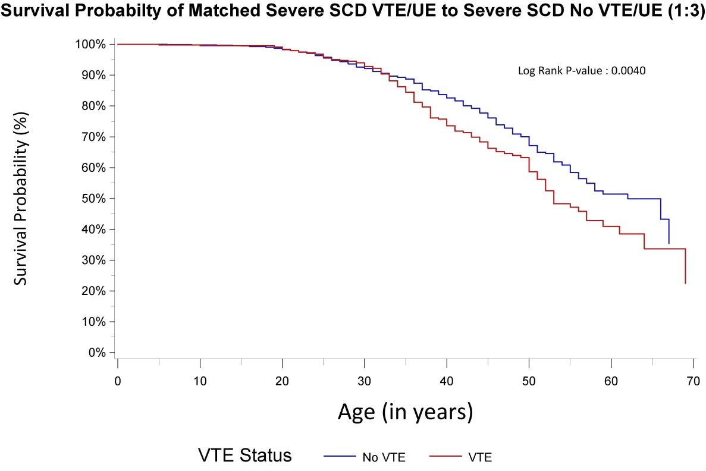
Adverse effect of VTE on Survival
Brunson et al., BJH

Slide 18
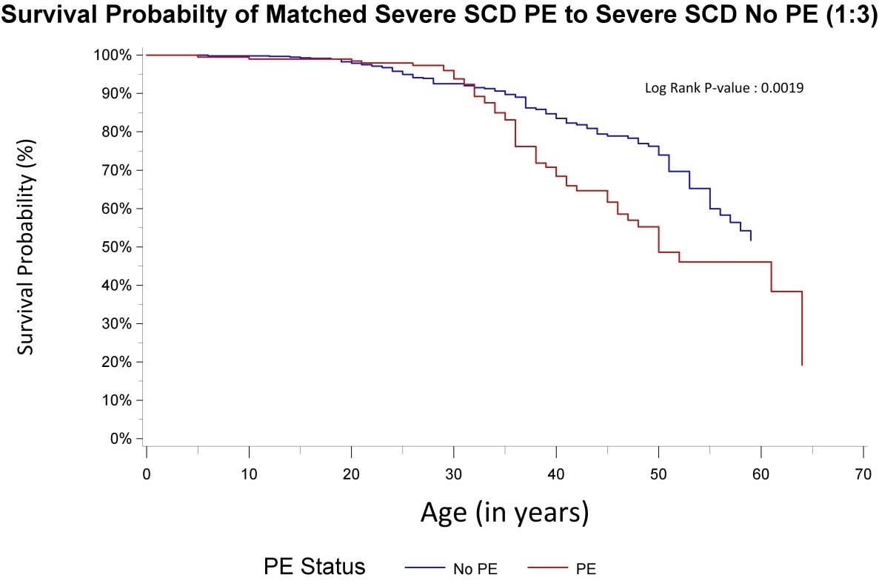
Adverse effect of PE on survival
Brunson et al., BJH

Slide 19
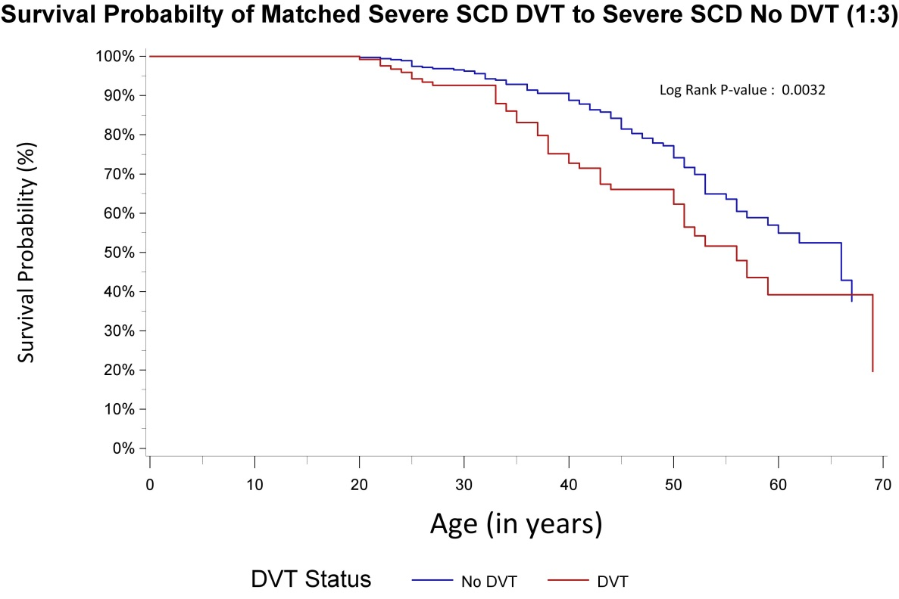
Adverse effect of DVT on Survival
Brunson et al., BJH

Slide 20
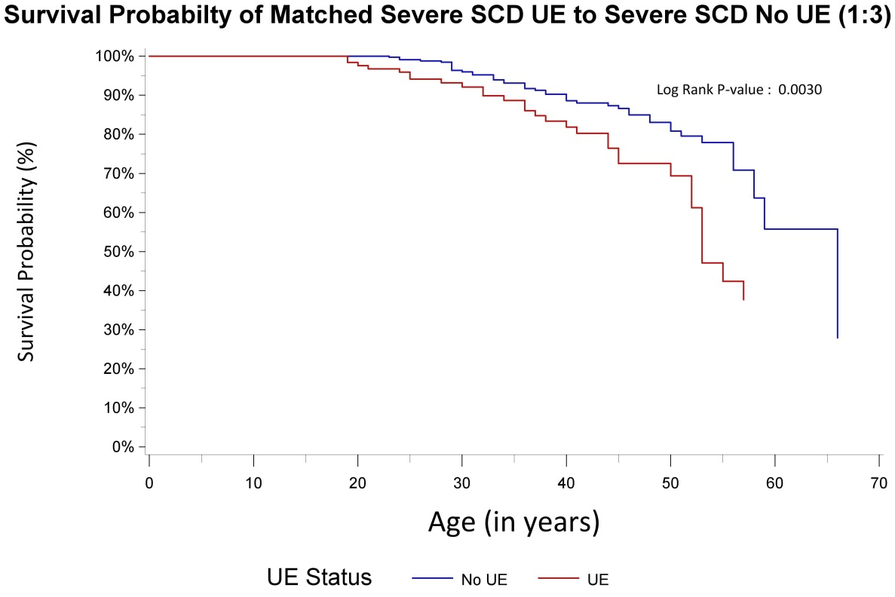
Adverse effect of UE DVT on Survival
Brunson et al., BJH

Slide 21
Multivariable* Cox Proportional Hazard Models for Survival among California Sickle Cell Disease (SCD) patients, 1991-2013
Variables | HR | 95% CI | P-Value
Gender
Male | REF
Female | 0.78 | (0.69, 0.89) | 0.0002
Race/Ethnicity
African-American | REF
Non-African American | 0.98 | (0.75, 1.27) | 0.8693
SCD Severity
Less Severe | REF
Severe | 1.83 | (1.61, 2.09) | <.0001
Thrombosis Event^
No VTE | REF
PE | 2.75 | (2.10, 3.61) | <.0001
DVT | 3.3 | (2.48, 4.40) | <.0001
UE | 2.54 | (1.71, 3.77) | <.0001
Recurrent Thrombosis Event^
No Recurrent Event | REF
Recurrent VTE or UE* | 0.97 | (0.69, 1.38) | 0.886
* Adjusted for all variables in the table and stratified by birth cohort.
^ Incident thrombosis and recurrent thrombosis events were included as a time dependent covariates
PE - pulmonary embolism; DVT - deep vein thrombosis; UE - upper extremity thrombosis
Brunson et al., BJH

Slide 22
Venous Thromboembolism Recurrence

Slide 23
Recurrence Differs by Severity and Index Event
Overall 3.9% at 12 months
Overall 17.9% at 12 months

Slide 24
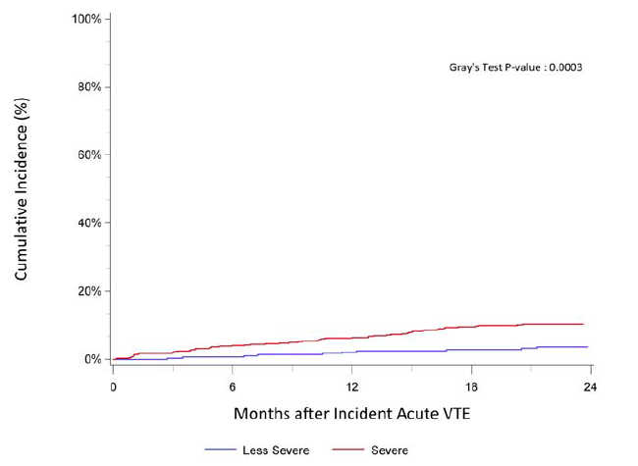
Cumulative Incidence of Major Bleeding
Increased risk associated with severe disease
Severe 7.4% at 12 mo
Non-severe 2.1% at 12 mo
Wun et al., Submitted

Slide 25
Wun et al., Submitted

Slide 26
Wun et al., Submitted

Slide 27
Conclusions
Venous thromboembolism is common in adult patients with SCD
There is a high incidence on VTE recurrence in patients with SCD
There also appears to be increased risk of major bleeding in SCD patients with incident VTE
This information should inform primary and secondary prophylaxis for VTE in patients with SCD

Slide 28
UC Davis COHORT
Center for Oncology Hematology Outcomes Research and Training
Division of Hematology Oncology
UC Davis School of Medicine

Slide 29
UC Davis Adult Sickle Cell Team

