Slide 1
Optimizing Sickle Cell Care September 5, 2019 Edward Donnell Ivy, MD, MPH Medical Officer, Division of Services for Children with Special Health Needs (DSCSHN) Maternal and Child Health Bureau (MCHB) Health Resources and Services Administration (HRSA)

Slide 2
Disclosures
I do not have any financial disclosures or financial relationships with any commercial interest in relation to this presentation.

Slide 3
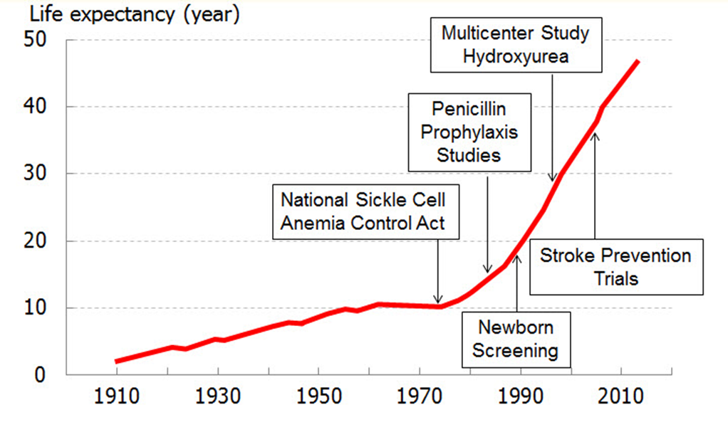
Improving Access to Care
To ensure all patients with SCD receive better treatments and even a cure, the following is needed:
Health systems should be developed to improve access to evidence-based care
The systems should not only focus on treatments, but how patients access the treatments, which providers are accessible to the patient population and how healthcare is paid for by the patient population

Slide 4
MCHB Hemoglobinopathies Program
HRSA Mission: To improve health outcomes and address health disparities through access to quality services, a skilled health workforce, and innovative, high-value programs.
The Hemoglobinopathy Programs consist of programs designed to support individuals with hemoglobinopathies and ensure that they have access to comprehensive evidence-based care in a Medical Home that promotes prevention and chronic disease management.

Slide 5
Six core performance measures for Children and Youth with Special Health Needs
Family/professional partnership in decision-making
2. Coordinated, comprehensive care through a medical home
3. Adequate health insurance and financing for needed services
4. Early and continuous screening for special health care needs
5. Community-based services that are organized for easy use by families
6. Effective transition to adult health care, work and independence

Slide 6
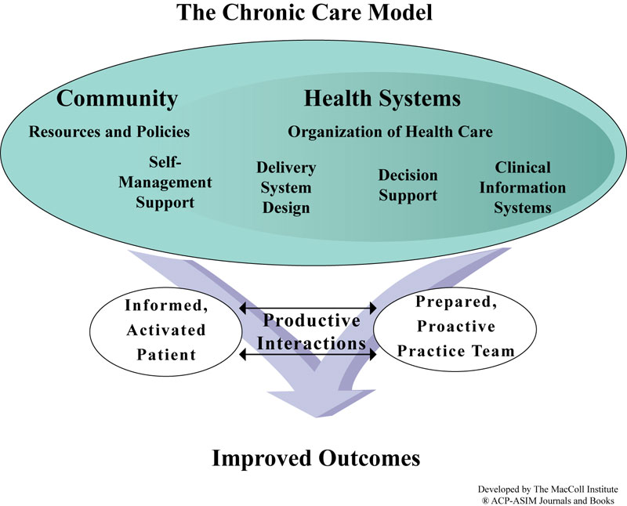
SCDNBSP
SCDTDP

Slide 7
SCDTDP – Brief Overview
Purpose: Improve health outcomes in sickle cell disease, reduce sickness and death from sickle cell disease, reduce individuals with sickle cell receiving care only in emergency departments, and improve coordinated and comprehensive services to individuals with sickle cell and their families.
Project Period: 9/1/2017 – 8/31/2021
Five Regional Awardees:
Northeast JOHNS HOPKINS UNIVERSITY
Southeast CHARLOTTE-MECKLENBURG HOSPITAL AUTHORITY
Midwest CINCINNATI CHILDREN'S HOSPITAL MEDICAL CENTER
Heartland WASHINGTON UNIVERSITY (ST. LOUIS)
Pacific CENTER FOR COMPREHENSIVE CARE AND DIAGNOSIS OF INHERITED BLOOD DISORDERS
Progress to Date:
43 states involved with regions
Five regions have implementing at least one Project ECHO program
8 Project ECHO programs total
4 Project ECHOs in the Northeast.

Slide 8
Project ECHO® Clinics
Who should participate in the Johns Hopkins Sickle Cell Disease ECHO®?
Primary Care Providers, Hematologists, Emergency Department Providers, Nurses, Social Workers, Hospitalists, and Advanced Practice Providers who would like to learn more or become experts in Sickle Cell Disease care.
What is a typical Johns Hopkins Sickle Cell Disease ECHO® Clinic like?
Participants connect to this highly interactive telementoring video conference by phone, tablet, pc, phone or in person. During each clinic we discuss two cases presented by participants. In between the case discussions, there is a brief didactic presentation on an aspect of sickle cell care. These topics might include Acute Chest Syndrome, Neurological complications, ED Management, Pain Management, among many more.
The ECHO® Clinic is hosted virtually
Every Wednesday
1:00pm-2:15pm
How can I find out more information or register to attend on the Johns Hopkins Sickle Cell Disease ECHO®?
Contact Bailey House at bailey.house@jhmi.edu or 443-287-0608

Slide 9
Sickle Cell Disease Newborn Screening and Follow-up Program
Purpose: To ensure that individuals diagnosed with SCD through newborn screening receive appropriate follow-up services including counseling, education, access to a medical home, and other support services.
Technical assistance center that supports CBOs to improve the care of individuals with SCD/SCT identified through newborn screening.
Project Period: 6/1/2017 – 5/31/2021
Awardee: Sickle Cell Disease Association of America
HRSA Staff: Mia Morrison (PO), Donnell Ivy (MO)
Requirements
Provide direct support and financial assistance to a minimum of 15 CBOs in 15 states
Train 150 Community Health Workers
Increase partnerships:
Informal and formal, CBOs, hospitals, health systems, state public health departments, PCPs, FQHCs
Serve 15,000 individuals with sickle cell disease

Slide 10
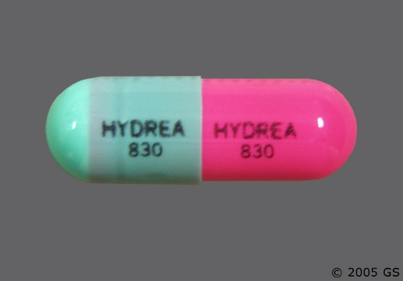
Hydroxyurea and Endari
Hydroxyurea
From 1998 – 2018, HU was the only FDA approved therapy for SCD
Hydroxyurea increases fetal hemoglobin
Hydroxyurea reduces sickle cell crisis, major medical complications, emergency room visits and hospitalizations
Endari
FDA approved Endari for sickle cell in 2018
Endari is an amino acid (L-glutamine)
Endari helps cells to stay flexible (reduces stress on cells)

Slide 11
Bone marrow transplant in Sickle Cell Disease
Offers “cure” to individuals with sickle cell disease
Matched, related donors
New trials into matched, unrelated donors
Requires high doses of chemotherapy
Reduced use of chemotherapy (nonmyeloablative) therapy in older individuals with sickle cell disease (Results in recipient having mix of donor cells and recipient cells (mixed chimarism)
Graph vs host disease is a significant risk with bone marrow transplant

Slide 12
What does Optimal Care Look like? Clinical View
According to the NHLBI Guidelines
includes Hydroxyurea in all individuals with Hgb SS or SBeta0
includes daily penicillin twice a day for all children less than 5 years
includes screening for stoke risk in children using TCD
includes chronic transfusion therapy for children at risk of
includes screening for renal function and pulmonary function
Would include access to the latest and best therapies available as they come onto the market
To ensure access to care for all individuals we must work on health care systems
Source: https://www.nhlbi.nih.gov/sites/default/files/media/docs/sickle-cell-disease-report%20020816_0.pdf

Slide 13
What does Optimal Care Look like? Health System View
Sickle Cell Care in a Medical Home:
▪Accessible: Care is easy for the child and family to obtain, including geographic access and insurance accommodation.
▪Family-centered: The family is recognized and acknowledged as the primary caregiver and support for the child, ensuring that all medical decisions are made in true partnership with the family.
▪Continuous: The same clinician team cares for the child from infancy through young adulthood, providing assistance and support to transition to adult care.
▪Comprehensive: Preventive, primary, and specialty care are provided to the child and family.
▪Coordinated: A care plan is created in partnership with the family and communicated with all health care clinicians and necessary community agencies and organizations.
▪Compassionate: Genuine concern for the well-being of a child and family are emphasized and addressed.
▪Culturally Effective: The family and child's culture, language, beliefs, and traditions are recognized, valued, and respected
Medical home includes care from a hematologist and a primary care provider

Slide 14
Contact Information
Edward Donnell Ivy, MD, MPH
Medical Officer, Genetic Services Branch
Maternal and Child Health Bureau (MCHB)
Health Resources and Services Administration (HRSA)
Email: eivy@hrsa.gov
Phone: 301-443-9775

