Slide 2
Disclosure Statement
I do not have a relevant financial relationships with any commercial interests in relation to this program/presentation.

Slide 7
WHAT’Z So: In Conversations
- Children are still being born with Sickle Cell Disease. HOW?
People are dating and mating and no idea that they carry the trait
or a gene that can create a form of SCD.
New Born Screening helps and still after the fact
Started in California on 27 FEB 1990
- Adults with Sickle Cell having difficulty transitioning to next level of care.
Our Community experience is Medical field has not implemented
effective training around the care and results of patients with SCT or SCD

Slide 8
WHAT’Z So: Sickle Cell Trait
- people still collapsing from sickle cell trait
- myths about who is affected my Sickle Cell Trait and or Disorder
people having health issues that could be related to the trait
and being overlooked because old dialogue has a clause that
we usually don't have complications
- Sickle Cell Trait numbers have been the same for years.
Colleges requiring Mandatory Screening for all Athletes to be
identified with SCT or SCD
- Some think it could lead to possible discrimination to that student.

Slide 9
Sickle Cell Trait (AS) Prevalence and Global Distribution
Worldwide > 300 million people with SCT
Countries with high prevalence of SCT
Nigeria > 30 million
India > 20 million*
Congo, DR > 16 million
Brazil > 9 million
Tanzania > 6 million
Kenya > 5 million
Ghana > 4 million
Saudi Arabia > 4 million
USA > 3 million
Major impact of SCT on public health, military, or sports, if present, not likely to be missed in these countries

Slide 10
WHAT’Z So: Sickle Cell Trait
Diagnosis:
SCT is diagnosed with a simple blood test.
People at risk of having SCT can talk with a doctor or
health clinic about getting this test.
It is estimated that: is born with Sickle Cell Trait (SCT)
1 in 13 Black or African-American babies (SCT)
1 out of every 100 Hispanic-American babies (SCT)
1 in 625 Caucasians babies (SCT)

Slide 11
WHAT’Z So: Sickle Cell Trait
How Sickle Cell Trait is Inherited.
If both parents have SCT, there is a 50% (or 1 in 2) chance that any child of theirs also will have SCT, if the child inherits the sickle cell gene from one of the parents.
Such children will not turn into SCD, they can pass SCT on to their children and there are know Risk Factors
If both parents have SCT, there is a 25% (or 1 in 4) chance that any child of theirs will have SCD.
There is the same 25% (or 1 in 4) chance that the child will not have SCD or SCT.

Slide 12
¿WHAT’Z in your Genes?
Hemoglobin Types
Sickle Cell Trait
(AS) - Adult (A) and Sickle (S)
Sickle Cell Disease (SS)
Normal
(AA hemoglobin)
RBCs with S live about 20 days (A’s live about 100 days)
Become sticky and inflexible. Clog blood vessels, depriving oxygen to parts of the body.

Slide 13
Sickle Cell Trait Exertion and What to know
Know your Trait Status ie. SCT, Thalassemia and HbC, HbD, HbE……..
Asthma and Cardiac Arrest ie. Breathing, and muscle tightening lack(-)
oxygen
Acute Illness ie. Immune System, Cold and flu leads to dehydration in body
Lack of Sleep ie. Fatigue and dehydration and muscles are weak
Suboptimal Nutrition ie. Proper diet and water intake. Food fuels the body
Medication ie. Side effects, kidney, liver and cks. Elevated state.
Medical Exam to confirm health status in your student athlete. Create a
workout plan with balance various hydrations of water and sports drinks

Slide 14
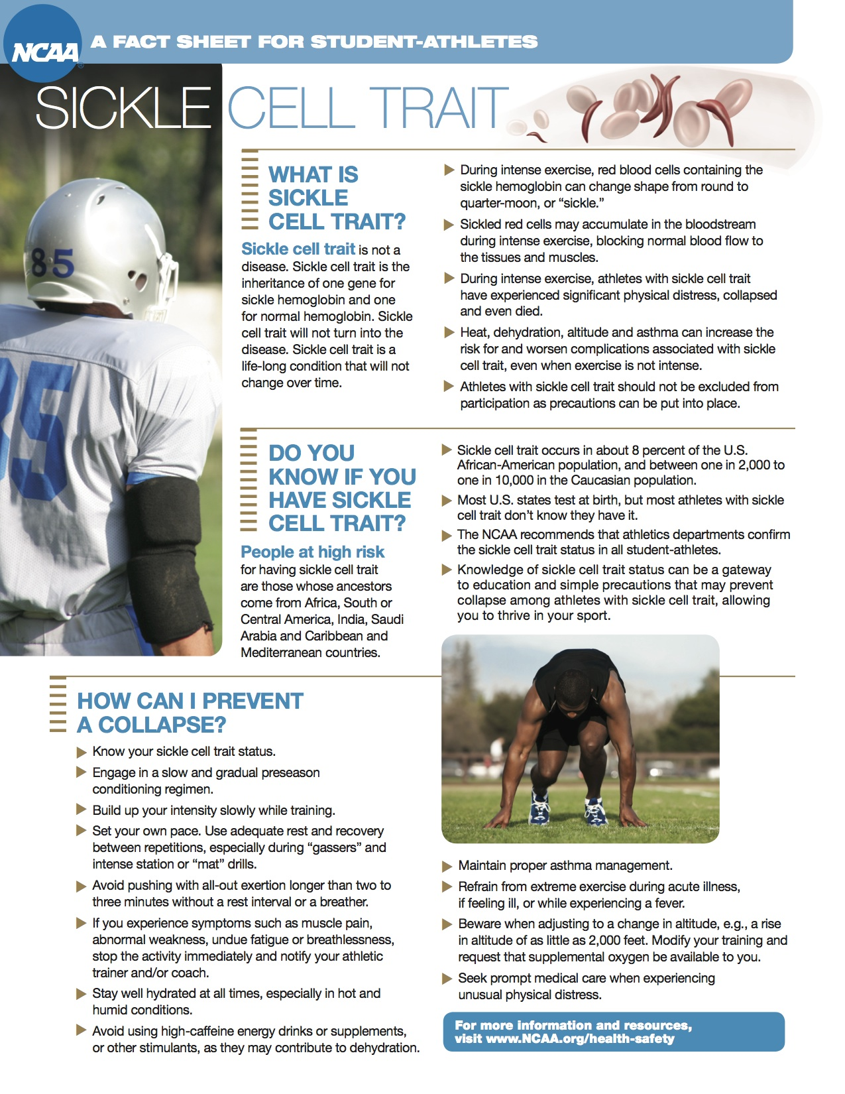

Slide 15
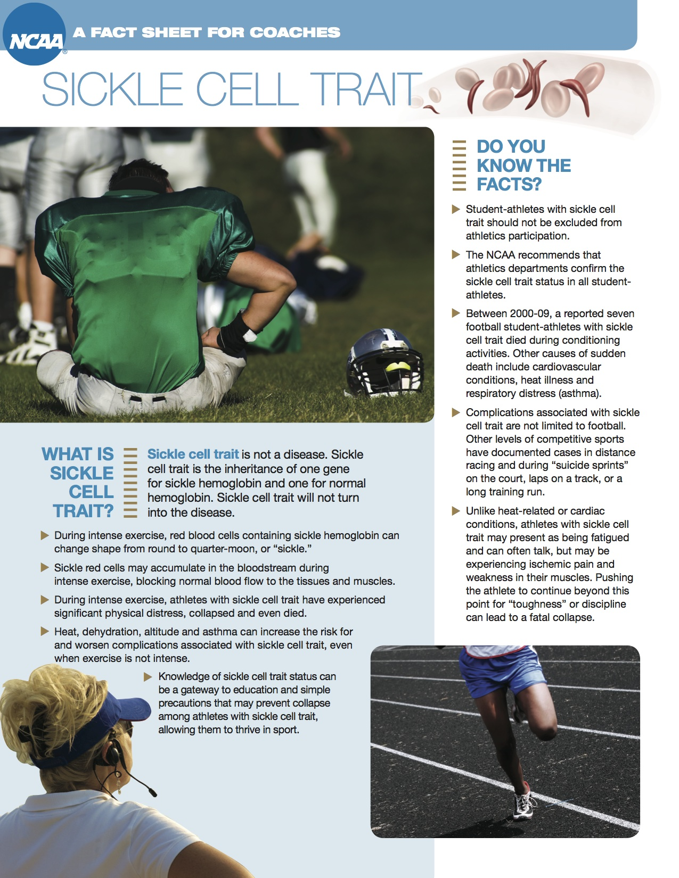

Slide 16
Hemoglobin Electrophoresis
Shocks the Blood Cells
The purpose of the prenatal hemoglobinopathy screening program is to identify couples whose children may be at high risk to have an inherited hemoglobinopathy (blood disease). The program is targeted to the ethnic groups that have an increased risk for these conditions.

Slide 17
Blood/Proteins

Slide 18
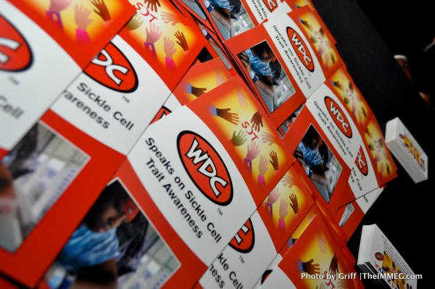
These are the Basic Facts o Sickle Cell Trait
https://www.cdc.gov/ncbddd/sicklecell/traits.html
WDConSCT.org

Slide 19
Questions
Ask your Mate:
¿WHAT’Z IN YOUR GENEZ?

Slide 20
A+ Tour Military

Slide 21
A+ Tour School

Slide 22
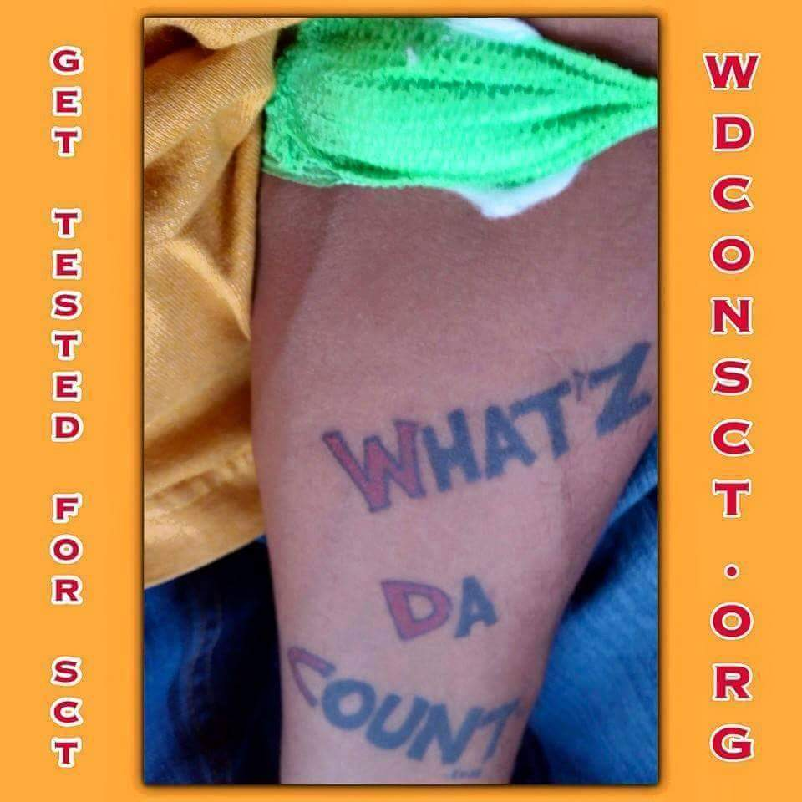
Questions

