Slide 1


Gene therapy for sickle cell disease
Mark Walters, MD

Slide 2
Financial Disclosure
In accordance with the ACCME® standards for Commercial Support Number 6, my relevant financial relationships are disclosed:
Medical Director:
AllCells, Inc
Consultant:
Trucode
Editas Medicine

Slide 3
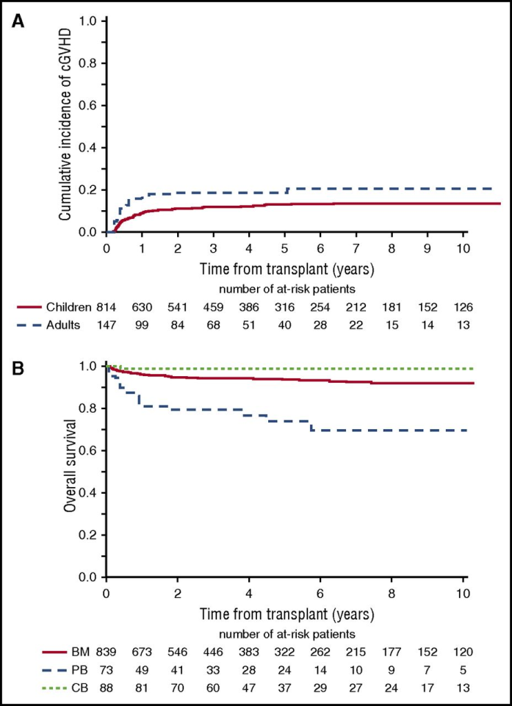
HLA-ID sibling HCT for SCD – N=1000
adults
Complication incidence – Graft-versus-host disease
children
UCB
marrow
PBSC
Successful outcome – overall survival
E Gluckman et al Blood 2017 129:1548-1556

Slide 4
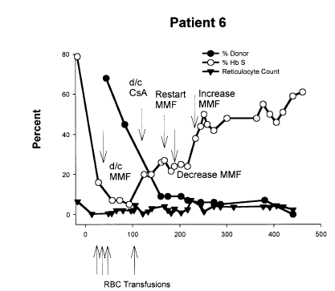
2 – 5% donor
Iannone R, et al. BBMT. 2003;9(8):519-28.

Slide 5
Barriers to Transplant for SCD
Only 18% of families have HLA-ID sibling donor
Only 19% have well-matched unrelated donor
Clinicians do not refer patients because of GVHD and risk of dying
Transplant is largely restricted to children, but applied very sparingly

Slide 6

HGB-206: An open-label, multicenter phase 1/2 study of LentiGlobin Drug Product for severe sickle cell disease
Enrollment Criteria: Group C
Key Outcomes: Group C
≥ 12 and ≤ 50 years of age
History of painful episodes for 2 or more years
Poor response to hydroxyurea
      HbA^{T87Q} ≥ 30% of total Hb
      Total Hb increase ≥ 3 g/dL compared to baseline OR total Hb ≥ 10 g/dL
      A 75% reduction in pain episodes by 24 months following infusion
Target enrollment: 35 evaluable subjects

Slide 7
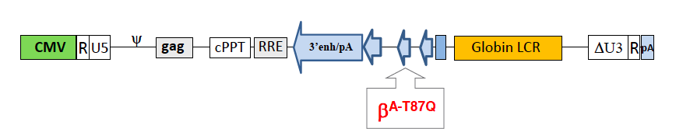
LentiGlobin BB305: Rationale for use in hemoglobin disorders
β^{S}
β^{S}
β^{S}
β^{A-T87Q}
or γ
β^{A-T87Q}-globin level can be monitored post-infusion
β^{A-T87Q}-globin and fetal globin inhibit HbS
Phe
Phe
Val⁶
Thr⁸⁷
Val⁶
Gln⁸⁷
Leu
Leu
polymerization
destabilization
Hb^{AT87Q} + HbF ≥ 30% has anti-sickling,
disease-modifying potential
Takekoshi & Leboulch, PNAS 1995. Ngo et al., Br.J.Haematol 2012; 156(2):259-64. Pawliuk et al, Science 2001; 294(5550):2368-71 Andreani M, et al. Haematologica 2011;96(1):128-133.

Slide 8
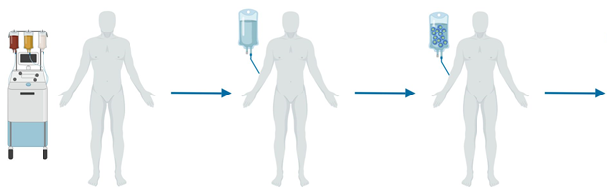
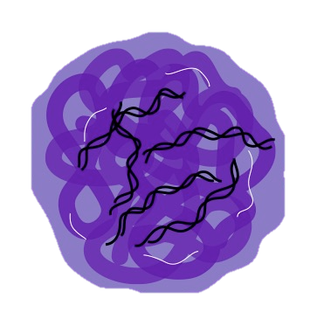

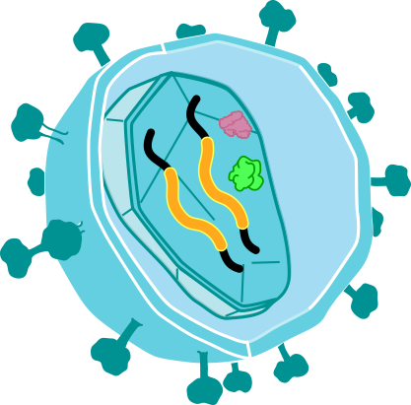
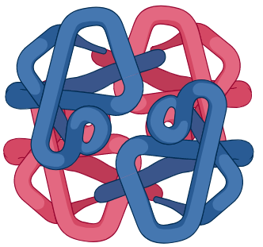
LentiGlobin for SCD gene therapy overview
Stem Cell collection
Busulfan
to destroy sickle stem cells
Gene Therapy Stem Cell infusion
Gene therapy stem cells engraft and make healthy RBCs
2-yr follow-up
Long-Term
Follow-Up Study
Modified RBCs express gene therapy-derived HbA^{T87Q}
LentiGlobin manufacturing
+
β^{T87Q}
α
Select CD34+ cells
Transduce with BB305 lentiviral vector
Cryopreserve, test, release DP
α
β^{T87Q}

Slide 9
HGB-206 Group C: Patient characteristics
N= 19 patients who started stem cell collection
Parameter | Group C N=19
Age at consent, years median (min – max) | 26 (18 – 36)
Gender | 8F 11 M
Genotype, β^{S}/β^{S} | 19
SCD History
Hydroxyurea, n | 11
VOCs, n Annualized no. of events, median (min – max) | 15 4.0 (2.0 – 13.5)
ACS, n Annualized no. of events, median (min – max) | 2 1 (1 – 1)
Stroke, n | 3
TRJV >2.5 m/s, n | 1

Slide 10
Safety profile of plerixafor mobilization/apheresis
In 36 stem cell collection cycles in 19 patients, 7 adverse events ( ≥ grade 3) were reported
Grade ≥ 3 AEs within 7 days of each plerixafor in a mobilization cycle | N=19 n (%)
Vaso-occlusive pain¹ | 2 (10.5)
Hypomagnesaemia | 2 (10.5)
Abdominal pain | 1 (5.3)
Arthralgia | 1 (5.3)
Non-cardiac chest pain | 1 (5.3)

Slide 11
HGB-206 Group C: Safety profile shows the effect of busulfan conditioning
grade ≥ 3 adverse events that happened in 2 or mor patients | N=13 n (%)
Febrile neutropenia | 10 (77)
Stomatitis | 7 (54)
Abdominal pain upper | 2 (15)
Alanine aminotransferase increased | 2 (15)
Blood bilirubin increased | 2 (15)
Nausea | 2 (15)
Serious adverse events Post DP infusion in ≥ 2 patients | N=13 n (%)
Nausea | 2 (15)
Vomiting | 2 (15)
Serious adverse events were reported in 6 patients
No gene therapy product-related adverse events
No cases of veno-occlusive liver disease observed to date
No graft failure or deaths reported
No vector-mediated active virus and no evidence of pre-leukemia (clonal expansion)

Slide 12
HGB-206 Group C: HbA^{T87Q} and Hb after infusion
Median total Hb at screening was 9.4 (8.3 – 10.2) g/dL
Notes:
Table 2.4.1
Table 8.1.1

Slide 13
HGB-206 Group C: Median HbS ≤ 50% of total Hb by 6 mos.
Median Hb (g/dL) | 10.7 | 11.5 | 11.4 | 11.7 | 15.0
40%
46%
50%
49%
36%
33%
46%
47%
52%
59%
HbA^{T87Q} ranged from 4.5 – 8.8 g/dL at last visit

Slide 14
HGB-206 Group C: Decreased hemolysis following DP infusion
Reticulocyte Counts
Lactate Dehydrogenase
Total Bilirubin
†
N* | 13 | 10 | 8 | 7 | 5 | 1 |  | 11 | 10 | 7 | 7 | 5 | 1 |  | 13 | 10 | 8 | 7 | 5 | 1

Slide 15
HGB-206 Group C: No ACS or pain events after LentiGlobin treatment
1 non-serious Grade 2 VOC was observed in 1 pt ~3.5 months post DP infusion

Slide 16
HGB-206 Group C: Summary
  Plerixafor mobilization is safe and feasible in patients with SCD
  Durable anti-sickling HbA^{T87Q} (4.5 – 8.8 g/dL at last visit , with median HbS ≤ 50%) is expressed in patients with ≥ 6 months of follow-up
  Total unsupported Hb > 10 g/dL (10.2 – 15.0 g/dL) at last visit in patients with ≥ 6 months of follow-up with improved hemolysis markers
  No ACS or serious VOCs observed in Group C patients post-LentiGlobin treatment to date
  Safety profile is generally consistent with busulfan myeloablative conditioning
Longer follow-up and recently expanded enrollment with modified endpoints will help further assess the clinical impact of LentiGlobin for SCD​

Slide 17
HGB-206 Study sites and investigators
Thank you to the study participants and their families
Ann and Robert H. Lurie Children’s Hospital of Chicago, Northwestern University
Alexis Thompson • Katherine Hammond
Medical University of South Carolina, Charleston
Julie Kanter • Brandi Day
Michelle Hudspeth • Jennifer Jaroscak
Children’s Hospital of Philadelphia, UPenn
Janet Kwiatkowski • Pranaya Venkatapuram
UCSF Benioff Children’s Hospital, Oakland
Mark Walters • Marci Moriarty
Cyrus Bascon • Frans Kuypers
Emory University, Atlanta
Lakshmanan Krishnamurti
Ashley Dulson
Megan Hanby
National Institutes of Health, Molecular and Clinical Hematology Branch, Bethesda
John Tisdale • Stephanie Helwing
Matt Hsieh
Wynona Coles
Naoya Uchida
Columbia University Medical Center
Markus Mapara • Julia Gould
Monica Bhatia
bluebird bio, Inc.
Erin Whitney
Ren Chen
Iva Kronja
Purvi Mody

