Slide 2
What is Sickle Cell and what can YOU do to improve it?
Vernell Lucas, DC
Hydration and PH Balance
Enagic.com
(562)881-3535
Long Beach, CA

Slide 3
Causes of Sickle Cell Disease
Dehydration
Hypoxia
Low Electricity

Slide 4
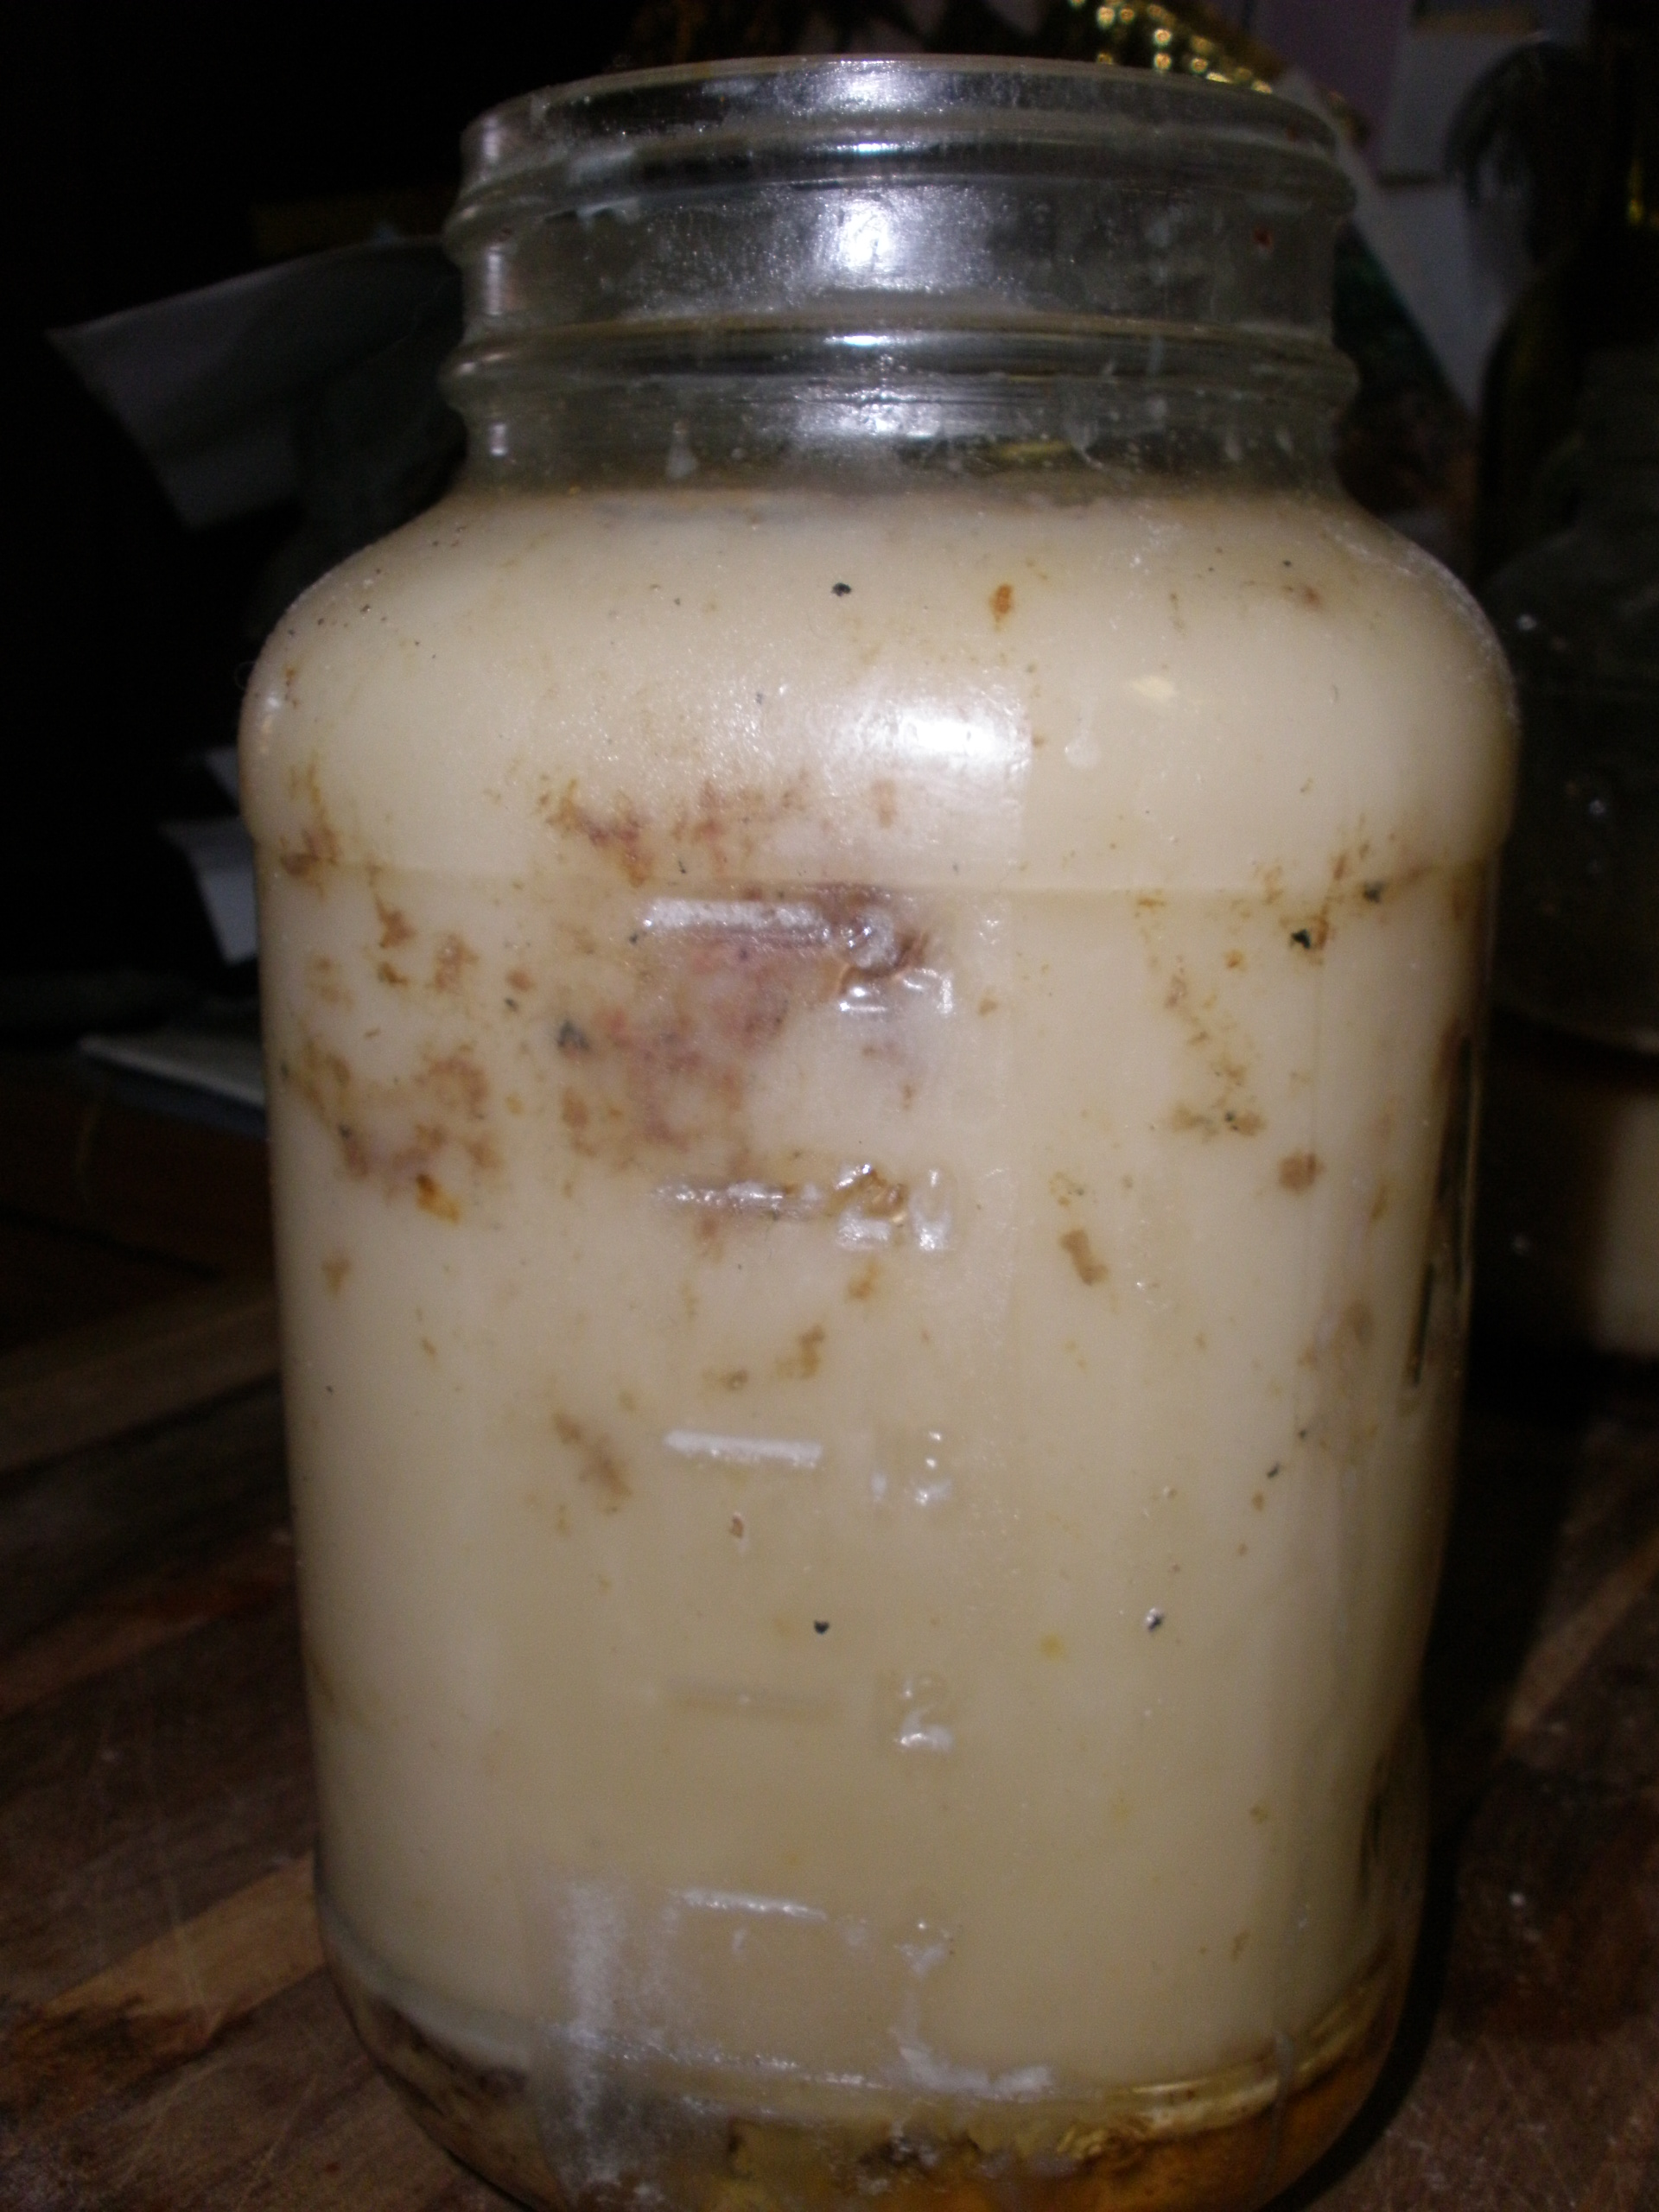
Contributors to Flare Ups
Poor Diet
Poor Water
Alcohol
Red Meat
Energy Drinks
Fried Foods
Diary
Stress

Slide 9
Did you know your blood is 83% water?

Slide 13
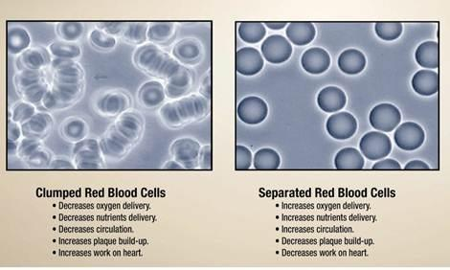
Voltage is the Difference!

Slide 14
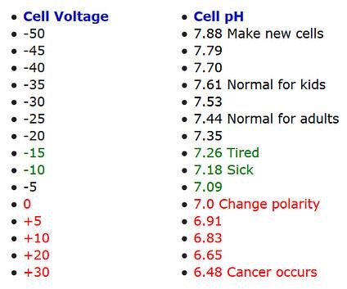

Slide 21
Let me know how I can help.
Vernell Lucas, DC
“Doc”
Enagic.com
(562)881-3535
Long Beach, CA

