Slide 1
Virtual Reality for Pediatric Sickle Cell Disease Pain and Oncology Procedures
Simon Robertson
Founder / CEO KindVR
10th Annual Sickle Cell Disease Educational Seminar
UC Davis Medical Center
September 7th, 2018

Slide 2
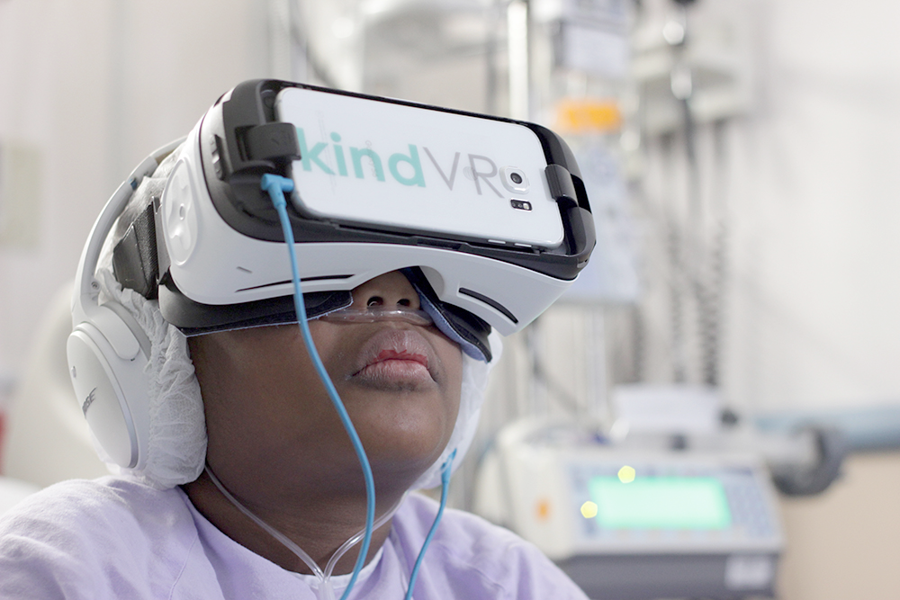
Background
Game designer wanting to do more than entertain
Started volunteering with Child Life Services in 2014
HemOnc Team at UCSF Benioff Children’s Hospital Oakland encouraged collaborative exploration of VR as a therapeutic tool
Representing UCSF Benioff Children’s Hospital Oakland and The Hospital for Sick Children in Toronto, Canada

Slide 3
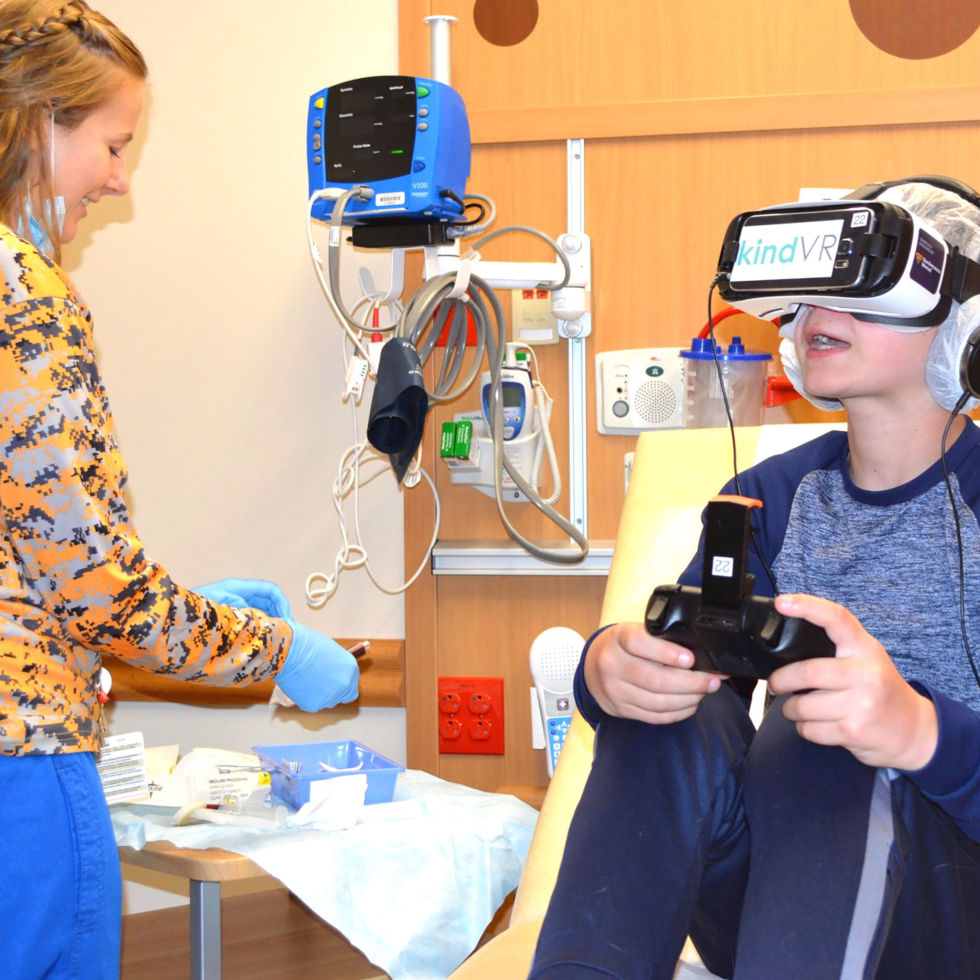
VR Research & Mechanism of Action
Possible Mechanism of Action for VR pain reduction:
“Virtual Reality reduces pain by directing patients’ attention into the virtual world, leaving less attention available to process incoming neural signals from pain receptors.” - Dr. Hunter Hoffman
VR stimulates multiple regions of the brain.
Visual System - Real time Stereo 3D images.
Auditory System - Real time 3D Spatial audio.
Interactive Content, Low latency head tracking,
VR creates sense of presence.
Interactive VR can include cognitive tasks to engage the mind.
Hunter G. Hoffman, PhD. Virtual Reality as an Adjunctive Non-pharmacologic Analgesic for Acute Burn Pain During Medical Procedures; The Society for Behavioral Medicine 1/25/2011

Slide 4
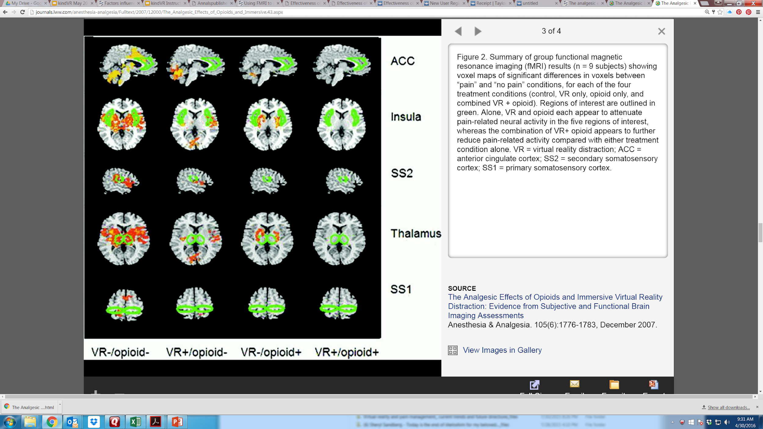
Interactive VR can be synergistic with opioids
Condition No Help VR Opioid VR & Opioid
Pain Intensity 8.3 5.9 7.7 4.5
Hunter G. Hoffman, PhD Todd L. Richards, PhD Trevor Van Oostrom, MD Barbara A. Coda, MD Mark P. Jensen, PhD David K. Blough, PhD Sam R. Sharar, MD - The Analgesic Effects of Opioids and Immersive Virtual Reality Distraction: Evidence from Subjective and Functional Brain Imaging Assessments Anesthesia & Analgesia 2007;105:1776 –83

Slide 5
Virtual Reality as a Complementary Pain Therapy in Hospitalized Patients with Sickle Cell Disease
Anurag K. Agrawal, MD, Simon Robertson, Liat Litwin, Erica Tringale, RN, MS, CPNP, Marsha Treadwell, PhD, Carolyn Hoppe, MD, and Anne Marsh, MD
UCSF Benioff Children’s Hospital Oakland
Oakland, CA

Slide 6
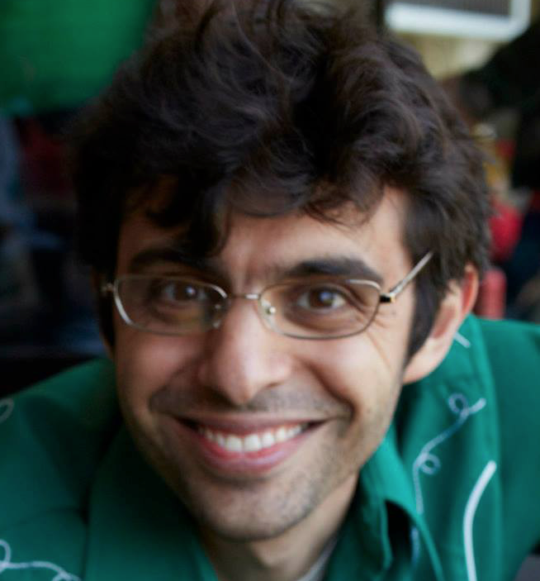
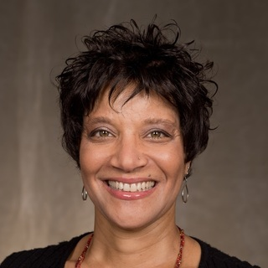
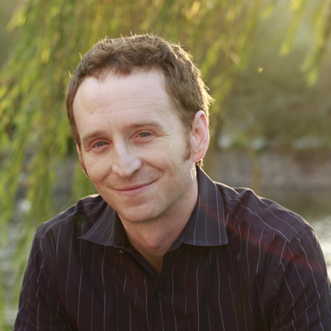
Sickle Cell Disease - Team
UCSF Benioff Children’s Hospital Oakland
Anne Marsh, MD Hematology / Oncology UCSF Benioff Children’s
Hospital Oakland
Anu Agrawal, MD Hematology/Oncology UCSF Benioff Children’s
Hospital Oakland
Chris Vlasses, MD Pediatric Hospitalist UCSF Benioff Children’s
Hospital Oakland
Marsha J. Treadwell, PhD
Mental Health & Child Development UCSF Benioff Children’s Hospital Oakland
Simon Robertson kindVR Founder
Carolyn Hoppe, MD Hematology/Oncology UCSF Benioff Children’s
Hospital Oakland
Erica Tringale
RN, MS, C-PNP
UCSF Benioff Children’s
Hospital Oakland
Liat Litwin Research Assistant Tufts University

Slide 7
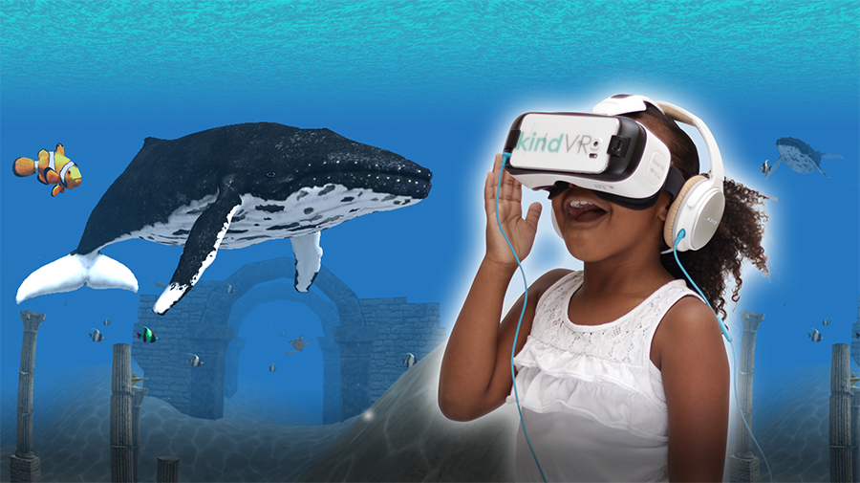
VR and Sickle Cell Disease
Specific Aim 1:
To test the usability and acceptability of immersive virtual reality technology in sickle cell patients hospitalized with pain.
Specific Aim 2:
To determine if a virtual reality immersive experience serves as an effective adjunctive therapy to traditional pain reduction treatments in patients with sickle cell disease hospitalized due to pain.
Software: KindVR Aqua
IRB: Approved November 2015
Start: December 2015
Completion: September 2016
Primary Investigator: Dr. Anne Marsh

Slide 8
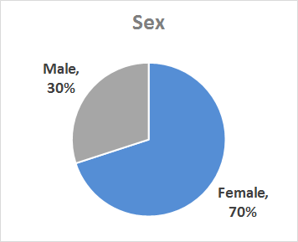
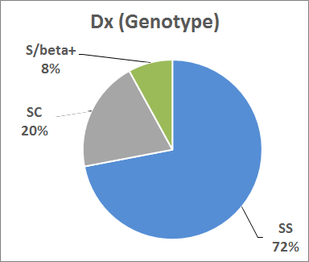
Patient Demographics
Number of Patients: 30
Age Range: 8 - 25
Age Mean: 16.5
Female: 21
Male: 9
Genotypes
SS: 21
SC: 5
S/beta+: 4

Slide 9
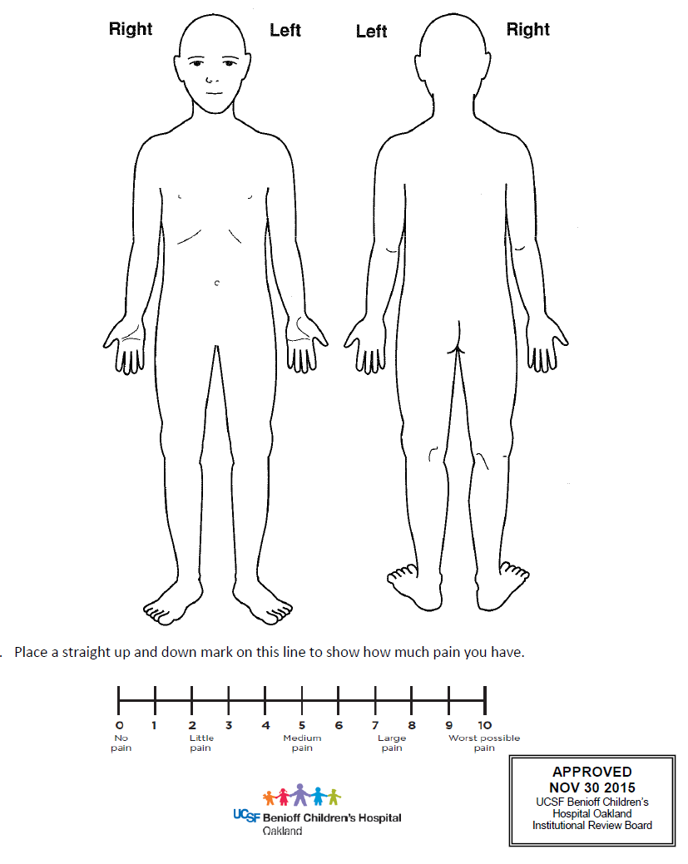
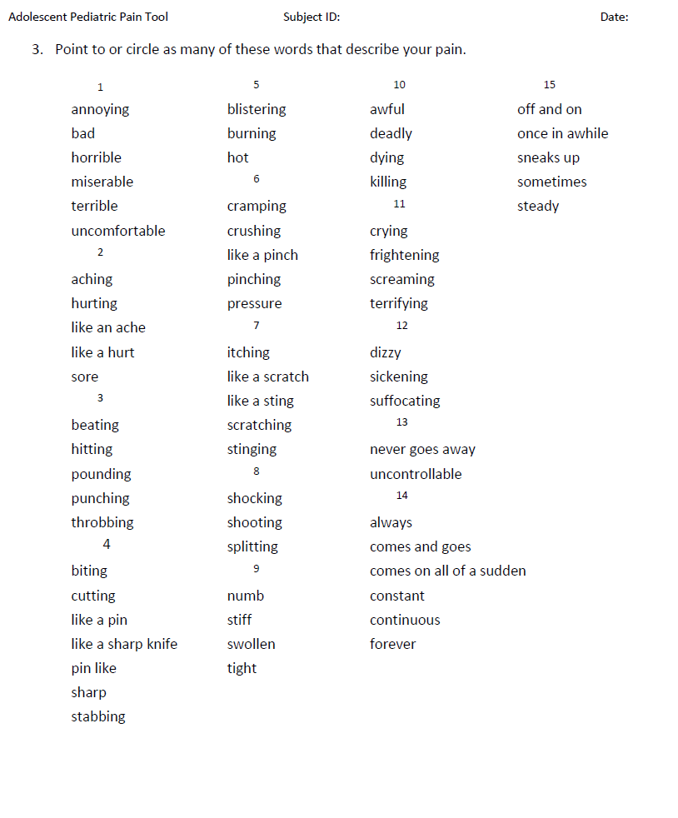
Measurement - Adolescent Pediatric Pain Tool (APPT)

Slide 10
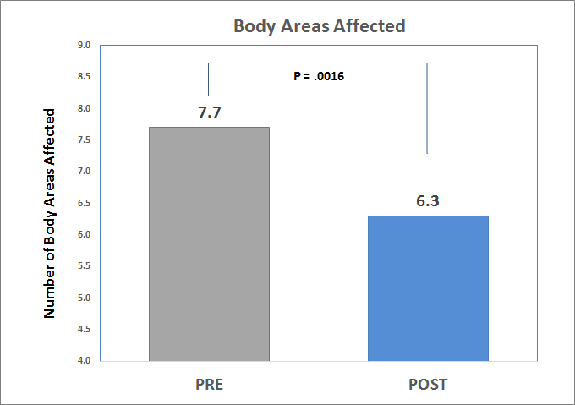
Significant Reduction in Body Areas Affected (-18%)

Slide 11
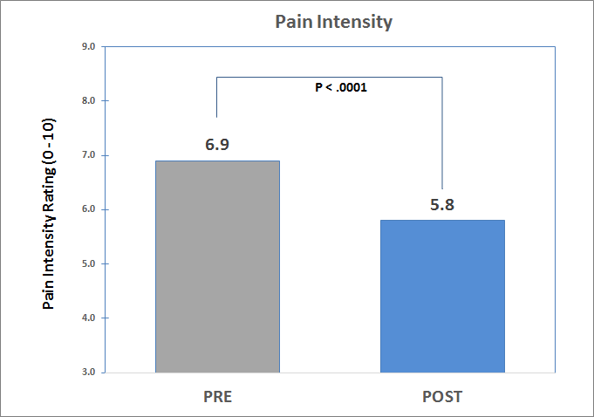
Significant Reduction in Pain Intensity (-16%)

Slide 12
Significant Reduction in Pain Descriptors (-32%)

Slide 13
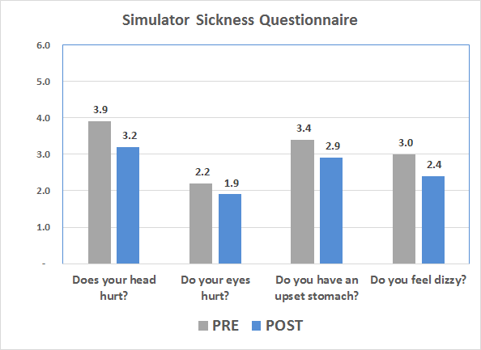
Simulator Sickness Questionnaire

Slide 14
Patient Feedback on VR Experience
VR Experience Feedback | Question | Average Score (0 - 10)
Immersion | How much did you feel like you were inside the virtual world? | 9.1
Felt Real | How real did Aqua feel to you? | 8.1
Fun | How much fun did you have while playing Aqua? | 9.4
Comfortable | Playing Aqua was comfortable. | 9.6
Hospital Experience | Playing Aqua made me feel better about my hospital stay. | 8.6
Play Again | I would play Aqua again when I am in pain. | 9.9

Slide 15
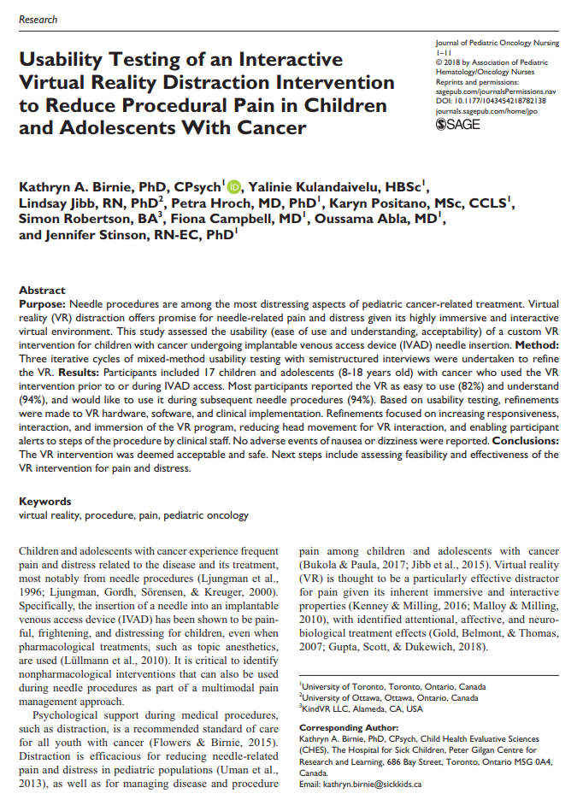
Usability and Safety Testing of an Interactive Virtual Reality Distraction Intervention to Reduce Procedural Pain in Children With Cancer
Kathryn A. Birnie, PhD, Lindsay Jibb, RN PhD, Oussama Abla, MD, Karyn Positano, MSc CCLS, Vanessa Hum MEnvSc, Petra Hroch, PhD, Nabilah Juma, BScN, and Jennifer Stinson, RN PhD
The Hospital for Sick Children
Toronto, Canada

Slide 16
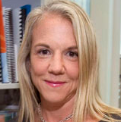
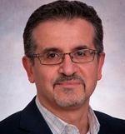
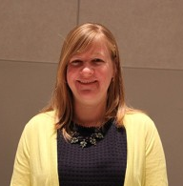
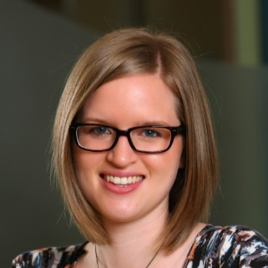
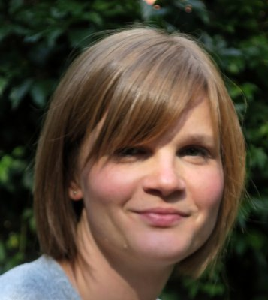
Oncology Research Team
Jennifer Stinson
PhD, RN-EC, CPNP
Chronic Pain Program
Hospital for Sick Children
Oussama Abla, MD Haematology/Oncology Hospital for Sick Children
Lindsay Jibb
RN, PhD University of Ottawa
Karyn Positano
MSc CCLS Child Life Specialist
Hospital for Sick Children
Kathryn A. Birnie, PhD Psychologist, Postdoctoral Fellow
Hospital for Sick Children
Vanessa Hum, MEnvSc
Clinical Research Manager
Hospital for Sick Children
Petra Hroch, PhD
McMaster University
Nabilah Juma
BScN Hospital for Sick Children

Slide 17
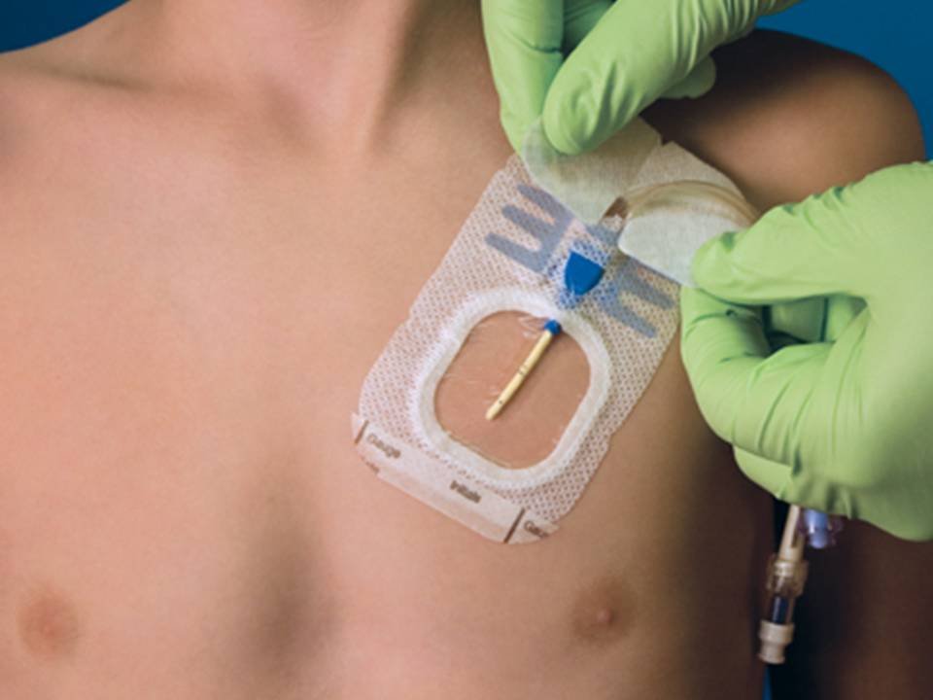
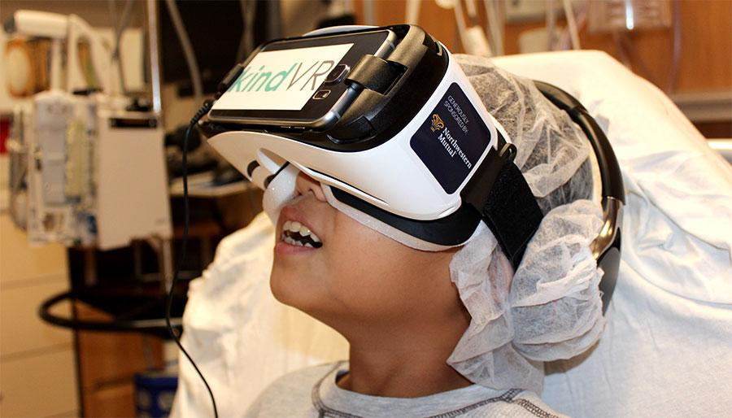
Study Objective - Phase I
Study Objective
Assess the usability and safety of a custom VR intervention for youth with cancer undergoing subcutaneous port access.
Methodology
Semi-structured interviews were undertaken over three iterative cycles of usability testing to refine the VR intervention.

Slide 18
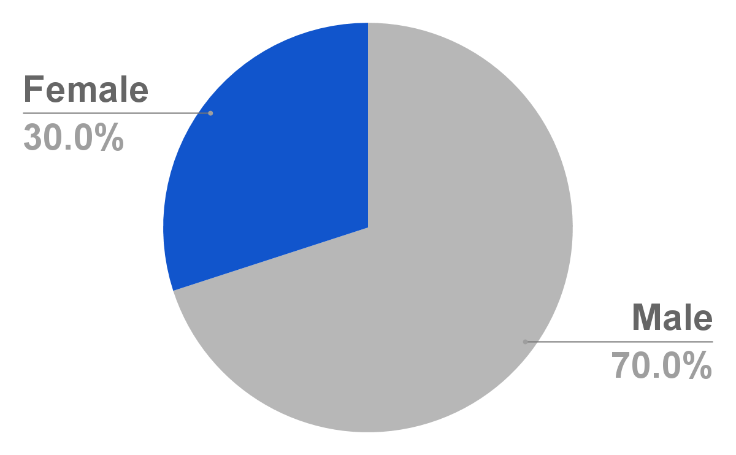
Patient Demographics
Number: 17 patients (cycle one=5) (cycle two=6) (cycle three=6)
Age: 8-18 years
Mean Age: 11.7 years
Male/Female: 70%/30%
Most common cancer diagnoses:
acute lymphoblastic leukemia (n=7; 41%)
brain tumour (n=4; 23%).

Slide 19
Development Cycles - Phase I
Cycle One
Cycle Two
Cycle Three
Oncology Patients Non-procedural
Oncology Patients During Procedure
Oncology Patients During Procedure
Multiple Refinements to Software and Procedural Steps:
Patient and staff communication
Patient posture during procedure
Patient’s attention during procedure
Patient sense of security
Infection Control
Staff & Patient ease-of-use

Slide 20
Phase I - Results
Overall - Participants reported that the VR was fun, easy to use, and understand.
Safety - No adverse events of nausea or dizziness were reported.
Acceptance - All participants were interested in using the VR intervention in a subsequent needle procedure.
Next Step - Phase II RCT Randomized Controlled Trial to assess effectiveness of the VR intervention for pain and distress.

Slide 21
VR Research - Looking Forward
Sickle Cell Disease
St. Jude Children’s Research Hospital RCT for Sickle Cell Outpatients
Port Access Procedures
SickKids The Hospital for Sick Children Phase II - RTC for Port Access
Children’s Hospital of Wisconsin Pediatric Oncology Procedures
UCSF Benioff Children’s Hospital Oakland Port Access Procedures

Slide 22
Hospitals actively using KindVR

Slide 23
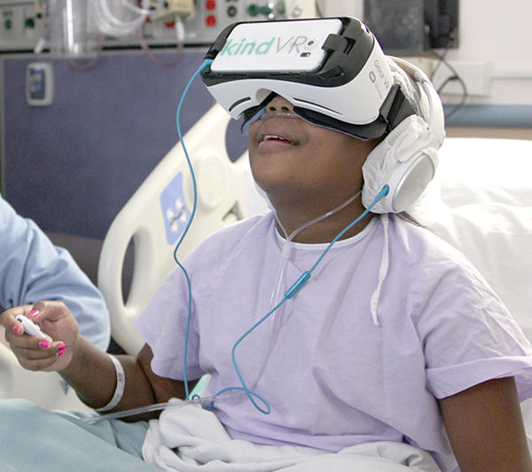
Thank You
Simon Robertson
simon@KindVR.com
925-487-1180
Twitter:
@KindVR
@SimonRobertson

Slide 24
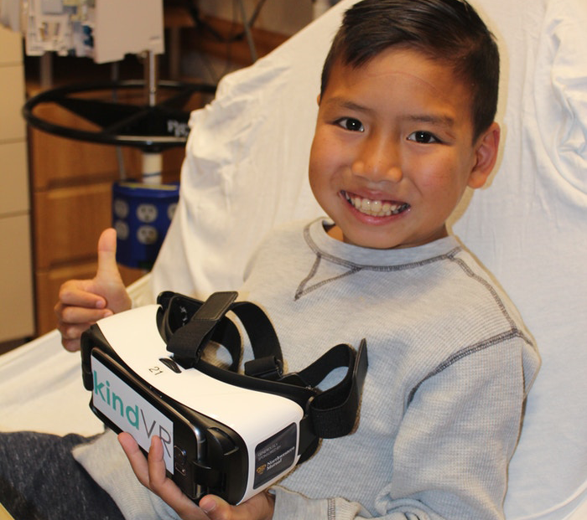
Thank You
Simon Robertson
simon@KindVR.com
925-487-1180
Twitter:
@KindVR
@SimonRobertson

Slide 25
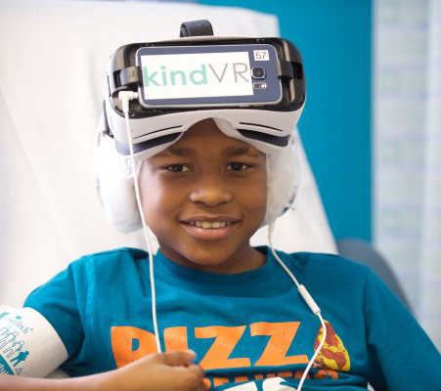
Thank You
Simon Robertson
simon@KindVR.com
925-487-1180
Twitter:
@KindVR
@SimonRobertson

