Slide 1
Gene addition therapy in Sickle Cell Disease
Anjulika Chawla, MD
Associate Medical Director
September 5, 2019

Slide 2
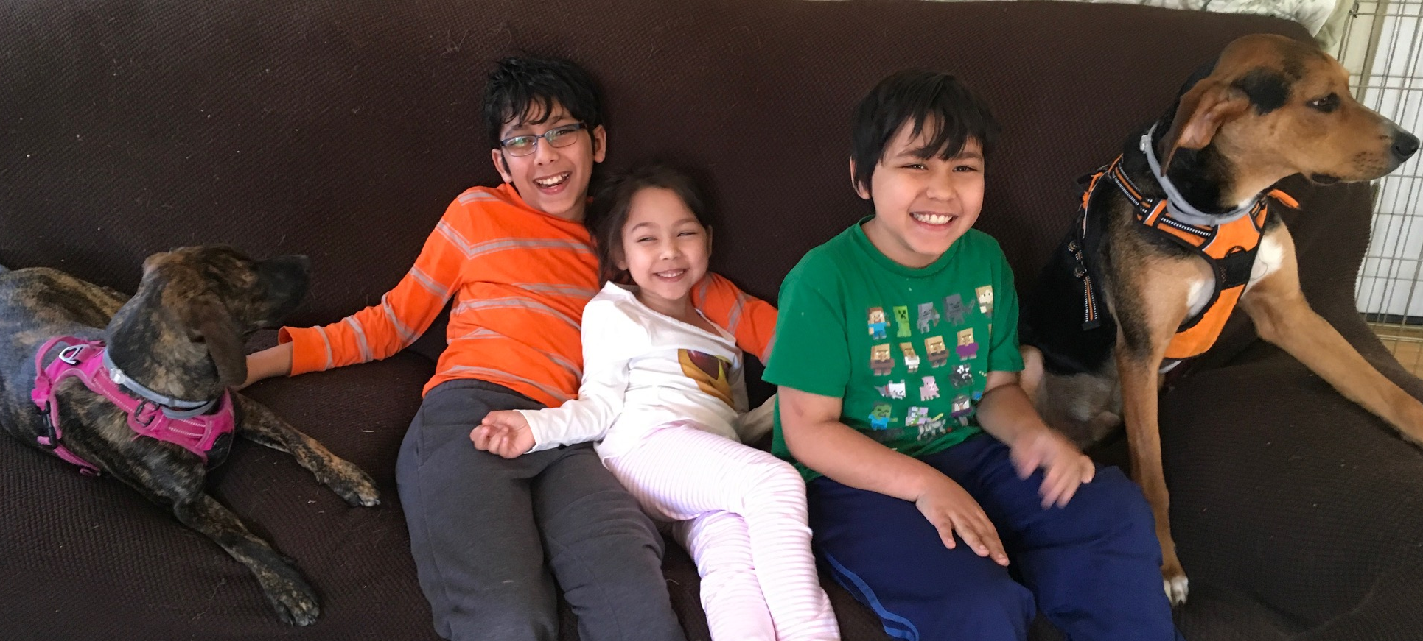
Disclosures
Associate Medical Director, bluebird bio
Sickle Cell Disease Medical Lead
Pediatric Hematologist
Care for pediatric/young adult patients with blood disorders and cancer
Hasbro Children’s Hospital, Division of RIH, owned by Lifespan Corporation
Associate Professor, Clinical
Teach medical students, residents, and fellows (or anyone who comes too close)
Brown University, Providence RI
Mother of 4 kids and 2 dogs
Supportive husband and family
No understanding of work/life/sleep balance

Slide 3
Sickle Cell Disease (SCD)
Severe blood disorder that causes anemia, frequent pain crises and shortened lifespan
Global annual birth incidence ~ 300,000 – 400,000
Mean age of death in the U.S. is 44 years¹
PROGRAM OVERVIEW
Plan to pursue accelerated development path based on hematological primary endpoint
Phase 3 study to begin in 2019
HGB-206 amended and Group C expanded
1Paulukonis et al, California’s Sickle Cell Data Collection Cohort, 2005-2015* ASH 2017*
Source: Global Genes

Slide 4
Sickle cell disease (SCD) is characterized by high morbidity and early mortality
Complications
High levels of HbS in RBCs
Vaso-occlusive pain
> 50% of patients with SCD die before 45 years of age¹
Anemia
Cerebral vasculopathy/ stroke
30
Vaso-occlusion
Retinopathy
Hemolysis
25
Vasculopathy
Acute chest syndrome
Pulmonary hypertension
20
1979
2006
HbS polymerization
& sickling
Percentage of deaths
↓O₂
Hepato-splenic sequestration
Cardiovascular complications
15
10
Kidney disease
5
Priapism
0
Sudden death
<1
1-4
5-9
10-14
15-19
20-24
25-34
35-44
45-54
55-64
65-74
75-84
85+
Leg ulcers
Age at death by age group
Organ failure
Osteonecrosis
1. Hassell K., Am J Prev Med, 2010
Hb, hemoglobin; RBCs, red blood cells
4
Notes:
Arrows:
Treatment of complications
Reduce number and severity of complications
Treatment of SCD: Increasing Hgb F, Diluting Hgb S with transfusion
But what if we could treat at the genetic level?

Slide 5
How do we find out what life with SCD look like in 2019?
Real World Evidence: Principles
Study affected people as they are with current treatment
Look and listen to the people with the diagnosis
Gather the information in an organized manner
What is happening to the lives of people with SCD in real time
Gathering real world evidence
Collaborations with
Sickle Cell Disease Experts
Bone Marrow and Stem Cell transplant experts
Retrospective and prospective registries
Understanding with information already present
Hospitalization, complication and mortality rates over a population
Studies looking at patient reported outcomes
SCD NBS
Medical Encounters
Clinical Trials
SCD USA

Slide 6
Sickle cell disease (SCD) is characterized by high morbidity and early mortality
Complications
High levels of HbS in RBCs
Vaso-occlusive pain
> 50% of patients with SCD die before 45 years of age¹
Anemia
Cerebral vasculopathy/ stroke
30
Vaso-occlusion
Retinopathy
Hemolysis
25
Vasculopathy
Acute chest syndrome
Pulmonary hypertension
20
1979
2006
HbS polymerization
& sickling
Percentage of deaths
↓O₂
Hepato-splenic sequestration
Cardiovascular complications
15
10
Kidney disease
5
Priapism
0
Sudden death
<1
1-4
5-9
10-14
15-19
20-24
25-34
35-44
45-54
55-64
65-74
75-84
85+
Leg ulcers
Age at death by age group
Organ failure
Osteonecrosis
1. Hassell K., Am J Prev Med, 2010
Hb, hemoglobin; RBCs, red blood cells
6
Notes:
Arrows:
Treatment of complications
Reduce number and severity of complications
Treatment of SCD: Increasing Hgb F, Diluting Hgb S with transfusion
But what if we could treat at the genetic level?

Slide 7
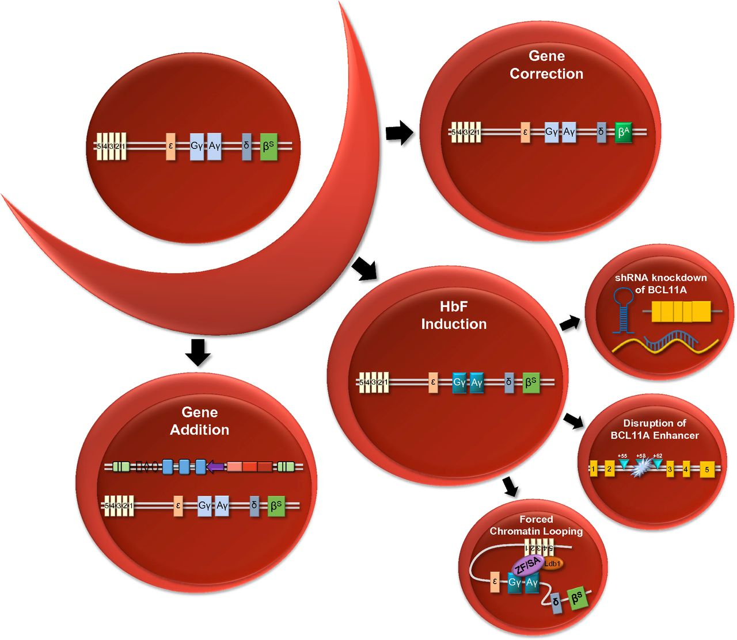
Root cause treatment: Stem Cell Transplant and Gene Therapy
Stem Cell Transplantation
Procedure that clears replaces sickle stem cells with normal allogenic cells
Allogeneic hematopoietic “Cure”
EFS with match sibling donor is >90%
~1,200 transplants performed 1984-2014 :
Lack of match donor
Patient health ang age
Cost and availability of transplant
Bender MA, Seibel GD. GeneReviews. 2014. Online available: http://www.ncbi.nlm.nih.gov/books/NBK1377/
Megan D. Hoban et al. Blood 2016;127:839-848
©2016 by American Society of Hematology
Notes:
Strategies for gene therapy for SCD: schematic overview of various approaches for correcting the sickle phenotype via gene therapy. Gene correction: targeted genome engineering leads to correction of the sickle mutation such that β^{S} is repaired as β^{A}. HbF induction: multiple strategies for induction of γ-globin expression include shRNA-mediated knockdown of BCL11A, targeted disruption of the +58 DNase I HS site in the BCL11A erythroid-specific enhancer, and forced chromatin looping to promote association of the β-globin LCR with the γ-globin genes. Gene addition: integrating lentiviral vector carrying a β-globin, γ-globin, or antisickling β-globin cassette. Ldb1, transcription factor; ZF/SA, zinc-finger self-association domain.

Slide 8
Gene Addition Therapy Process

Slide 9
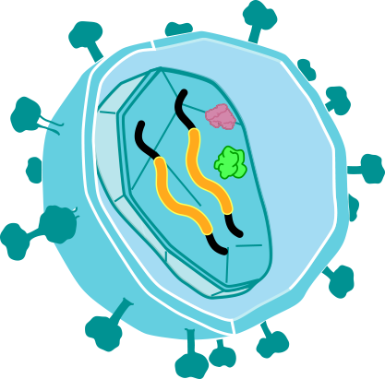
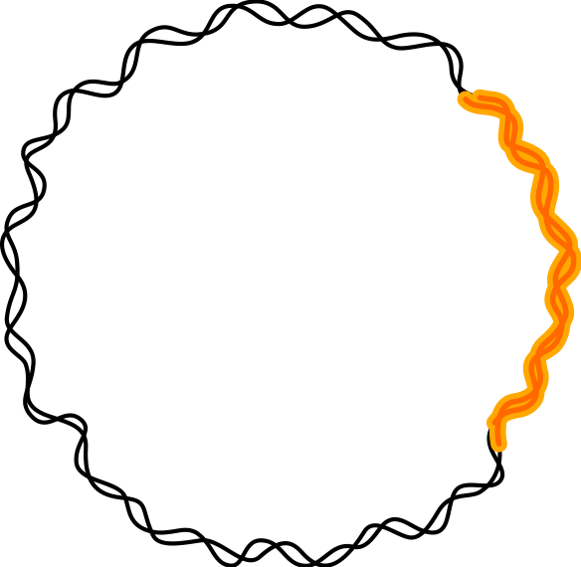
BB305 vector and Investigational LentiGlobin Drug Product
BB305 lentiviral vector production
Transduction of autologous CD34+ HSCs with the BB305 LVV
β^{A-T87Q} expression cassette
β^{A-T87Q}
BB305 LVV
Packaging cell
Autologous CD34+ HSC
LentiGlobin
autologous CD34+ cells transduced ex vivo with the BB305 LVV
Plasmids
BB305 LVV
Self-inactivating^{1,2}
Replication incompetent^{1,2}
BB305 lentiviral vector
β^{S}
β^{S}
β^{S}
β^{A-T87Q}
β^{A-T87Q}
ψ
F
F
∆U3 | R | U5 |  | gag |  | cPPT |  | RRE |  |  |  |  |  | β-globin LCR |  | ∆U3 | R | U5
V⁶
T⁸⁷
V⁶
Q⁸⁷
3’ enhancer
L
L
Integration and reverse transcription
For packaging
Facilitates efficient reverse transcription
Human β-globin gene
Modified β-globin locus control region
Integration and reverse transcription
For nuclear export
polymerization
destabilization
Viral genetic elements are shown in blue
Kanter. ASH 2015. Abstract 3233
HSC, hematopoietic stem cell; LVV, lentiviral vector.
1. Negre et al. Hum Gene Ther. 2016; 2. Negre et al. Curr Gene Ther. 2015; 3. Pawliuk et al. Science 2001.
Notes:
Our lentiviral vectors are assembled using 293T cells.
Plasmids are introduced to the cells – encoding all the genetic material required to assemble the lentiviral vector carrying the functional gene of interest.
The 293T cells then assemble our lentiviral vectors packaged with the functional gene.
The assembled vectors are harvested, purified, concentrated and formulated prior to freezing for storage.
Negre et al. Hum Gene Ther. 2016
BB305 is a self-inactivating lentiviral vector which is replication incompetent
The BB305 vector was designed to express a modified human β-globin (HBB) gene with a threonine to glutamine substitution at position 87 (T87Q)^{1,3}
This modified HBB gene encodes for production of β^{A-T87Q}-globin which is incorporated into HbA^{T87Q 1}
β^{A-T87Q} can be distinguished from other globin chain variants by reverse-phase HPLC

Slide 10
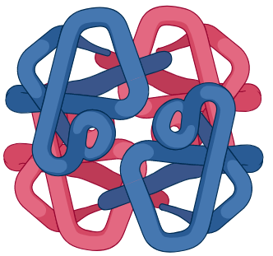
Overview of investigational treatment process
HSC collection
Bone marrow harvest or mobilization with plerixafor & apheresis
Busulfan myeloablative conditioning
DP infusion
Transduced HSCs engraft and contribute to reconstitution of functional RBCs
2-yr follow-up
Long-Term
Follow-Up Study
Gene therapy-derived HbA^{T87Q}
LentiGlobin DP centralized manufacturing
β^{T87Q}
α
Select CD34+ cells
Transduce with BB305 lentiviral vector
Cryopreserve, test, release DP
α
β^{T87Q}
DP, drug product; HSCs, hematopoietic stem cells, PB, peripheral blood; RBC, red blood cell.
10

Slide 11
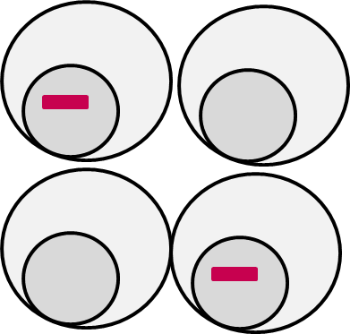
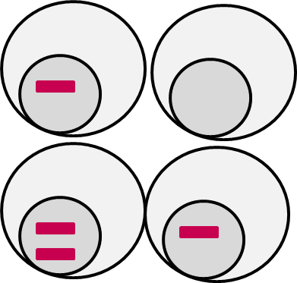
Gene Therapy Specific Vocabulary
VCN
Vector copy number:
The number of vector genomes per diploid genome
0.5
1
1
%LVV+
The percentage of a population of cells that contains vector
50%
75%
100%
11

Slide 12
HGB-206: Exploratory assay allows for single-cell resolution of Hb expression to assess pancellularity of HbA^{T87Q}
Exploratory assay: Single red blood cell western blot with anti-β^{S} or anti-β^{A}/β^{A-T87Q} antibodies
RBCs with normal adult Hb β^{A}/β^{A}
RBCs from β^{S}/β^{S}
SCD patient
RBCs from sickle cell trait β^{S}/β^{A}
RBCs from β^{S}/β^{S} SCD patient
on transfusions
RBCs from LentiGlobin treated β^{S}/β^{S} SCD patient
Proportion of RBCs with HbS and/or HbA/HbA^{T87Q}
RBCs, red blood cells.
Kanter. EHA 2019. Abstract S1633.

Slide 13
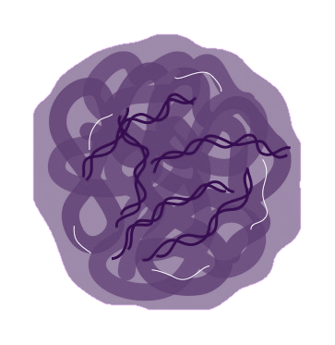
HGB-206: Study design
HSC collection
Bone marrow harvest or mobilization with plerixafor & apheresis
Busulfan myeloablative conditioning
DP infusion
Transduced HSCs engraft and contribute to reconstitution of functional RBCs
β^{T87Q}
α
Modified RBCs express gene therapy-derived HbA^{T87Q}
α
β^{T87Q}
2-yr follow-up
Long-Term
Follow-Up Study
 | Group A | Group B | Group C
Pre-collection transfusion regimen | Optional | Required | Required
HSC source | Bone marrow | Bone marrow | Mobilized PB
Manufacturing process | Original | Orig Refined | Refined
LentiGlobin DP centralized manufacturing
+
Select CD34+ cells
Transduce with BB305 lentiviral vector
Cryopreserve, test, release DP
DP, drug product; HSCs, hematopoietic stem cells, PB, peripheral blood; RBCs, red blood cells.

Slide 14
Accelerated Development Plan Using Novel Composite Primary Endpoint Based on Hemoglobin
HGB-206 Group C
(Sickle Cell Disease, history of VOEs over 24 months)
HGB-210
(Sickle Cell Disease, history of VOEs over 24 months)
HGB-205
(Transfusion-dependent β-thalassemia & severe sickle cell disease)
EXPANDED
Updated Primary Endpoint
Up to add’l 21 patients
Expanded age range
Ongoing Phase 1/2, single arm, multi-center, U.S. study
N=41 (Group C)
Phase 3, single arm, multi-center, global study
NEW
Planned for 2019
Phase 1/2, single-center in France
N=7 (4 β-thalassemia)
Primary Endpoint: HbA^{T87Q} and Total Hb
Key Secondary Endpoint:
Reduction in severe VOEs
≥12 years of age - ≤50 years of age
Primary Endpoint: HbA^{T87Q} and Total Hb
Key Secondary Endpoint:
Reduction in severe VOEs
All thalassemia subjects dosed as of Sep 2015
2 year study duration; last β-thalassemia subject visit ≈Sep 2017
Additional Clinical Investigation in Other Patient Types and Ages Planned
Plans Based on Ongoing Engagement with Regulators
Notes:
Voice over
Now let us outline our plan…
Would be updated post-minutes

Slide 15
Thank You!
All the brave people and families affected by sickle cell disease
All the tireless providers who keep trying to make the lives of people with sickle cell better
All the vocal advocates that keep sickle cell in the conversation
All the dedicated researchers who continue to search for better answers for the questions of sickle cell disease
Cayenne Wellness for being all of the above and bringing us together for this conference

