Slide 1
The Brain: Executive Functioning and Sickle Cell Disease
Eboni I. Lance, M.D., Ph.D.
Medical Director,
Sickle Cell Neuro-developmental Clinic
Kennedy Krieger Institute
Assistant Professor of Neurology
Johns Hopkins University School of Medicine

Slide 2
Disclosure Slide
I do not have a relevant financial relationships with any commercial interests in relation to this program/presentation.
I do not anticipate discussing the unapproved/investigative use of a commercial product/device during this activity or presentation.

Slide 3
Objectives
Identify common forms of brain injury in sickle cell disease
Define executive function and identify importance in general pediatric and adult development
Identify impact of sickle cell disease on executive function
Identify common strategies to improve executive function

Slide 4
What are neuro-developmental disorders?
Specific
Learning
Disabilities
Motor
Disorders
ADHD
Intellectual
Disability
Language Disorders
Autism
Spectrum
Disorders

Slide 5
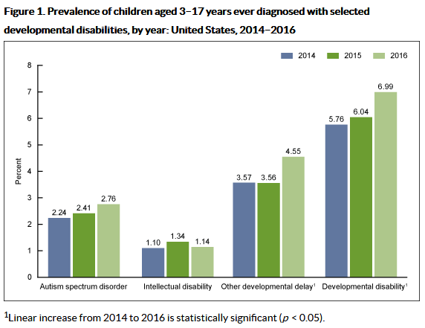
Neuro-developmental Disorders
https://www.cdc.gov/ncbddd/adhd/data.html Page last updated: March 20, 2018
Notes:
On the rise per CDC

Slide 6
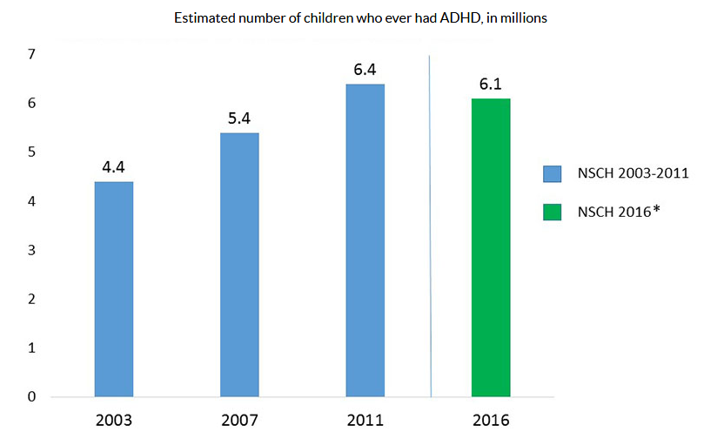
Attention Deficit Hyperactivity Disorder
https://www.cdc.gov/ncbddd/adhd/data.html Page last updated: March 20, 2018
Notes:
On the rise per CDC

Slide 7
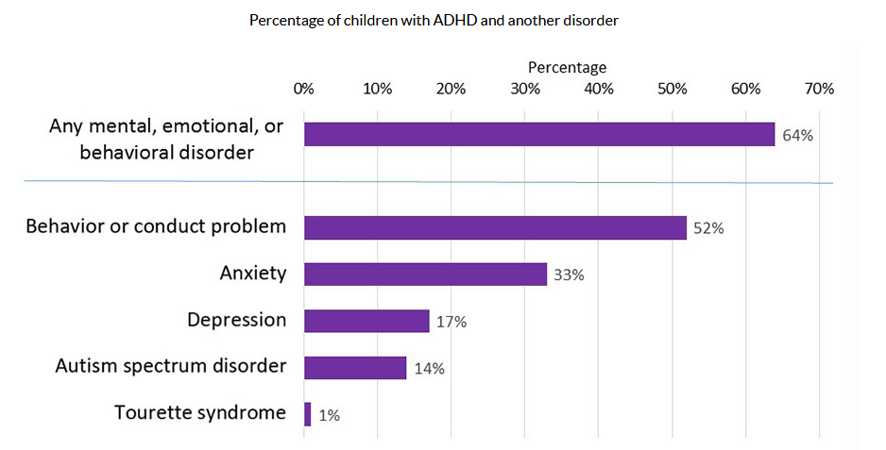
Attention Deficit Hyperactivity Disorder
Zablotsky B, et. al. NCHS Data Brief, no 291: National Center for Health Statistics. 2017.
Notes:
On the rise per CDC

Slide 8
What do neuro-developmental disorders have to do with pediatric sickle cell disease?

Slide 9
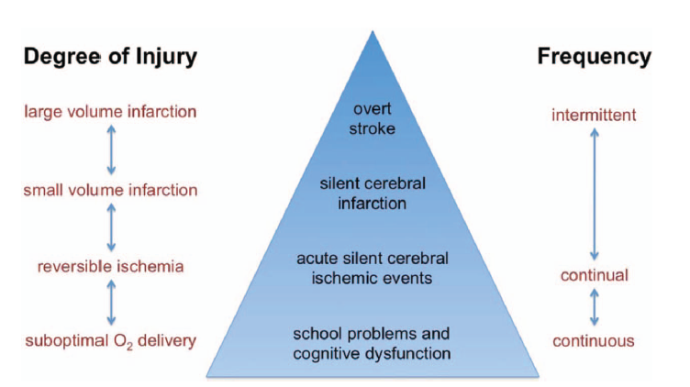
Different Types of Brain Injury in SCD
Hematology Am Soc Hematol Educ Program. 2014 Quinn CT¹.

Slide 10
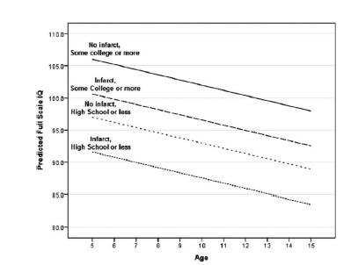
Parent education and biologic factors influence on cognition in sickle cell anemia
American Journal of Hematology Volume 89, Issue 2, pages 162-167, 14 FEB 2014
Notes:
Effect of age, presence of SCI, and head of household education on predicted FSIQ. Model predictions with household per capita income and hemoglobin oxygen saturation fixed at mean value.
© IF THIS IMAGE HAS BEEN PROVIDED BY OR IS OWNED BY A THIRD PARTY, AS INDICATED IN THE CAPTION LINE, THEN FURTHER PERMISSION MAY BE NEEDED BEFORE ANY FURTHER USE. PLEASE CONTACT WILEY'S PERMISSIONS DEPARTMENT ON PERMISSIONS@WILEY.COM OR USE THE RIGHTSLINK SERVICE BY CLICKING ON THE 'REQUEST PERMISSION' LINK ACCOMPANYING THIS ARTICLE. WILEY OR AUTHOR OWNED IMAGES MAY BE USED FOR NON-COMMERCIAL PURPOSES, SUBJECT TO PROPER CITATION OF THE ARTICLE, AUTHOR, AND PUBLISHER.

Slide 11
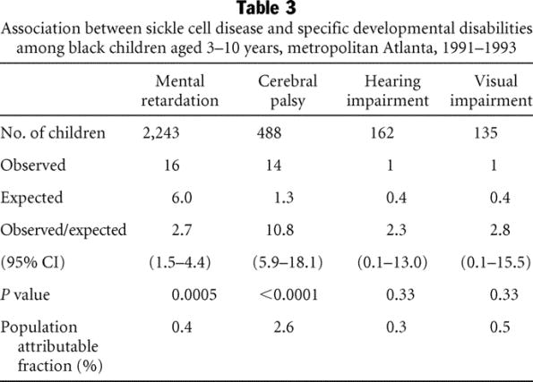
Association between sickle cell disease and specific developmental disabilities
2
Ashley-Koch, Allison et.al. Genetics in Medicine. 3(3):181-186, May/June 2001.
Notes:
Children ages 3 – 10 years old
Measures of intellectual disability, cerebral palsy, hearing and vision impairment
Restricted to black children with stroke
Calculated expected rates of non SCD population
RESULTS:
Children with SCD had increased risk for DD (O/E = 3.2, P < 0.0001), particularly mental retardation (O/E = 2.7, P = 0.0005) and cerebral palsy (O/E = 10.8, P < 0.0001). This risk was confined to DD associated with stroke (O/E = 130, P < 0.0001; for DD without stroke: O/E = 1.3, P = 0.23).
CONCLUSIONS:
Children with SCD have increased risk for DD associated with stroke; thus, aggressive interventions are needed to prevent stroke in these children.

Slide 12
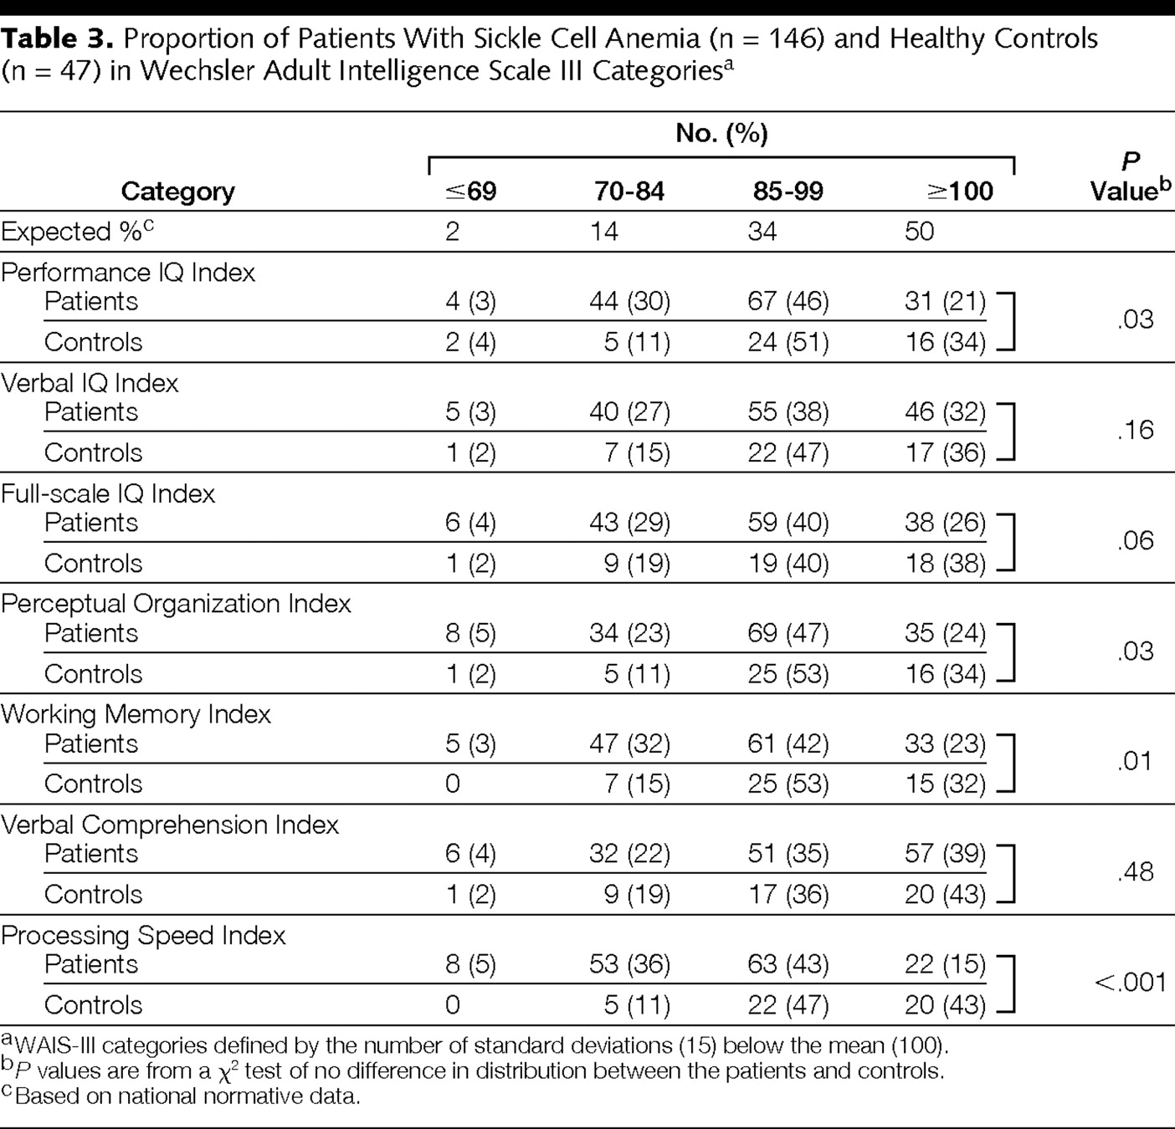
Proportion of Patients With Sickle Cell Anemia and Healthy Controls
Vichinsky, E. P. et al. JAMA 2010;303:1823-1831
Notes:
Table 3. Proportion of Patients With Sickle Cell Anemia (n = 146) and Healthy Controls (n = 47) in Wechsler Adult Intelligence Scale III Categories
Adulthood
HbSS and HB S beta-thal adults age 19 – 55 years
Excluded those with any history of neurologic injury, stroke, abnormal neuro exam or imaging, cognitive impairment, depression, other chronic disorders, recent acute illness, medication that might affect cognition, recent transfusions
10 mg/dL) aged 19 to 55 years and of African descent (n=149) or community controls (Hb AA and normal hemoglobin level) (n=47). Participants were stratified on age, sex, and education.

Slide 13
SCD and NDD
Parent-Reported Neuro-developmental Disorders in Children with SCD
Boulet, SL et al. Am J Prev Med 2010; 38 (4S):S528-S535).
Notes:
Data from 1997 – 2005 National Health Interview Survey Child Sample Core
192 children age 0 – 17 with SCD
Matched comparison group in age and ethnicity from same data sample
Looked at medical and developmental conditions and healthcare status
aMaternal education information missing for 17 children with SCD and 2373 children without SCD.
bInsurance information missing for eight children with SCD and 604 children without SCD.
*p0.05 for chi-square test of distribution of variable in children with SCD compared with children without SCD.
SCD, sickle cell disease; SCHIP, State Children’s Health Insurance Program

Slide 14
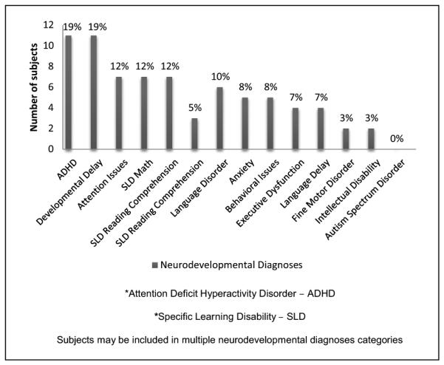
SCD and NDD
Neuro-developmental Disorders at
KKI SCD Neurodevelopmental Clinic
Lance EI, et. al.. Clinical pediatrics. 2015;54(11):1087-1093.
Notes:
Neurodevelopmental Diagnoses of Subjects (n = 59)
22% had history of stroke
Under-representation of autism
Children with S-B thal – higher chance of attention issues than SS
Higher odds of behavior issues in patients with h/o asthma
May be easier to uncover in routine care of patients with milder disease

Slide 15
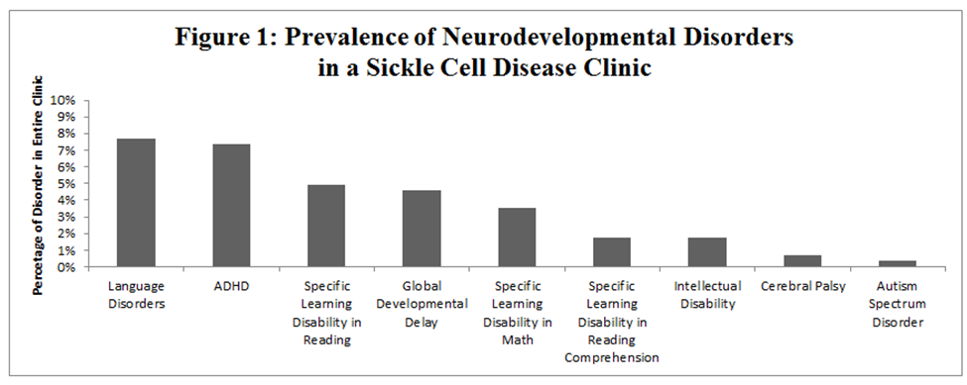
SCD and NDD
Prevalence of Neuro-developmental Disorders in Pediatric Hematology Clinic
Lance EI, et al. Unpublished Data, 2019.
Notes:
Total n approximately 284

Slide 16
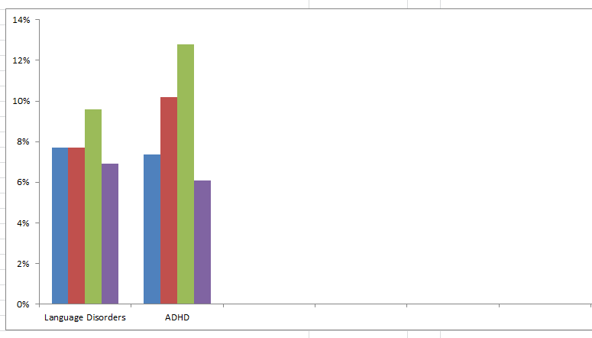
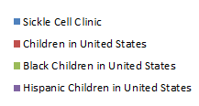
SCD and NDD
Prevalence of Neuro-developmental Disorders in Pediatric Hematology Clinic
Lance EI, et al, 2019. Black, LI, et al. 2015, NIDCH. Xu, Guifeng et al. JAMA Network Open 2018.
Notes:
Neurodevelopmental Diagnoses of Subjects (n = 59)

Slide 17
What is Executive Function?
Credit: Shutterstock

Slide 18
Executive Function Definition Center on the Developing Child – Harvard University
https://developingchild.harvard.edu/resources

Slide 19
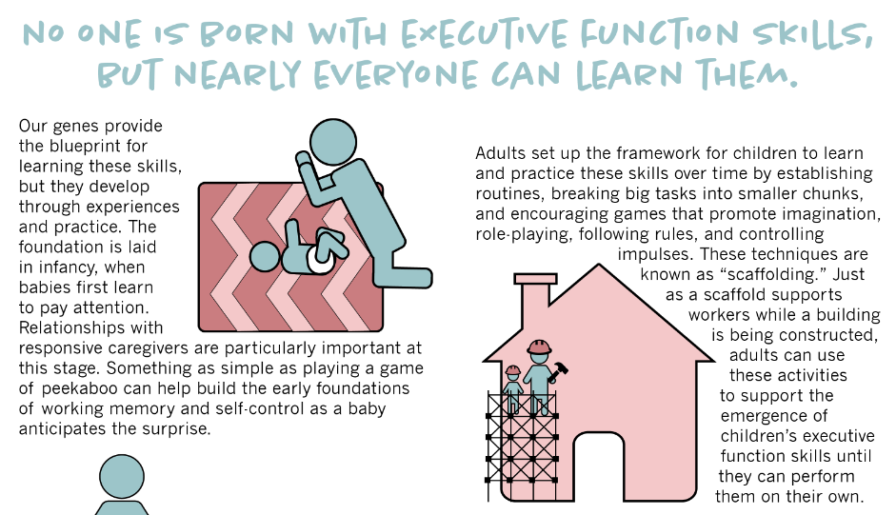
Executive Function Definition Center on the Developing Child – Harvard University
https://developingchild.harvard.edu/resources

Slide 20
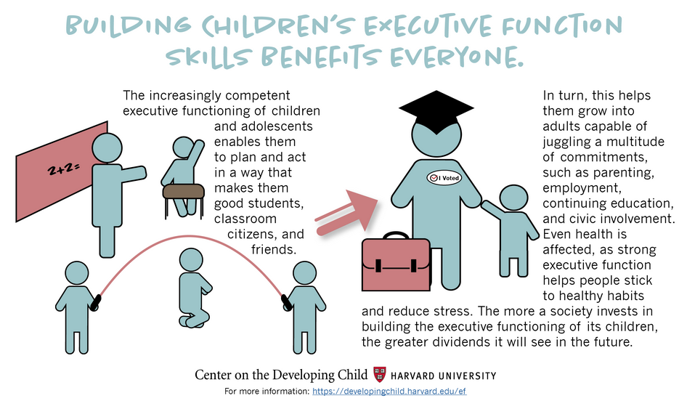
Executive Function Definition Center on the Developing Child – Harvard University
https://developingchild.harvard.edu/resources

Slide 21
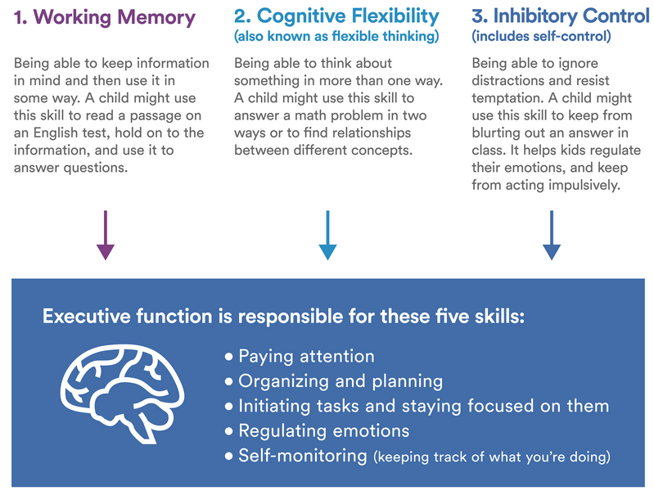
Executive Function Definition Understood.org
https://www.understood.org/en/learning-attention-issues/

Slide 22
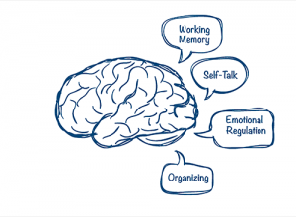
Executive Function Definition CHADD.org
https://chadd.org/about-adhd/executive-function-skills/

Slide 23
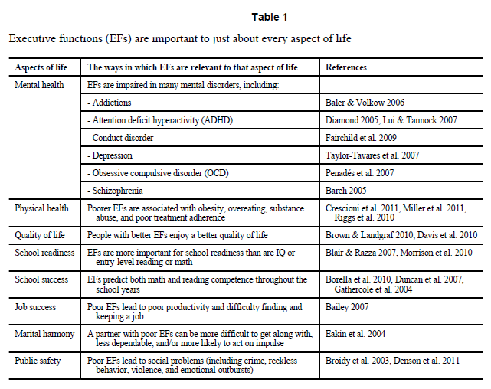
Executive Function Importance
Diamond, Adele. Executive Functions. Annu Rev Psychol. 2013 ; 64: 135–168.

Slide 24
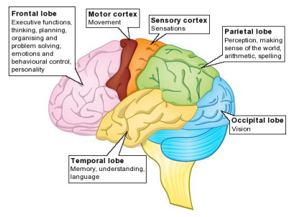
What does Executive Function have to do with sickle cell disease?
Headway.org.uk

Slide 25
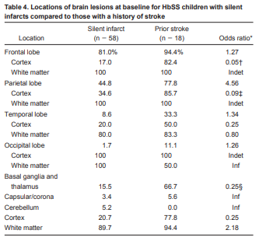
What does Executive Function have to do with sickle cell disease?
Pegelow, Charles et. al. Blood 2002 99:3014-3018.
Notes:
There was considerable scatter in the location of lesions observed in baseline MRI studies (Table 4). Among children with silent infarcts, the majority had lesions involving the frontal lobe (81%), followed by the parietal lobe (45%), the basal ganglia or thalamus (16%), and the temporal lobe (9%). Very few lesions were located in the occipital lobe or cerebellum.

Slide 26
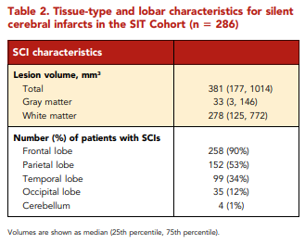
What does Executive Function have to do with sickle cell disease?
Ford AL, et al. Blood. 2018;132(16):1714–1723.
Notes:
Tissue-type and lobar characteristics for silent cerebral infarcts in the SIT Cohort (n = 286)
ilent cerebral infarcts in children with SCA are common, progressive, and associated with cognitive morbidity.^{4⇓⇓⇓-8,31,32} We tested the hypothesis that the majority of SCIs would occur in the border zone region and the highest density of SCIs would occur in the region of lowest cerebral blood flow. In a large cohort of children with SCA and SCIs, we identified that the majority of SCIs were located within a common region in the deep white matter (Figure 2; Table 2). Further, by overlaying cerebral blood flow maps from an independent cohort of children with SCA, we demonstrated cerebral blood flow decreased as infarct density increased (Figure 4). These results are consistent with previous findings of stroke location in SCA showing that both SCIs fall within the white matter of the frontal and parietal lobes, and specifically within the border zone vascular distribution.^{4,18,33} Our findings are unique, in that we show 90% of children have SCIs within a relatively small border zone region, measuring 5.6% of total brain volume, and they occur in the region of low blood flow.

Slide 27
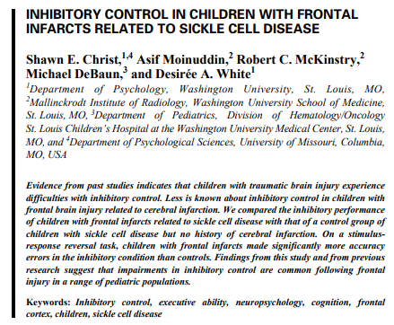
What does Executive Function have to do with sickle cell disease?
Shawn E. Christ,et. al. Child Neuropsychology, 13:2, 132-141
Notes:
Evidence from past studies indicates that children with traumatic brain injury experience difficulties with inhibitory control. Less is known about inhibitory control in children with frontal brain injury related to cerebral infarction. We compared the inhibitory performance of children with frontal infarcts related to sickle cell disease with that of a control group of children with sickle cell disease but no history of cerebral infarction. On a stimulus-response reversal task, children with frontal infarcts made significantly more accuracy errors in the inhibitory condition than controls. Findings from this study and from previous research suggest that impairments in inhibitory control are common following frontal injury in a range of pediatric populations.

Slide 28
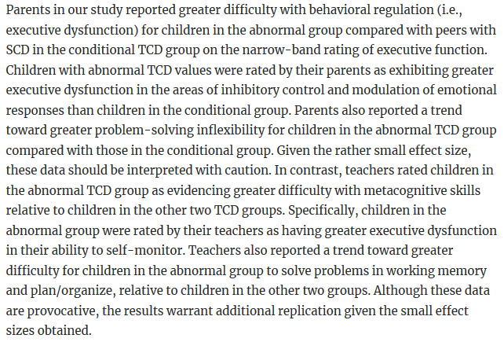
What does Executive Function have to do with sickle cell disease?
Mary C. Kral & Ronald T. Brown. Journal of Pediatric Psychology 2004 Volume 29(3): 185–195
Notes:
Evidence from past studies indicates that children with traumatic brain injury experience difficulties with inhibitory control. Less is known about inhibitory control in children with frontal brain injury related to cerebral infarction. We compared the inhibitory performance of children with frontal infarcts related to sickle cell disease with that of a control group of children with sickle cell disease but no history of cerebral infarction. On a stimulus-response reversal task, children with frontal infarcts made significantly more accuracy errors in the inhibitory condition than controls. Findings from this study and from previous research suggest that impairments in inhibitory control are common following frontal injury in a range of pediatric populations.

Slide 29
Executive Function in Infants with SCD
Researchers measured precursors of executive function in 9 and 12 month old infants with and without sickle cell disease
There were no performance differences between groups
Sickle cell infants showed improvement in tasks between 9 to 12 months
Hogan AM, et. al. J Child Neurol. 2013;28(10):1197–1202.
Notes:
Executive dysfunction occurs in sickle cell anemia, but there are few early data. Infants with sickle cell anemia (n = 14) and controls (n = 14) performed the “A-not-B” and Object Retrieval search tasks, measuring precursors of executive function at 9 and 12 months. Significant group differences were not found. However, for the A-not-B task, 7 of 11 sickle cell anemia infants scored in the lower 2 performance categories at 9 months, but only 1 at 12 months (P = .024); controls obtained scores at 12 months that were statistically comparable to the scores they had already obtained at 9 months. On the Object Retrieval task, 9- and 12-month controls showed comparable scores, whereas infants with sickle cell anemia continued to improve (P = .027); at 9 months, those with lower hemoglobin oxygen saturation passed fewer trials (R _{s} = 0.670, P = .024) and took longer to obtain the toy (R _{s} = –0.664, P = .013). Subtle delays in acquiring developmental skills may underlie abnormal executive function in childhood.

Slide 30
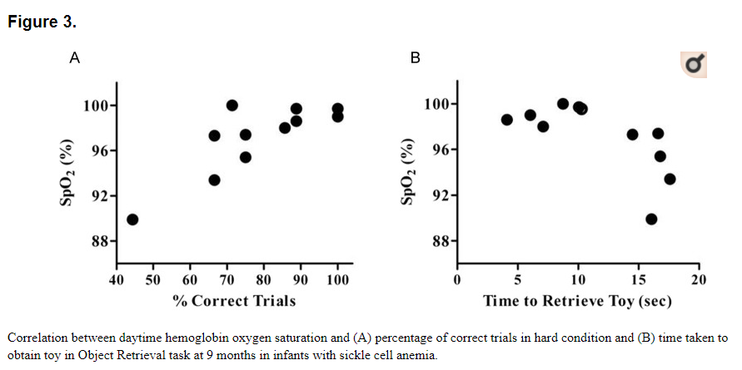
Executive Function in Infants with SCD
Hogan AM, et. al. J Child Neurol. 2013;28(10):1197–1202.
Notes:
Executive dysfunction occurs in sickle cell anemia, but there are few early data. Infants with sickle cell anemia (n = 14) and controls (n = 14) performed the “A-not-B” and Object Retrieval search tasks, measuring precursors of executive function at 9 and 12 months. Significant group differences were not found. However, for the A-not-B task, 7 of 11 sickle cell anemia infants scored in the lower 2 performance categories at 9 months, but only 1 at 12 months (P = .024); controls obtained scores at 12 months that were statistically comparable to the scores they had already obtained at 9 months. On the Object Retrieval task, 9- and 12-month controls showed comparable scores, whereas infants with sickle cell anemia continued to improve (P = .027); at 9 months, those with lower hemoglobin oxygen saturation passed fewer trials (R _{s} = 0.670, P = .024) and took longer to obtain the toy (R _{s} = –0.664, P = .013). Subtle delays in acquiring developmental skills may underlie abnormal executive function in childhood.

Slide 31
Executive Function in Preschool Children with SCD
Two studies by Downes et. al. have looked at EF in preschool children with SCD
Potential deficits in inhibitory control and cognitive flexibility noted in children with SCD
Children with SCD required more support to shift focus and stay on task in comparison to children without SCD
Michelle Downes et. al., Child Neuropsy, 25:2, 278-285; JINS, 24(9), 949-954.
Notes:
Executive deficits are commonly reported in children with sickle cell anemia. Earlier identification of executive deficits would give more scope for intervention, but this cognitive domain has not been routinely investigated due to a lack of age-appropriate tasks normed for preschool children. In particular, information relating to patient performance on an executive task that reflects an everyday activity in the classroom could provide important insight and practical recommendations for the classroom teacher at this key developmental juncture as they enter the academic domain. The performance of 22 children with sickle cell anemia was compared to 24 matched control children on the Preschool Executive Task Assessment. Findings reveal that children with sickle cell anemia are performing poorer than their matched peers on this multi-step assessment. In particular, children with sickle cell anemia required more structured support to shift focus after a completed step, as reflected by poorer scores in the quantitative Sequencing and Completion domains. They also required more support to stay on task, as seen by poorer ratings in the qualitative Distractibility domain. Abbreviations:PETA: Preschool Executive Task Assessment; SCA: Sickle Cell Anemia; EF: Executive Functioning.
Children with sickle cell anemia (SCA) are commonly reported to experience executive dysfunction. However, the development of executive function (EF) in preschool-age children without stroke in this patient population has not been investigated so it is unclear when and how these deficits emerge.
METHODS:
This case-control study examines the feasibility of assessing the early development of executive functioning in 22 preschool children years with SCA in the domains of processing speed, working memory, attention, inhibitory control, and cognitive flexibility, as well as everyday function, in comparison to matched control children.
RESULTS:
A pattern of potential deficits in early emerging executive skills was observed in the domains of inhibitory control and cognitive flexibility. Parents reported no differences for everyday EF and no significant differences were observed for working memory and processing speed.
CONCLUSIONS:
Results suggest that deficits in everyday executive difficulties, working memory, and processing speed, as commonly reported for older children with SCA, may not yet have emerged at this early developmental stage, despite specific deficits in cognitive flexibility and inhibitory control on behavioral measures. The feasibility of using available executive measures with preschool age children to characterize the development of early EF skills is discussed. (JINS, 2018, 24, 949-954).

Slide 32
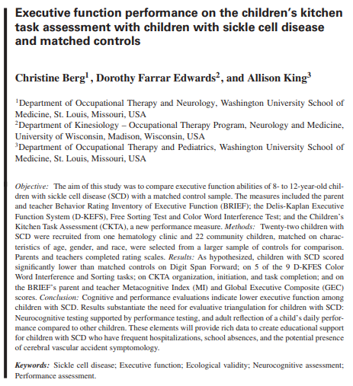
Executive Function in School-Age Children with SCD
Notes:
OBJECTIVE:
The aim of this study was to compare executive function abilities of 8- to 12-year-old children with sickle cell disease (SCD) with a matched control sample. The measures included the parent and teacher Behavior Rating Inventory of Executive Function (BRIEF); the Delis-Kaplan Executive Function System (D-KEFS), Free Sorting Test and Color Word Interference Test; and the Children's Kitchen Task Assessment (CKTA), a new performance measure.
METHODS:
Twenty-two children with SCD were recruited from one hematology clinic and 22 community children, matched on characteristics of age, gender, and race, were selected from a larger sample of controls for comparison. Parents and teachers completed rating scales.
RESULTS:
As hypothesized, children with SCD scored significantly lower than matched controls on Digit Span Forward; on 5 of the 9 D-KFES Color Word Interference and Sorting tasks; on CKTA organization, initiation, and task completion; and on the BRIEF's parent and teacher Metacognitive Index (MI) and Global Executive Composite (GEC) scores.
CONCLUSION:
Cognitive and performance evaluations indicate lower executive function among children with SCD. Results substantiate the need for evaluative triangulation for children with SCD: Neurocognitive testing supported by performance testing, and adult reflection of a child's daily performance compared to other children. These elements will provide rich data to create educational support for children with SCD who have frequent hospitalizations, school absences, and the potential presence of cerebral vascular accident symptomology.

Slide 33
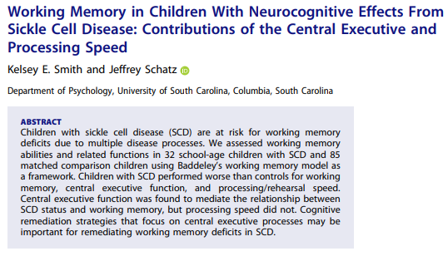
Executive Function in School-Age Children with SCD
Notes:
Children with sickle cell disease (SCD) are at risk for working memory deficits due to multiple disease processes. We assessed working memory abilities and related functions in 32 school-age children with SCD and 85 matched comparison children using Baddeley's working memory model as a framework. Children with SCD performed worse than controls for working memory, central executive function, and processing/rehearsal speed. Central executive function was found to mediate the relationship between SCD status and working memory, but processing speed did not. Cognitive remediation strategies that focus on central executive processes may be important for remediating working memory deficits in SCD.

Slide 34
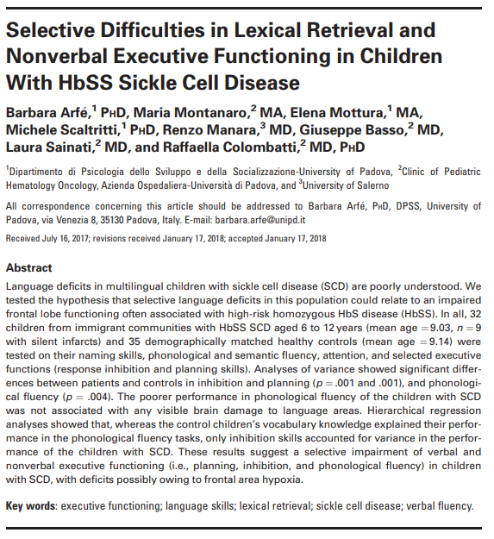
Executive Function in School-Age Children with SCD
Notes:
Language deficits in multilingual children with sickle cell disease (SCD) are poorly understood. We tested the hypothesis that selective language deficits in this population could relate to an impaired frontal lobe functioning often associated with high-risk homozygous HbS disease (HbSS). In all, 32 children from immigrant communities with HbSS SCD aged 6 to 12 years (mean age = 9.03, n = 9 with silent infarcts) and 35 demographically matched healthy controls (mean age = 9.14) were tested on their naming skills, phonological and semantic fluency, attention, and selected executive functions (response inhibition and planning skills). Analyses of variance showed significant differences between patients and controls in inhibition and planning (p = .001 and .001), and phonological fluency (p = .004). The poorer performance in phonological fluency of the children with SCD was not associated with any visible brain damage to language areas. Hierarchical regression analyses showed that, whereas the control children's vocabulary knowledge explained their performance in the phonological fluency tasks, only inhibition skills accounted for variance in the performance of the children with SCD. These results suggest a selective impairment of verbal and nonverbal executive functioning (i.e., planning, inhibition, and phonological fluency) in children with SCD, with deficits possibly owing to frontal area hypoxia.

Slide 35
Executive Function Importance
Diamond, Adele. Executive Functions. Annu Rev Psychol. 2013 ; 64: 135–168.
Notes:
Executive functions (EFs) make possible mentally playing with ideas; taking the time to think before acting; meeting novel, unanticipated challenges; resisting temptations; and staying focused. Core EFs are inhibition [response inhibition (self-control--resisting temptations and resisting acting impulsively) and interference control (selective attention and cognitive inhibition)], working memory, and cognitive flexibility (including creatively thinking "outside the box," seeing anything from different perspectives, and quickly and flexibly adapting to changed circumstances). The developmental progression and representative measures of each are discussed. Controversies are addressed (e.g., the relation between EFs and fluid intelligence, self-regulation, executive attention, and effortful control, and the relation between working memory and inhibition and attention). The importance of social, emotional, and physical health for cognitive health is discussed because stress, lack of sleep, loneliness, or lack of exercise each impair EFs. That EFs are trainable and can be improved with practice is addressed, including diverse methods tried thus far.

Slide 36
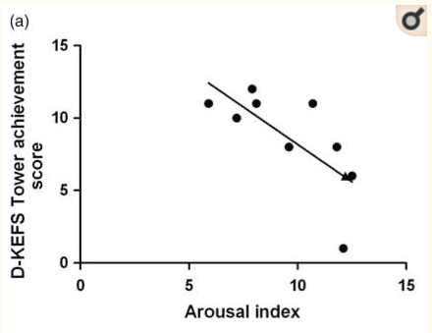
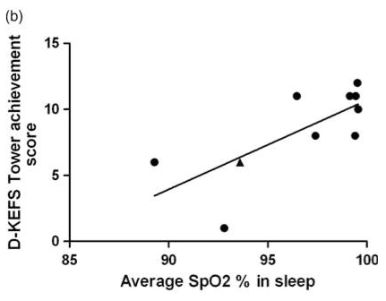
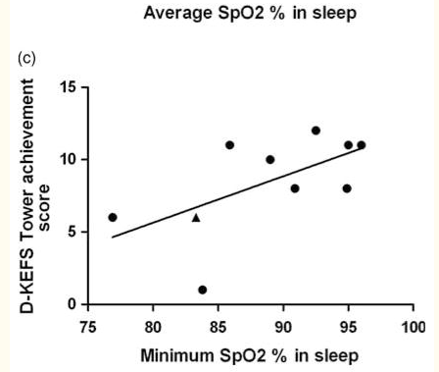
Executive Function Importance in SCD
Aspects of Life |  | Reference
Sleep | Nocturnal hemoglobin oxygen desaturation and increased sleep arousals associated with poorer Executive Function Scores | Hollocks MJ, et al. J Int Neuropsychol Soc. 2012;18(1).
Notes:
Delis-Kaplan Executive Function Systems (D-KEFS)
Executive functioning was assessed using two subtests from the D-KEFS assessment battery (Delis, Kaplan, & Kramer, 2001). The D-KEFS Tower test measures spatial planning, rule learning, and inhibition of impulsive responding. The overall achievement score is based upon the number of correct towers and how many moves taken to complete the tower. The D-KEFS Sorting test measures problem solving, concept formation and conceptual reasoning. Scores for the D-KEFS sorting test are given for the accuracy of sorts and description of sorts.
Previous research has identified cognitive impairment in children with sickle cell anemia (SCA, Hemoglobin SS) compared with controls, partly accounted for by overt neuropathology after clinical stroke, "covert" ("silent") infarction, and severity of anemia. However, cognitive deficits have also been identified in children with SCA with no history of stroke and a normal T2-weighted magnetic resonance imaging (MRI) scan. Our aim was to investigate whether nocturnal hemoglobin oxygen desaturation and sleep fragmentation could be associated with cognitive impairment in children with SCA. We assessed 10 children with SCA (9 with normal MRI) using neuropsychological measures of executive function. Cognitive assessment was immediately followed by overnight polysomnography to record nocturnal hemoglobin oxygen saturation and sleep arousals. Decreases in hemoglobin oxygen saturation and/or increased sleep arousals were associated with reduced performance on cognitive assessment. Nocturnal hemoglobin oxygen desaturation and sleep fragmentation may be a contributing factor to executive dysfunction in SCA.

Slide 37
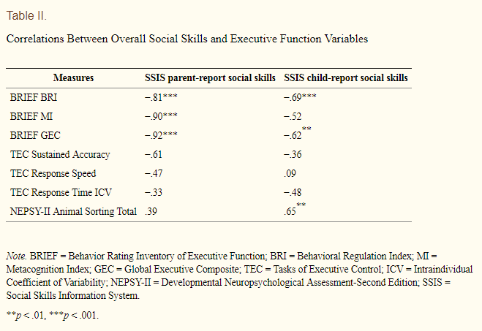
Executive Function Importance in SCD
Aspects of Life |  | Reference
Social Skills | Poorer executive function scores (child and parent report) were associated with poorer social skills (child and parent report) | Hensler M, et al. J Pediatr Psychol. 2014;39(5):493–500.
Notes:
OBJECTIVES:
To explore the relationship between executive function (EF) and social skills in youth with sickle cell disease (SCD).
METHODS:
20 youth with SCD completed objective tests of EF (Tasks of Executive Control; Animal Sorting subtest from the Developmental Neuropsychological Assessment-Second Edition), an IQ screener, and paper-and-pencil measures of social skills (Social Skills Improvement System [SSIS]). Primary caregivers completed paper-and-pencil measures of EF (Behavior Rating Inventory of Executive Function) and social skills (SSIS).
RESULTS:
EF scores from the Behavior Rating Inventory of Executive Function related to parent- and child-reported social skills such that EF deficits correlated with poorer overall and domain-specific social skills. Similarly, EF scores from the Animal Sorting test related to child-reported social skills. Worse parent-reported EF predicted worse parent-reported social skills above the variance accounted for by IQ.
CONCLUSIONS:
EF is related to social skills and may be necessary for successful social interaction among youth with SCD. These results provide rationale and guidance for future larger-scale investigations of EF and social skills among children with SCD.

Slide 38
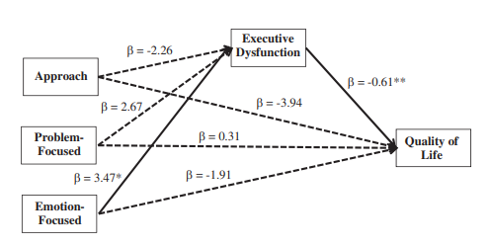
Executive Function Importance in SCD
Aspects of Life |  | Reference
Quality of Life | Pain + Executive Dysfunction + emotion-focused coping (internalizing, catastrophizing, externalizing) predicted poor health related quality of life. | Natasha Ludwig, et. al., Journal of Pediatric Psychology, 2018 (43)10.
 | Executive functioning predicts child and parent reported quality of life in children with sickle cell disease | Taryn M. Allen, et. al. Child Neuropsychology, 23:8, 889-906,
Notes:
The Pain Coping Questionnaire (PCQ) is a 39-item child-report questionnaire that assesses use of various pain coping strategies in children and adolescents between the ages of 8 and 18 (Reid, Gilbert, & McGrath, 1998). For each item, children rate how often they engage in a specific coping behavior on a 5-point scale (0 = never to 4 = very often). The PCQ comprises eight subscales and three higher-order scales: approach (i.e., information-seeking, problem-solving, seeking social support, and positive self-statements), problem-focused avoidance (i.e., behavioral distraction and cognitive distraction), and emotion-focused avoidance (i.e., externalizing and internalizing/catastrophizing).
Sickle cell disease (SCD) is a lifelong condition characterized by pain, which is associated with reduced health-related quality of life (HRQL). Data suggest that patients with SCD vary in how they cope and their neurocognitive abilities. This study aimed to characterize executive functioning and pain coping styles in children with SCD experiencing a range of pain frequency (i.e., chronic, episodic, and asymptomatic) and to examine whether executive functioning mediates the relationship between pain coping and HRQL.
Method:
Participants included 100 children and adolescents with SCD between the ages of 8 and 18 years (M = 13.53, SD = 2.8) and their parents who were recruited during outpatient SCD clinic visits in a children's hospital. Children completed questionnaires related to pain experience and pain coping. Parents completed questionnaires about demographic information, their child's executive functioning, and HRQL.
Results:
Pain intensity, executive dysfunction, and engagement in emotion-focused coping (i.e., internalizing/catastrophizing and externalizing) predicted poor HRQL. In addition, engagement in emotion-focused coping predicted executive dysfunction. Multivariate analysis of covariance revealed executive functioning did not differ based on pain frequency; however, executive functioning was a significant mediator that helped explain the relationships between distraction and emotion-focused coping techniques on HRQL.
Conclusion:
Findings support that executive functioning is an important factor in understanding the relationship between pain coping and HRQL in youth with SCD. Future research is warranted to examine the potential impact of executive functioning on the utility of interventions targeting adaptive pain coping in youth with SCD.

Slide 39
Executive Function Importance in SCD
Kemar V Prussien, et. al., Journal of Pediatric Psychology 2019, 1-11.
Notes:
Objective
To provide a comprehensive quantitative review of neurocognitive function in sickle cell disease (SCD) across multiple domains, cerebral infarct status, and the lifespan.
Methods
One hundred and ten studies were identified in PubMed, MedLine, and PsycINFO involving 110 studies of 3,600 participants with SCD and 1,127 sibling or health controls.
Results
Meta-analytic findings indicate significant deficits across all neurocognitive domains, age groups, and infarct status. Significant deficits relative to the normative mean ranged from Hedges’ g = −.39 to g = −.63 in preschool children, g = −.83 to g = −1.18 in school-aged children and adolescents, and g = −.46 to g = −.86 in adults. Deficits in full scale IQ (FSIQ), verbal reasoning, perceptual reasoning, and executive function increased from preschool to school-aged samples. However, findings also showed that deficits were smaller in adult samples relative to school-aged samples, likely due to sampling bias in adult studies. Findings across infarct status in sickle cell anemia showed that deficits ranged from g = −.54 to g = −.65 in samples without infarcts, g = −.52 to g = −1.03 in samples with silent cerebral infarct, and g = −1.35 to g = −1.82 in samples with stroke. Deficits in each domain increased in magnitude from no infarct or stroke, to silent cerebral infarct, to overt stroke.
Conclusion
Individuals with SCD are at risk for cognitive deficits across domains, infarct status, and the lifespan. More research is necessary to determine unbiased effects for cognitive function in adults with SCD.

Slide 40
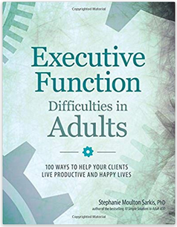
What can I do to help/improve my Executive Function?
Notes:
https://www.ncbi.nlm.nih.gov/pubmed/28192225 – yoga and pain – yoga as EF strategy

Slide 41
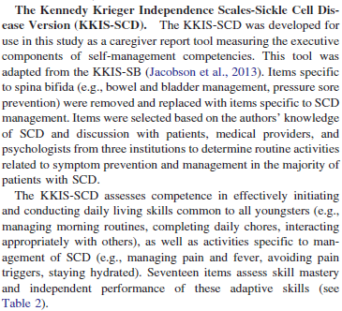
Executive Function Strategies: Diagnosis
Jones, K. E., et. al (2017). Rehabilitation Psychology, 62(3), 249-257.
Notes:
Purpose/Objective: Youth with sickle cell disease (SCD) are at an increased risk for executive dysfunction
and simultaneously have increased self-management needs compared to typical adolescents. This
unique combination may contribute, in part, to difficulties during transition to young adulthood. Current
measures assessing adaptive skills do not assess the executive components (e.g., initiation, prospective
memory) of SCD-related self-care tasks. Modeled on the KKIS-Spina Bifida (Jacobson et al., 2013), the
Kennedy Krieger Independence Scales-Sickle Cell Disease (KKIS-SCD) is a new caregiver-report
measure that assesses independence with self-management of SCD-specific demands as well as routine
daily activities in adolescents with SCD. Research Method/Design: Thirty-three youth with SCD and
their caregivers participated in this preliminary validation study examining the construct validity of the
KKIS-SCD total and composite scores (Initiation of Routines, Prospective Memory) and exploring
relationships of this measure with intellectual functioning, demographic factors, illness severity, and age.
Results: The KKIS-SCD exhibited generally good internal consistency (Cronbach’s alpha .733 to
.803), and demonstrated evidence for construct and discriminant validity when compared to an existing
measure of adaptive function. The KKIS-SCD was significantly associated with caregiver-report of
executive behaviors but not with intellectual functioning, demographic factors, illness severity, or age.
Conclusions/Implications: Results provide preliminary support for the KKIS-SCD as a reliable and valid
tool for the assessment of executive components of self-care management skills for youth with SCD.
Identifying specific weaknesses in executive function related to self-care management skills might assist
in guiding intervention and individualizing transition planning in these at-risk youth.

Slide 42
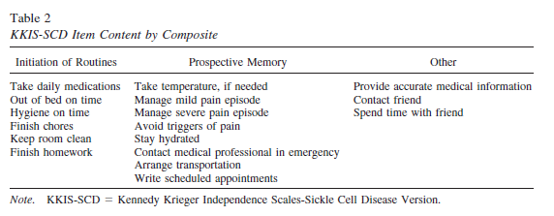
Executive Function Strategies: Diagnosis
Jones, K. E., et. al (2017). Rehabilitation Psychology, 62(3), 249-257.
Notes:
Purpose/Objective: Youth with sickle cell disease (SCD) are at an increased risk for executive dysfunction
and simultaneously have increased self-management needs compared to typical adolescents. This
unique combination may contribute, in part, to difficulties during transition to young adulthood. Current
measures assessing adaptive skills do not assess the executive components (e.g., initiation, prospective
memory) of SCD-related self-care tasks. Modeled on the KKIS-Spina Bifida (Jacobson et al., 2013), the
Kennedy Krieger Independence Scales-Sickle Cell Disease (KKIS-SCD) is a new caregiver-report
measure that assesses independence with self-management of SCD-specific demands as well as routine
daily activities in adolescents with SCD. Research Method/Design: Thirty-three youth with SCD and
their caregivers participated in this preliminary validation study examining the construct validity of the
KKIS-SCD total and composite scores (Initiation of Routines, Prospective Memory) and exploring
relationships of this measure with intellectual functioning, demographic factors, illness severity, and age.
Results: The KKIS-SCD exhibited generally good internal consistency (Cronbach’s alpha .733 to
.803), and demonstrated evidence for construct and discriminant validity when compared to an existing
measure of adaptive function. The KKIS-SCD was significantly associated with caregiver-report of
executive behaviors but not with intellectual functioning, demographic factors, illness severity, or age.
Conclusions/Implications: Results provide preliminary support for the KKIS-SCD as a reliable and valid
tool for the assessment of executive components of self-care management skills for youth with SCD.
Identifying specific weaknesses in executive function related to self-care management skills might assist
in guiding intervention and individualizing transition planning in these at-risk youth.

Slide 43
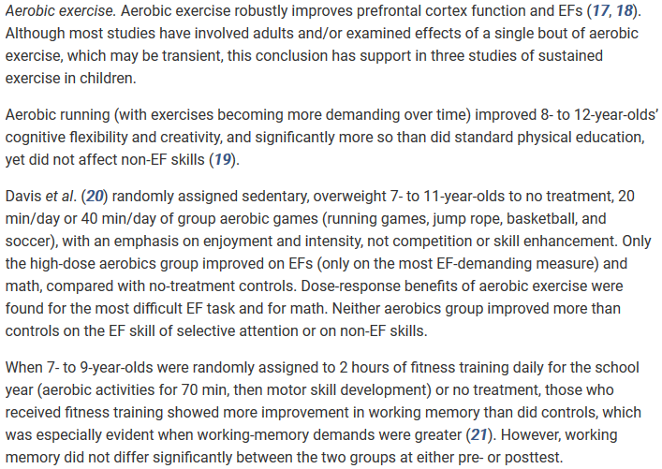
Executive Function Strategies: Exercise - Aerobic
Diamond, A. & Lee, K. (2011). Science 333(6045): 959-964.
Notes:
The NIH Toolbox Cognition Module is a standardized cognitive battery comprising seven tests that are validated and normed based on age and maternal education.
Individuals with sickle cell disease (SCD) experience cognitive deficits; however, it remains unclear whether medical treatments for SCD improve cognition. Given that executive abilities are typically impaired in individuals with SCD, they were the focus of the current study. Our primary hypothesis was that executive abilities would be higher acutely soon after a blood transfusion in children and young adults with SCD. We used tests from the NIH Toolbox to assess executive abilities in 27 participants with SCD receiving chronic transfusion in comparison to 34 participants with SCD receiving hydroxyurea (HU) and 41 non‐SCD demographically matched controls, all of whom were tested at two time points. Participants in the transfusion group completed cognitive testing within 3 days after a transfusion (soon after transfusion) and then within 3 days before their next transfusion (long after transfusion) over an interval of 3‐7 weeks. We found that executive abilities were significantly poorer for the transfusion and HU groups than for the control group. In support of our primary hypothesis, executive abilities for the transfusion group were significantly better soon after a transfusion compared to long after a transfusion, χ²(1) = 17.8, P < .0001. Our results demonstrate that executive abilities were higher acutely following a blood transfusion. These findings have implications for daily functioning, medical decision making, and academic achievement in children and young adults with SCD.
For theoretical purposes and to increase statistical power, we categorized tests of the NIH Toolbox as executive (Dimensional Change Card Sort Test, Flanker Inhibitory Control and Attention Test, and List Sorting Test) and nonexecutive abilities (Picture Vocabulary Test, Oral Reading Recognition Test, and Picture Sequence Memory Test). The NIH Toolbox provides similar composites (eg, Fluid and Crystalized). However, the Fluid composite contains the Pattern Comparison Test, which measures processing speed. Processing speed is not an executive skill. Therefore, we did not include it in our executive abilities composite, but instead assessed it separately.

Slide 44
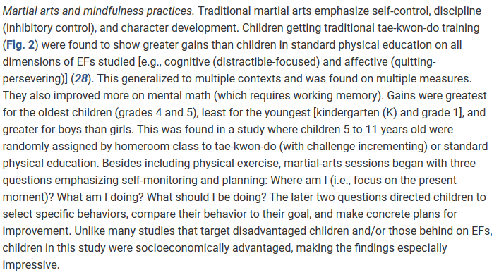
Executive Function Strategies: Exercise – Martial Arts
Diamond, A. & Lee, K. (2011). Science 333(6045): 959-964.
Notes:
The NIH Toolbox Cognition Module is a standardized cognitive battery comprising seven tests that are validated and normed based on age and maternal education.
Individuals with sickle cell disease (SCD) experience cognitive deficits; however, it remains unclear whether medical treatments for SCD improve cognition. Given that executive abilities are typically impaired in individuals with SCD, they were the focus of the current study. Our primary hypothesis was that executive abilities would be higher acutely soon after a blood transfusion in children and young adults with SCD. We used tests from the NIH Toolbox to assess executive abilities in 27 participants with SCD receiving chronic transfusion in comparison to 34 participants with SCD receiving hydroxyurea (HU) and 41 non‐SCD demographically matched controls, all of whom were tested at two time points. Participants in the transfusion group completed cognitive testing within 3 days after a transfusion (soon after transfusion) and then within 3 days before their next transfusion (long after transfusion) over an interval of 3‐7 weeks. We found that executive abilities were significantly poorer for the transfusion and HU groups than for the control group. In support of our primary hypothesis, executive abilities for the transfusion group were significantly better soon after a transfusion compared to long after a transfusion, χ²(1) = 17.8, P < .0001. Our results demonstrate that executive abilities were higher acutely following a blood transfusion. These findings have implications for daily functioning, medical decision making, and academic achievement in children and young adults with SCD.
For theoretical purposes and to increase statistical power, we categorized tests of the NIH Toolbox as executive (Dimensional Change Card Sort Test, Flanker Inhibitory Control and Attention Test, and List Sorting Test) and nonexecutive abilities (Picture Vocabulary Test, Oral Reading Recognition Test, and Picture Sequence Memory Test). The NIH Toolbox provides similar composites (eg, Fluid and Crystalized). However, the Fluid composite contains the Pattern Comparison Test, which measures processing speed. Processing speed is not an executive skill. Therefore, we did not include it in our executive abilities composite, but instead assessed it separately.

Slide 45
Executive Function Strategies: Exercise – Yoga
Diamond, A. & Lee, K. (2011). Science 333(6045): 959-964.
Notes:
AbstractContext.Sickle cell disease (SCD) vaso-occlusive crisis (VOC) remains an important cause of acute pain in pediatrics andthe most common SCD complication. Pain management recommendations in SCD include nonpharmacologicalinterventions. Yoga is one nonpharmacological intervention that has been shown to reduce pain in some populations;however, evidence is lacking in children with VOC.Objectives.The primary objective of this study was to compare the effect of yoga vs. an attention control on pain inchildren with VOC. The secondary objectives were to compare the effect of yoga vs. an attention control on anxiety, lengths ofstay, and opioid use in this population.Methods.Patients were eligible if they had a diagnosis of SCD, were 5e21 years old, were hospitalized for uncomplicatedVOC, and had an admission pain score of$7. Subjects were stratified based on disease severity and randomized to the yoga orcontrol group.Results.Eighty-three percent of patients approached (N¼73) enrolled on study. There were no significant differences inbaseline clinical or demographic factors between groups. Compared with the control group, children randomized to yoga hada significantly greater reduction in mean pain score after one yoga session (0.60.96 vs. 0.01.37;P¼0.029). There wereno significant differences in anxiety, lengths of stay, or opioid use between the two groups.Conclusion.This study provides evidence that yoga is an acceptable, feasible, and helpful intervention for hospitalizedchildren with VOC. Future research should further examine yoga for children with SCD pain in the inpatient and outpatientsettings. J Pain Symptom Manage 2017;53:1026e1034.Ó2017 American Academy of Hospice and Palliative Medicine. Published byElsevier Inc. All rights reserved.

Slide 46
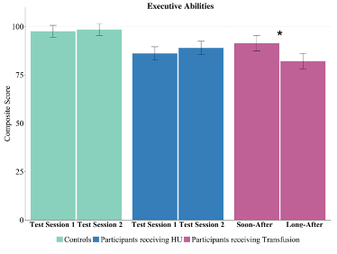
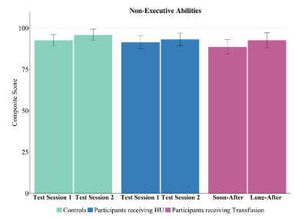
Executive Function Strategies: Transfusions
Hood, Anna M. et. al. (2019). Pediatric Blood and Cancer , online first 03 July 2019
Notes:
The NIH Toolbox Cognition Module is a standardized cognitive battery comprising seven tests that are validated and normed based on age and maternal education.
Individuals with sickle cell disease (SCD) experience cognitive deficits; however, it remains unclear whether medical treatments for SCD improve cognition. Given that executive abilities are typically impaired in individuals with SCD, they were the focus of the current study. Our primary hypothesis was that executive abilities would be higher acutely soon after a blood transfusion in children and young adults with SCD. We used tests from the NIH Toolbox to assess executive abilities in 27 participants with SCD receiving chronic transfusion in comparison to 34 participants with SCD receiving hydroxyurea (HU) and 41 non‐SCD demographically matched controls, all of whom were tested at two time points. Participants in the transfusion group completed cognitive testing within 3 days after a transfusion (soon after transfusion) and then within 3 days before their next transfusion (long after transfusion) over an interval of 3‐7 weeks. We found that executive abilities were significantly poorer for the transfusion and HU groups than for the control group. In support of our primary hypothesis, executive abilities for the transfusion group were significantly better soon after a transfusion compared to long after a transfusion, χ²(1) = 17.8, P < .0001. Our results demonstrate that executive abilities were higher acutely following a blood transfusion. These findings have implications for daily functioning, medical decision making, and academic achievement in children and young adults with SCD.
For theoretical purposes and to increase statistical power, we categorized tests of the NIH Toolbox as executive (Dimensional Change Card Sort Test, Flanker Inhibitory Control and Attention Test, and List Sorting Test) and nonexecutive abilities (Picture Vocabulary Test, Oral Reading Recognition Test, and Picture Sequence Memory Test). The NIH Toolbox provides similar composites (eg, Fluid and Crystalized). However, the Fluid composite contains the Pattern Comparison Test, which measures processing speed. Processing speed is not an executive skill. Therefore, we did not include it in our executive abilities composite, but instead assessed it separately.

Slide 47
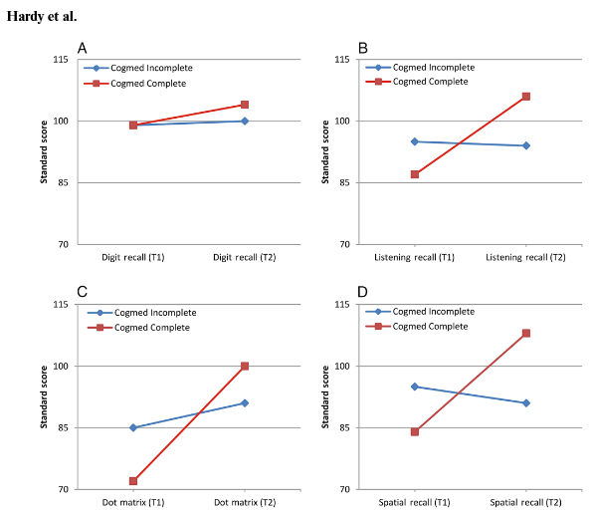
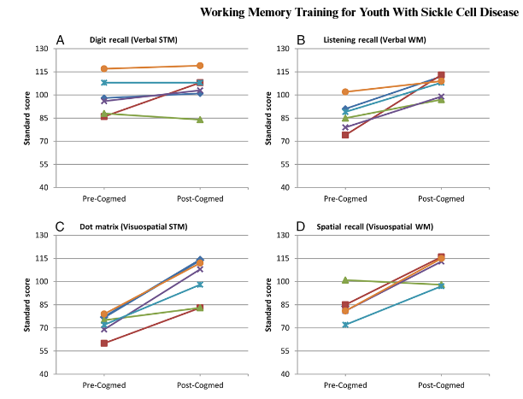
Executive Function Strategies: Computer Training
Hardy, Steven J et. al. (2016). Pediatric Blood and Cancer 63(9): 1578-85.
Notes:
Background
Children with sickle cell disease (SCD) are at increased risk for neurocognitive deficits, yet the literature describing interventions to ameliorate these problems and promote academic achievement is limited. We evaluated the feasibility and preliminary efficacy of a home‐based computerized working memory (WM) training intervention (Cogmed) in children with SCD.
Procedure
Youth with SCD between the age of 7 and 16 years completed an initial neuropsychological assessment; those with WM deficits were loaned an iPad on which they accessed Cogmed at home. Participants were instructed to work on Cogmed 5 days each week for 5 weeks (25 training sessions). We examined Cogmed usage characteristics and change on WM assessment scores following the intervention.
Results
Of the 21 participants (M age = 11.38, SD = 2.78; Mdn age = 10.00, interquartile range [IQR] = 5.00; 52% female) screened, 60% exhibited WM deficits (n = 12) and received the intervention and 50% (n = 6) completed Cogmed. The mean number of sessions completed was 15.83 (SD = 7.73; Mdn = 17.00, IQR = 16.00); females were more likely to complete Cogmed, χ²(1) = 6.00, P = 0.01. Participants who reported lower SCD‐related pain impact completed more sessions (r = 0.71, P = 0.01). Children who completed Cogmed exhibited improvements in verbal WM, visuospatial short‐term memory, and visuospatial WM.
Conclusions
Initial findings suggest Cogmed is associated with WM improvement in youth with SCD; however, adherence was lower than expected. Home‐based WM interventions may ameliorate SCD‐related WM deficits but strategies are needed to address barriers to program completion.

Slide 48
Executive Function Strategies: Computer Training
CogMed© Computerized training
Computerized and interactive games
Task switching computerized training
Continually increase demands
Limited transfer of skills to global tasks
Repeated practice is key
Diamond, Adele. Executive Functions. Annu Rev Psychol. 2013 ; 64: 135–168.
Notes:
Purpose/Objective: Youth with sickle cell disease (SCD) are at an increased risk for executive dysfunction
and simultaneously have increased self-management needs compared to typical adolescents. This
unique combination may contribute, in part, to difficulties during transition to young adulthood. Current
measures assessing adaptive skills do not assess the executive components (e.g., initiation, prospective
memory) of SCD-related self-care tasks. Modeled on the KKIS-Spina Bifida (Jacobson et al., 2013), the
Kennedy Krieger Independence Scales-Sickle Cell Disease (KKIS-SCD) is a new caregiver-report
measure that assesses independence with self-management of SCD-specific demands as well as routine
daily activities in adolescents with SCD. Research Method/Design: Thirty-three youth with SCD and
their caregivers participated in this preliminary validation study examining the construct validity of the
KKIS-SCD total and composite scores (Initiation of Routines, Prospective Memory) and exploring
relationships of this measure with intellectual functioning, demographic factors, illness severity, and age.
Results: The KKIS-SCD exhibited generally good internal consistency (Cronbach’s alpha .733 to
.803), and demonstrated evidence for construct and discriminant validity when compared to an existing
measure of adaptive function. The KKIS-SCD was significantly associated with caregiver-report of
executive behaviors but not with intellectual functioning, demographic factors, illness severity, or age.
Conclusions/Implications: Results provide preliminary support for the KKIS-SCD as a reliable and valid
tool for the assessment of executive components of self-care management skills for youth with SCD.
Identifying specific weaknesses in executive function related to self-care management skills might assist
in guiding intervention and individualizing transition planning in these at-risk youth.

Slide 49
Executive Function Strategies: School
Minimize distractions
Provide consistency and structure
Allow regular breaks from structured activity
Provide prompts as needed to redirect
Providing gentle corrective feedback
Subtle prompts
Ensure that you have child's attention before giving instructions
Make sure child understands instructions/expectations
Prompt child to their work before turning it in
Notes:
Recommendations to support attention and executive functioning in the classroom include the following:
Minimize distractions to the greatest extent possible (e.g., seating @FNAME@ at the front of the class, increased one-to-one contact with the teacher, small group instruction). This accommodation should not be limited to testing settings.
Provide consistency and structure through the use of daily schedules, standard seating arrangements, and clearly defined classroom expectations, rules, and consequences.
Allow regular breaks from structured activity. This should include movement breaks when @FNAME@ can leave @HIS@ seat for appropriate/approved activities .
Taking away recess should be avoided whenever possible because @FNAME@ very much needs this break from structured activity and opportunities for movement.
Provide prompts as needed to redirect @FNAME@ back to tasks if @HE@ appears distracted.
Providing gentle corrective feedback, particularly when the desired behavior is clearly stated (e.g., "You were listening really well before. I need you to listen now so we can finish one more thing.") will be far more successful in encouraging compliance and supporting @FNAME@'s self-esteem.
Subtle prompts (e.g., tapping @HIS@ desk, a whisper, pointing to the next item) are strongly preferable over more overt or punitive prompts (e.g., calling @HIS@ name from several feet away).
The following classroom supports/accommodations are recommended to address language and impulsivity.
Ensure that you have @FNAME@'s attention before giving instructions. It may be useful to remove stimuli/worksheets from view or place them out of reach to ensure you have @HIS@ full attention.
Make sure @HE@ understands instructions/expectations before allowing @HIM@ to begin independent work. Have @HIM@ complete a practice item while you are still monitoring @HIM@.
Teachers should prompt @FNAME@ to check @HIS@ work before turning it in as @HE@ frequently makes careless errors.
Even with supports/accommodations, @FNAME@ may be inconsistent in @HIS@ demonstration of skills. Teachers are encouraged to assess @HIS@ skills in multiple ways (e.g., open ended questions, multiple choice, matching, demonstration) to best determine @HIS@ progress and areas of need.

Slide 50
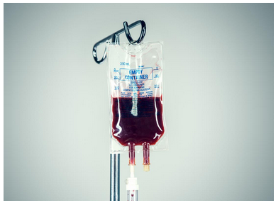
Executive Function Strategies
Notes:
Background
Children with sickle cell disease (SCD) are at increased risk for neurocognitive deficits, yet the literature describing interventions to ameliorate these problems and promote academic achievement is limited. We evaluated the feasibility and preliminary efficacy of a home‐based computerized working memory (WM) training intervention (Cogmed) in children with SCD.
Procedure
Youth with SCD between the age of 7 and 16 years completed an initial neuropsychological assessment; those with WM deficits were loaned an iPad on which they accessed Cogmed at home. Participants were instructed to work on Cogmed 5 days each week for 5 weeks (25 training sessions). We examined Cogmed usage characteristics and change on WM assessment scores following the intervention.
Results
Of the 21 participants (M age = 11.38, SD = 2.78; Mdn age = 10.00, interquartile range [IQR] = 5.00; 52% female) screened, 60% exhibited WM deficits (n = 12) and received the intervention and 50% (n = 6) completed Cogmed. The mean number of sessions completed was 15.83 (SD = 7.73; Mdn = 17.00, IQR = 16.00); females were more likely to complete Cogmed, χ²(1) = 6.00, P = 0.01. Participants who reported lower SCD‐related pain impact completed more sessions (r = 0.71, P = 0.01). Children who completed Cogmed exhibited improvements in verbal WM, visuospatial short‐term memory, and visuospatial WM.
Conclusions
Initial findings suggest Cogmed is associated with WM improvement in youth with SCD; however, adherence was lower than expected. Home‐based WM interventions may ameliorate SCD‐related WM deficits but strategies are needed to address barriers to program completion.

Slide 51
…with Gratitude, Respect, and Appreciation for our sickle cell patients and their families who inspired this research and participate in our clinical research program…

Slide 52
Objectives
Identify common forms of brain injury in sickle cell disease
Define executive function and identify importance in general pediatric and adult development
Identify impact of sickle cell disease on executive function
Identify common strategies to improve executive function

Slide 53
Acknowledgements
Multi-disciplinary mentorship team:
Hematology: James Casella, Emily Barron-Casella
Neurology/Development: Michael Johnston, Bruce Shapiro
Neuroradiology: Susumu Mori
Collaborators:
Alicia Cannon – SCD NDD Clinic Neuropsychology Director
Keith Slifer – KKI Behavioral Psychology
Bridget Gibbons
Hanzhung Lu – Hopkins Neuroradiology
Funding:
NHLBI K23 HL133455-01A1 Lance (PI)
KKI Innovation Grant Lance (PI)
NICHD U54 HD079123 Mahone (PI)

