Slide 1
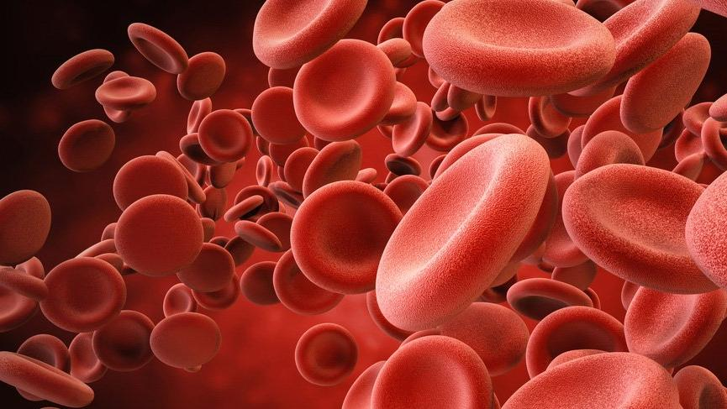
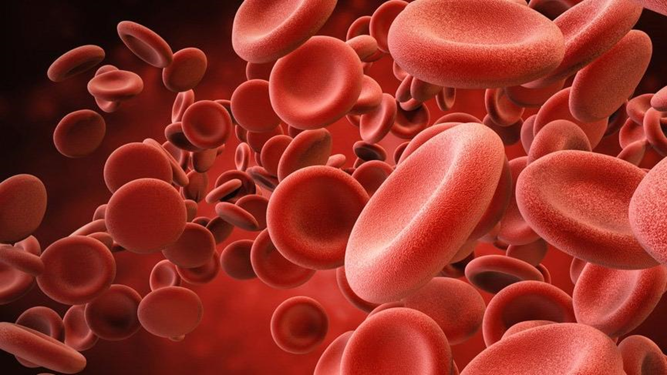
KIDNEY INVOLVEMENT IN SICKLE CELL DISEASE
Edgar V. Lerma, MD, FACP, FASN, FPSN (Hon)
Clinical Professor of Medicine
UIC/ Advocate Christ Medical Center
Oak Lawn, IL
7 September 2019

Slide 2
KIDNEY INVOLVEMENT IN SICKLE CELL DISEASE
Edgar V. Lerma, MD, FACP, FASN, FPSN (Hon)
Clinical Professor of Medicine
UIC/ Advocate Christ Medical Center
Oak Lawn, IL
7 September 2019

Slide 3
KIDNEY INVOLVEMENT IN SICKLE CELL DISEASE
Edgar V. Lerma, MD, FACP, FASN, FPSN (Hon)
Clinical Professor of Medicine
UIC/ Advocate Christ Medical Center
Oak Lawn, IL
7 September 2019

Slide 4
DISCLOSURE
Honoraria: UpToDate, McGraw-Hill Publishing, Elsevier Publishing, Springer Publishing, Wolters-Kluwer Publishing, Emedicine
Editorial Boards: American Journal of Kidney Diseases, American Journal of Nephrology, ASN Kidney News, Clinical Journal of the American Society of Nephrology, Clinical Reviews in Bone and Mineral Metabolism, International Urology and Nephrology, Journal of Clinical Lipidology, Journal of Vascular Access, Nephron, Prescribers Letter, Renal and Urology News, Reviews in Endocrinology and Metabolic Disorders
Advisory Board: Astra Zeneca

Slide 5
Disclosure of ABIM Service: Edgar V. Lerma, M.D.
I am a current member of the ABIM Nephrology Item-Writing Task Force.
To protect the integrity of certification, ABIM enforces strict confidentiality and ownership of exam content.
My participation in this CME activity is allowed under ABIM policy and is subject to the following:
As a member of an ABIM test committee, I agreed to keep exam information confidential, as it is owned exclusively by ABIM.
As is true for any ABIM candidate who has taken an exam for certification, I have signed the Pledge of Honesty in which I have agreed not to share ABIM exam content with others.
Therefore no exam content will be disclosed in my presentation.
ABIM does not endorse or authorize any board preparation programs.
Notes:
5

Slide 6
OBJECTIVES
To learn about the epidemiology of sickle cell nephropathy
To understand the mechanisms by which sickle cell disease affects kidney function
To learn about the renal manifestations of sickle cell disease and their various presentations
To discuss current available preventive and treatment strategies in dealing with sickle cell nephropathy

Slide 7
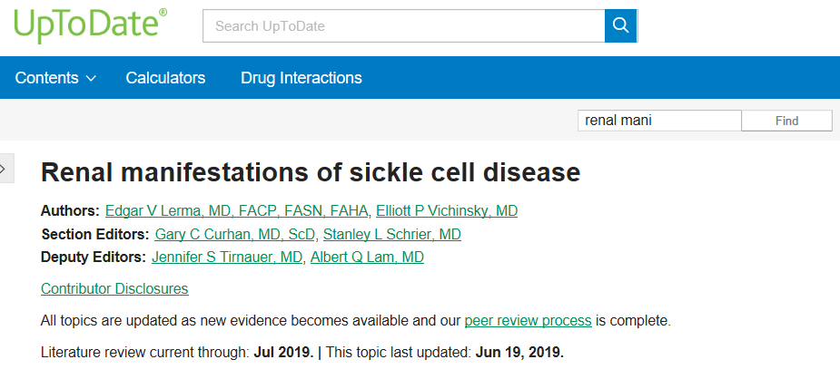

Slide 8
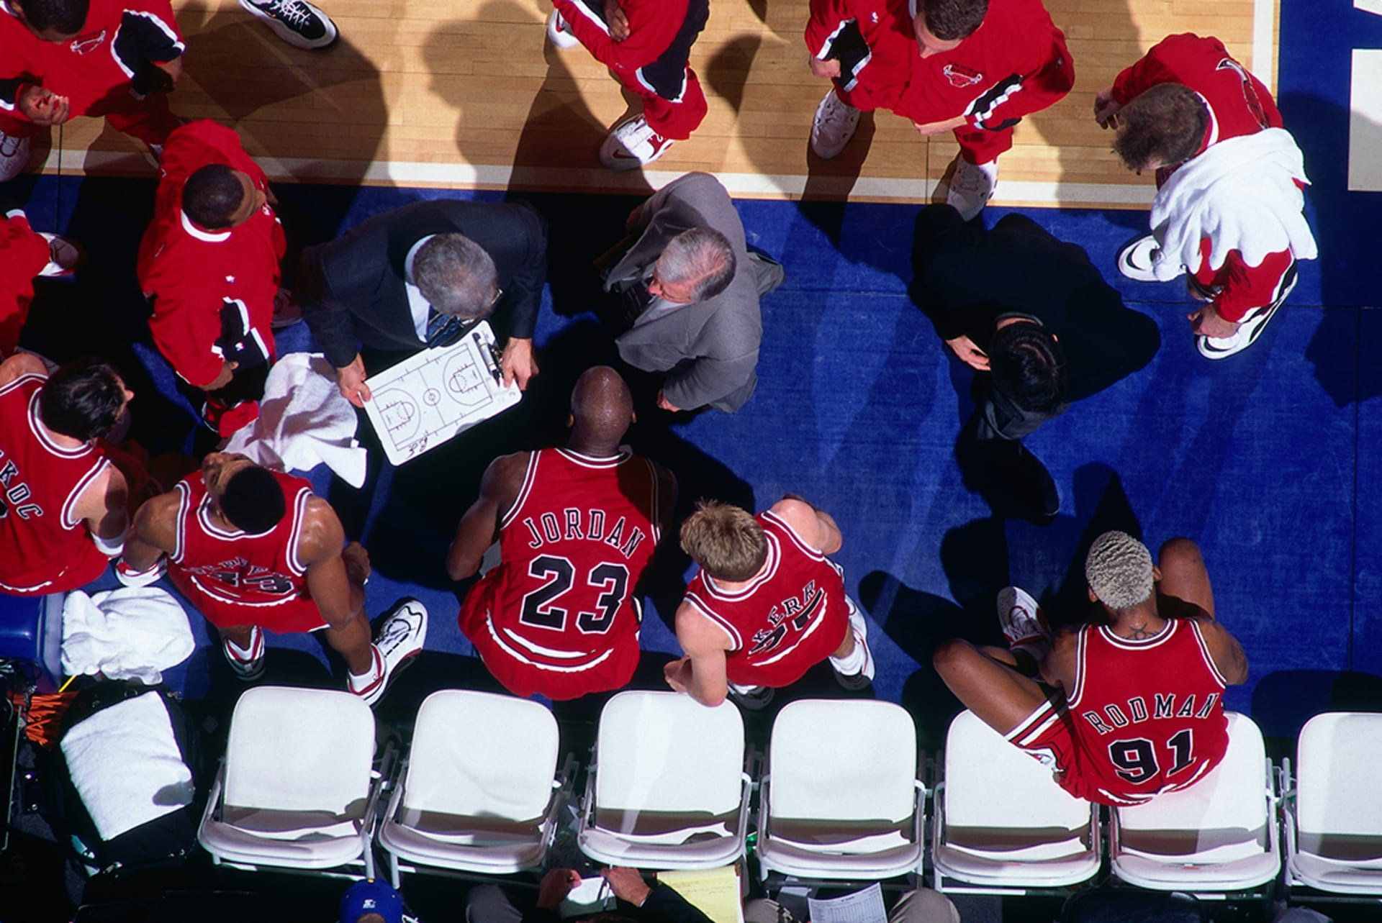
OUTLINE
Epidemiology
Pathogenesis
Clinical Presentation
Prevention
Treatment

Slide 9
EPIDEMIOLOGY

Slide 10
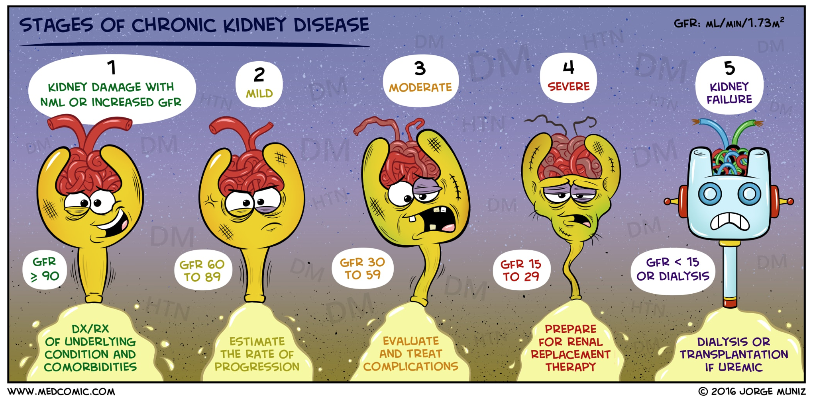

Slide 11
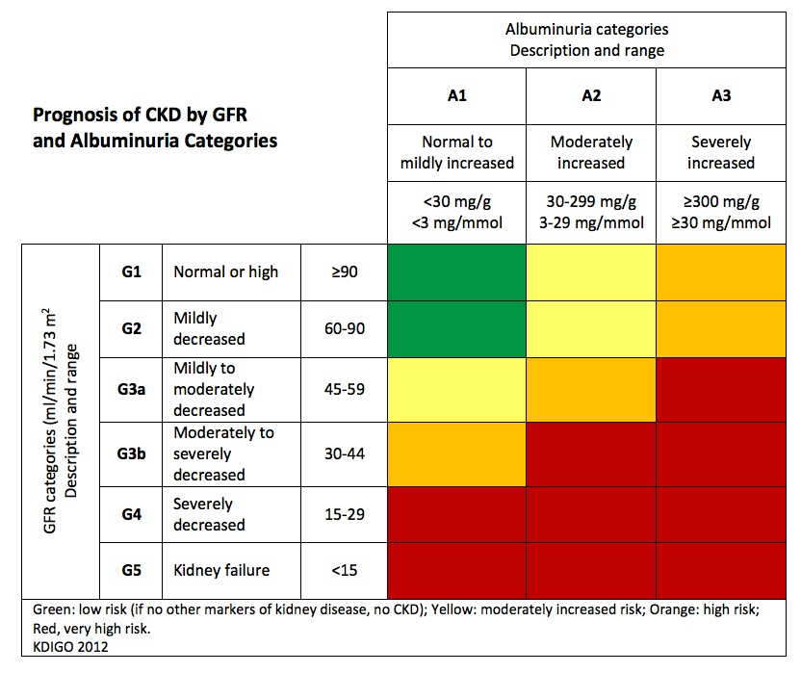

Slide 12
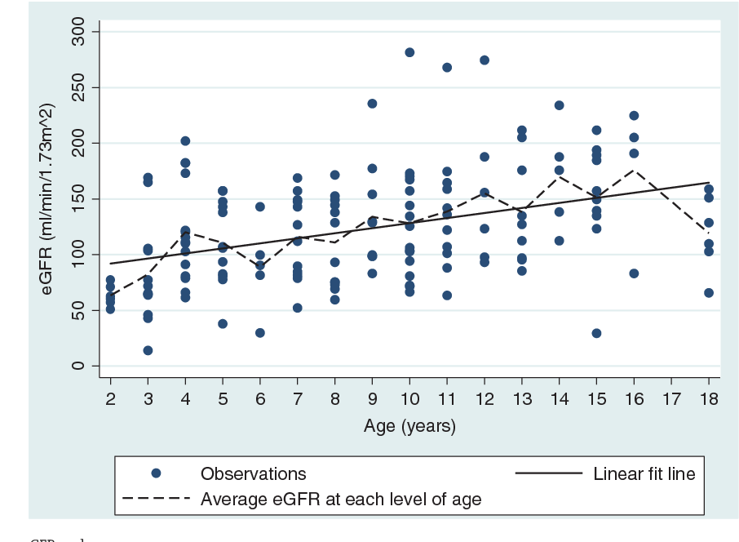
PREVALENCE
The prevalence of microalbuminuria is approximately 60% in those over 45 years, but only 4% to 12% of patients with SCD develop end-stage kidney disease (ESKD), though this figure may increase as the patient cohort ages.

Slide 13
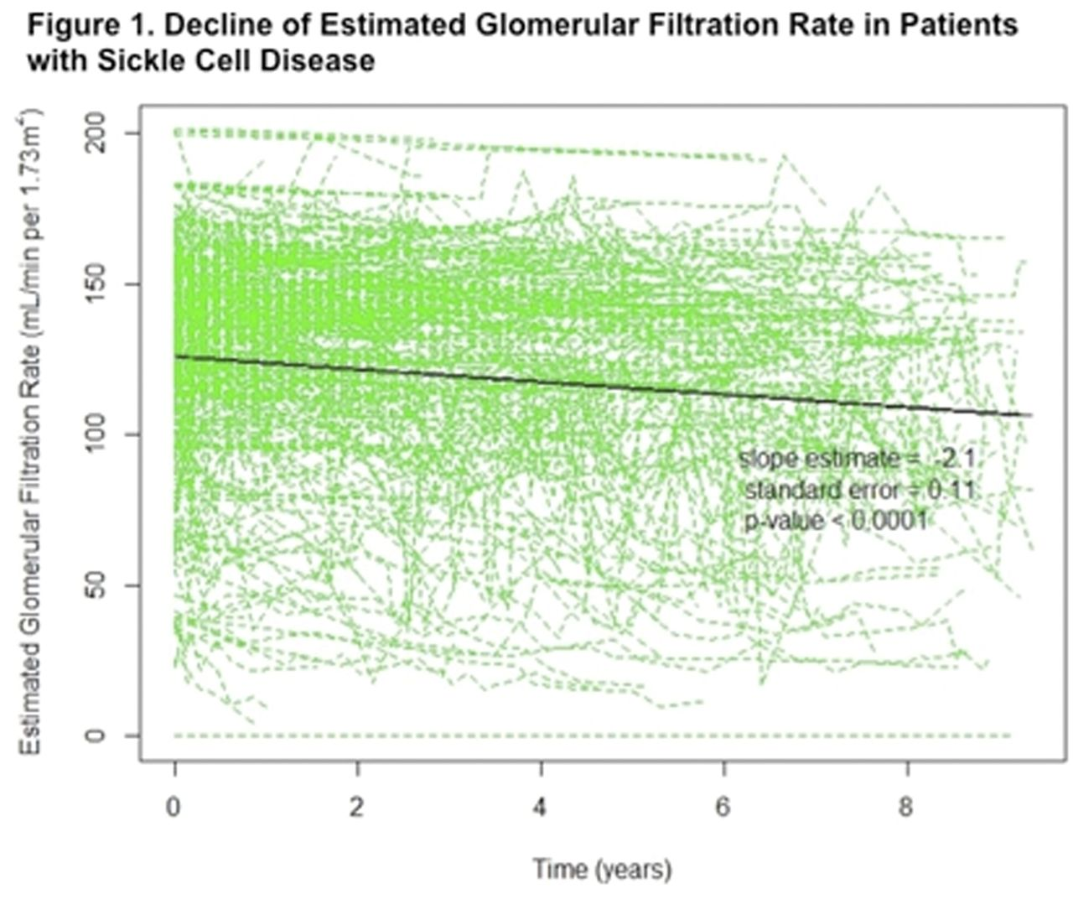
PREVALENCE
In 2008, advanced CKD was reported in 24% of patients with SCD who had survived to 60 years of age or more and was the cause of death in 45%.

Slide 14
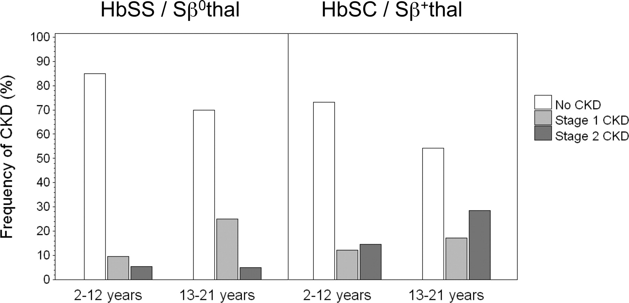
PREVALENCE
In general, SCN is more prevalent and more severe in those with HbSS- and HbSβ⁰-thalassemia than in those with milder forms of SCD such as HbSC.

Slide 15
PATHOGENESIS

Slide 16
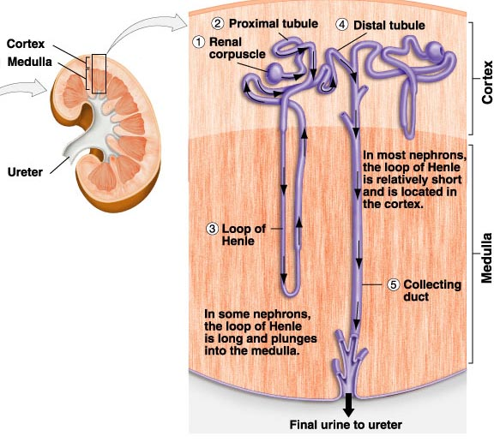
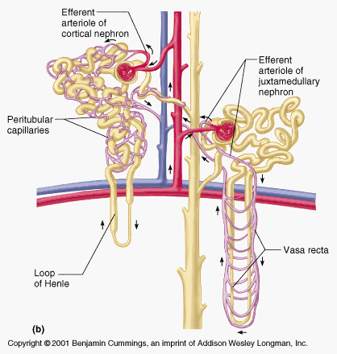
Notes:
The relative hypoxia (partial pressure of O₂: 10-35 mm Hg, acidosis and hyperosmolarity of the inner medulla make it an ideal environment for the polymerization of deoxygenated Hgb S and subsequent sickling of RBCs

Slide 17
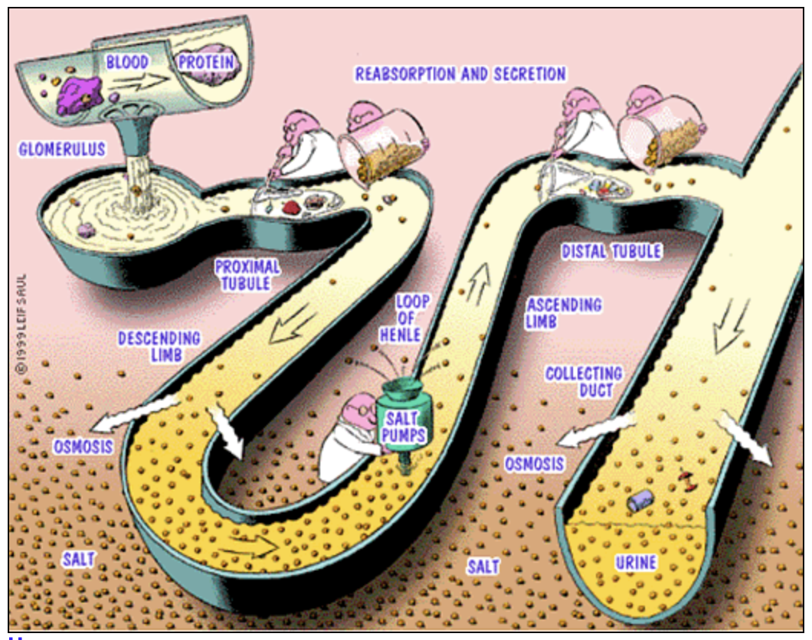

Slide 18
Low O2 tension
Hypertonic
Acidic
Notes:
The relative hypoxia (partial pressure of O₂: 10-35 mm Hg, acidosis and hyperosmolarity of the inner medulla make it an ideal environment for the polymerization of deoxygenated Hgb S and subsequent sickling of RBCs

Slide 19
Blood viscosity
Microthrombi formation
Ischemic necrosis
Notes:
The relative hypoxia (partial pressure of O₂: 10-35 mm Hg, acidosis and hyperosmolarity of the inner medulla make it an ideal environment for the polymerization of deoxygenated Hgb S and subsequent sickling of RBCs

Slide 20
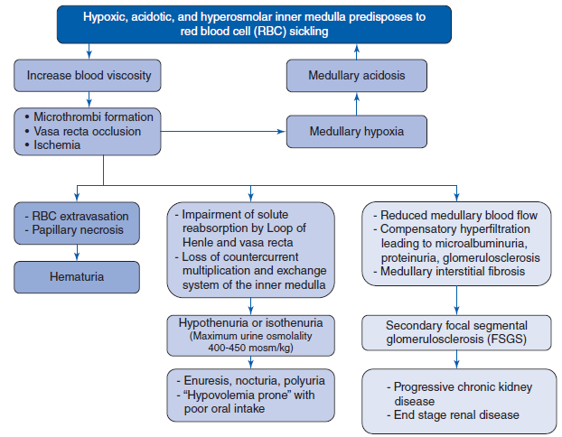
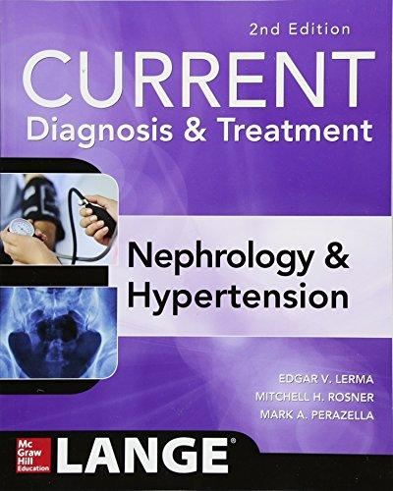

Slide 26
CLINICAL PRESENTATION

Slide 27
Hematuria and papillary necrosis
Tubular dysfunction
Acute Kidney Injury
Chronic Kidney Disease and SCD associated glomerulopathy
Malignancy

Slide 28
KIDNEY INVOLVEMENT IN SICKLE CELL DISEASE

Slide 29
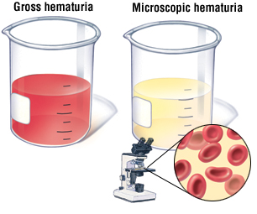
Hematuria
RBC sickling
Vascular obstruction
RBC extravasation

Slide 30
Hematuria
Both microscopic and macroscopic painless hematuria may be observed

Slide 31
Hematuria
Both microscopic and macroscopic painless hematuria may be observed
Bleeding typically remits spontaneously within a few days

Slide 32
Hematuria
Both microscopic and macroscopic painless hematuria may be observed
Bleeding typically remits spontaneously within a few days
Hematuria is usually unilateral

Slide 33
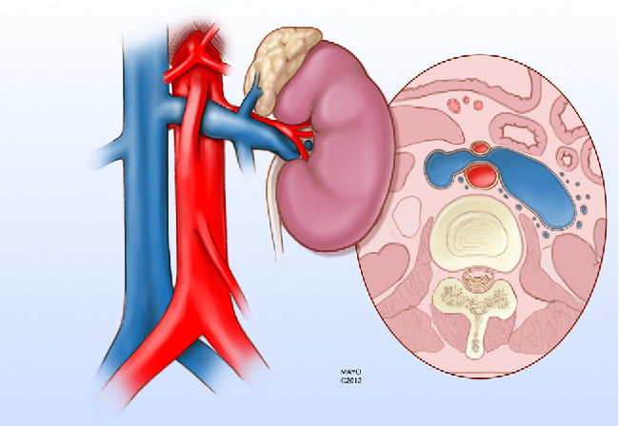
NUTCRACKER
PHENOMENON
Notes:
Hematuria is usually unilateral and originates more frequently from the left than the right due to the “nutcracker” phenomenon.

Slide 34
LEFT RENAL VEIN
NUTCRACKER
PHENOMENON
Notes:
Hematuria is usually unilateral and originates more frequently from the left than the right due to the “nutcracker” phenomenon.

Slide 35
SMA
LEFT RENAL VEIN
AORTA
NUTCRACKER
PHENOMENON
Notes:
Hematuria is usually unilateral and originates more frequently from the left than the right due to the “nutcracker” phenomenon.

Slide 36
Hematuria
Both microscopic and macroscopic painless hematuria may be observed
Bleeding typically remits spontaneously within a few days
Hematuria is usually unilateral
Bilateral hematuria occurs in approximately 10% of cases

Slide 37
Hematuria
Both microscopic and macroscopic painless hematuria may be observed
Bleeding typically remits spontaneously within a few days
Hematuria is usually unilateral
Bilateral hematuria occurs in approximately 10% of cases
Hematuria does not portend a greater risk for kidney failure

Slide 38
Papillary necrosis

Slide 39
Papillary necrosis
Usually discovered by radiologic investigation of patients with painless gross hematuria
Hematuria is not invariably present
In one series, there was no difference in the incidence of RPN between symptomatic (65%) and asymptomatic (62%) patients
Like hematuria, papillary necrosis does not portend a greater risk for kidney failure

Slide 40
Laboratory Findings
CBC with differential: chronic compensated hemolytic anemia with Hgb 8-10 gms/dL

Slide 41
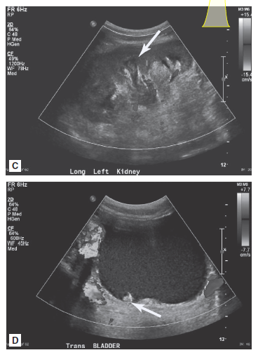
Imaging studies
dilated renal
pelvis and calyces
Kidney Ultrasound
Increased echodensity and “garland” pattern of calcification in the medullary pyramids are typical ultrasonographic findings.
small blood clot

Slide 42
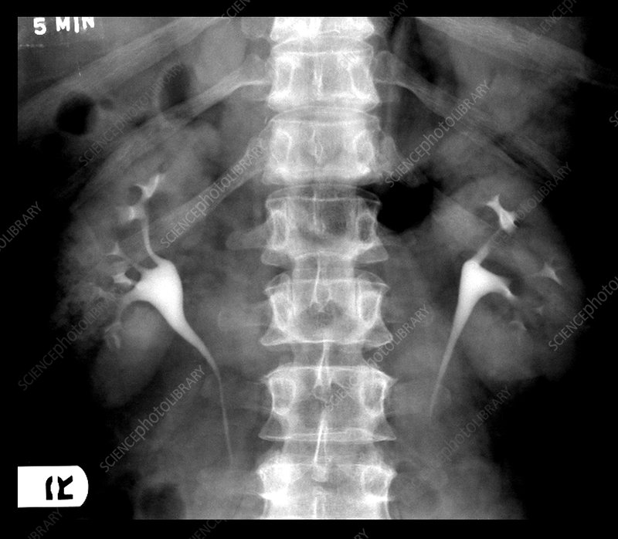
Imaging studies
Renal Pyelogram
Papillary necrosis with sloughing can appear as “egg in a cup” or “golf ball in a club” deformity.

Slide 43
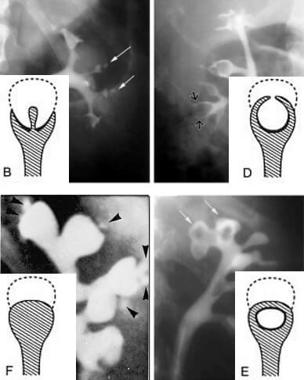
Imaging studies
Renal Pyelogram
Papillary necrosis with sloughing can appear as “egg in a cup” or “golf ball in a club” deformity.

Slide 44
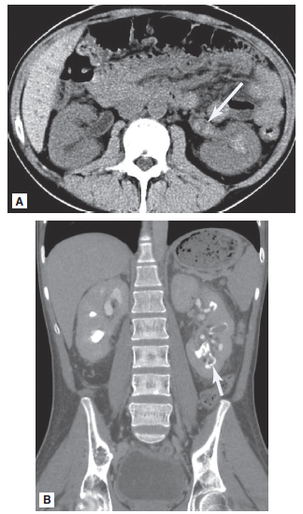
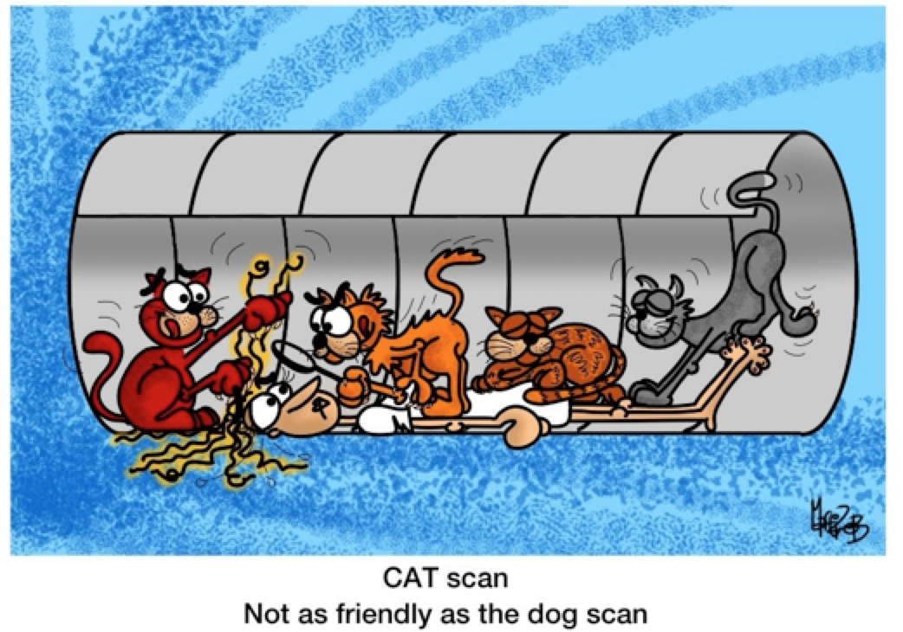
Imaging studies
hyperdense
“blood’
CT Scan
calyceal
“clubbing”

Slide 45
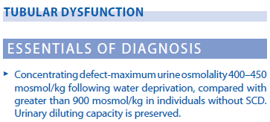
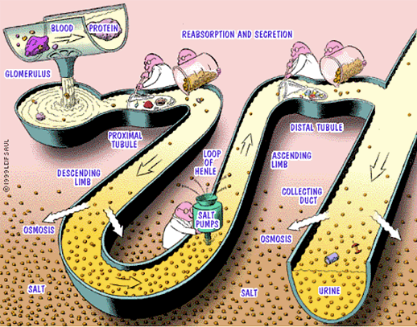
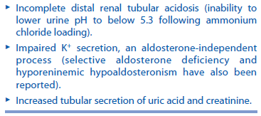
KIDNEY INVOLVEMENT IN SICKLE CELL DISEASE

Slide 47
KIDNEY INVOLVEMENT IN SICKLE CELL DISEASE

Slide 48
The most common tubular abnormality in SCD is urinary concentrating defect
Affected individuals may present with nocturnal enuresis (children), nocturia, polyuria, or “hypovolemia prone” with poor oral intake
In older adolescents and adults, medullary fibrosis and permanent destruction of collecting ducts result in irreversible concentrating defects

Slide 49
Laboratory Findings
Diminished concentrating ability leads to hypo- or isosthenuria, where U OSMs typically does not exceed 400-450 mOsm/kg (normally > 900 mOsm/kg)

Slide 51
Laboratory Findings
Hyperphosphatemia
Falsely low serum creatinine

Slide 52
KIDNEY INVOLVEMENT IN SICKLE CELL DISEASE ACUTE KIDNEY INJURY (AKI)
Impaired kidney function occurs in 5-18% of patients with SCD and can present as acute kidney injury (AKI) or chronic kidney disease (CKD)

Slide 53
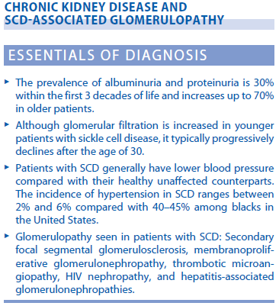
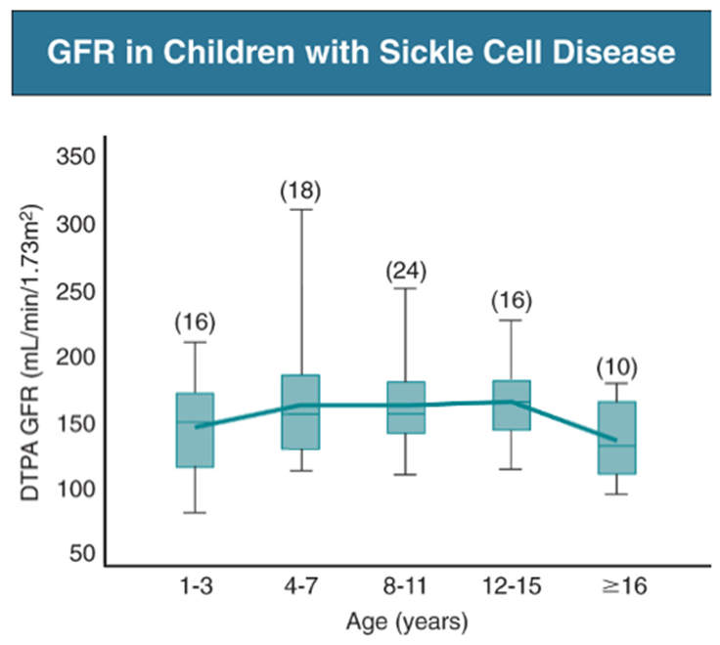
KIDNEY INVOLVEMENT IN SICKLE CELL DISEASE

Slide 54
The incidence of CKD among patients with SCD varies widely among different parts of the world

Slide 55
The incidence of CKD among patients with SCD varies widely among different parts of the world
2.6%

Slide 56
The incidence of CKD among patients with SCD varies widely among different parts of the world
2.6%
4.3%

Slide 57
The incidence of CKD among patients with SCD varies widely among different parts of the world
2.6%
4.3%
5.9%

Slide 58
The incidence of CKD among patients with SCD varies widely among different parts of the world
2.6%
4.3%
5.9%
11.6%

Slide 59
The incidence of CKD among patients with SCD varies widely among different parts of the world
2.6%
4.3%
5.9%
11.6%
22.5%

Slide 60
The incidence of CKD among patients with SCD varies widely among different parts of the world
Definition
2.6%
4.3%
5.9%
11.6%
22.5%

Slide 61
The incidence of CKD among patients with SCD varies widely among different parts of the world
Definition
Duration of follow-up
2.6%
4.3%
5.9%
11.6%
22.5%

Slide 62
The incidence of CKD among patients with SCD varies widely among different parts of the world
Definition
Duration of follow-up
Age of the population
2.6%
4.3%
5.9%
11.6%
22.5%

Slide 63
The incidence of CKD among patients with SCD varies widely among different parts of the world
Definition
Duration of follow-up
Age of the population
Hospital vs Clinic settings
2.6%
4.3%
5.9%
11.6%
22.5%

Slide 64
The incidence of CKD among patients with SCD varies widely among different parts of the world
Definition
Duration of follow-up
Age of the population
Hospital vs Clinic settings
Genetic factors (modifiers)
2.6%
4.3%
5.9%
11.6%
22.5%

Slide 65
The diagnosis of CKD among patients with SCD generally occurs between 30-40 years of age, with ESKD developing in approximately 11% of patients

Slide 66
Progression of CKD is thought to be due in part to
Early glomerular hypertrophy and hyperfiltration
Eventual development of FSGS

Slide 67
KIDNEY INVOLVEMENT IN SICKLE CELL DISEASE

Slide 68
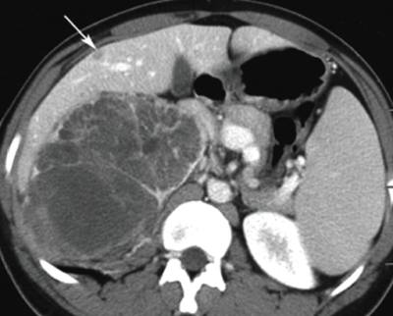
Renal Medullary Carcinoma

Slide 69
Renal Medullary Carcinoma
Rare, highly-aggressive (often metastatic at the time of presentation) non-clear cell renal cancer predominantly found in patients with sickle cell trait

Slide 70
Renal Medullary Carcinoma
Rare, highly-aggressive (often metastatic at the time of presentation) non-clear cell renal cancer predominantly found in patients with sickle cell trait
Typical onset is in early adulthood (20-30 years)

Slide 71
Renal Medullary Carcinoma
Rare, highly-aggressive (often metastatic at the time of presentation) non-clear cell renal cancer predominantly found in patients with sickle cell trait
Typical onset is in early adulthood (20-30 years)
Men are affected approximately twice as frequently as women

Slide 72
Renal Medullary Carcinoma
Rare, highly-aggressive (often metastatic at the time of presentation) non-clear cell renal cancer predominantly found in patients with sickle cell trait
Typical onset is in early adulthood (20-30 years)
Men are affected approximately twice as frequently as women
Presenting findings include: flank pain, hematuria, palpable mass (with right kidney involvement more common than left)

Slide 73
Renal Medullary Carcinoma
Rare, highly-aggressive (often metastatic at the time of presentation) non-clear cell renal cancer predominantly found in patients with sickle cell trait
Typical onset is in early adulthood (20-30 years)
Men are affected approximately twice as frequently as women
Presenting findings include: flank pain, hematuria, palpable mass (with right kidney involvement more common than left)
Loss of expression of the chromatin remodeling factor SMARCB1

Slide 74
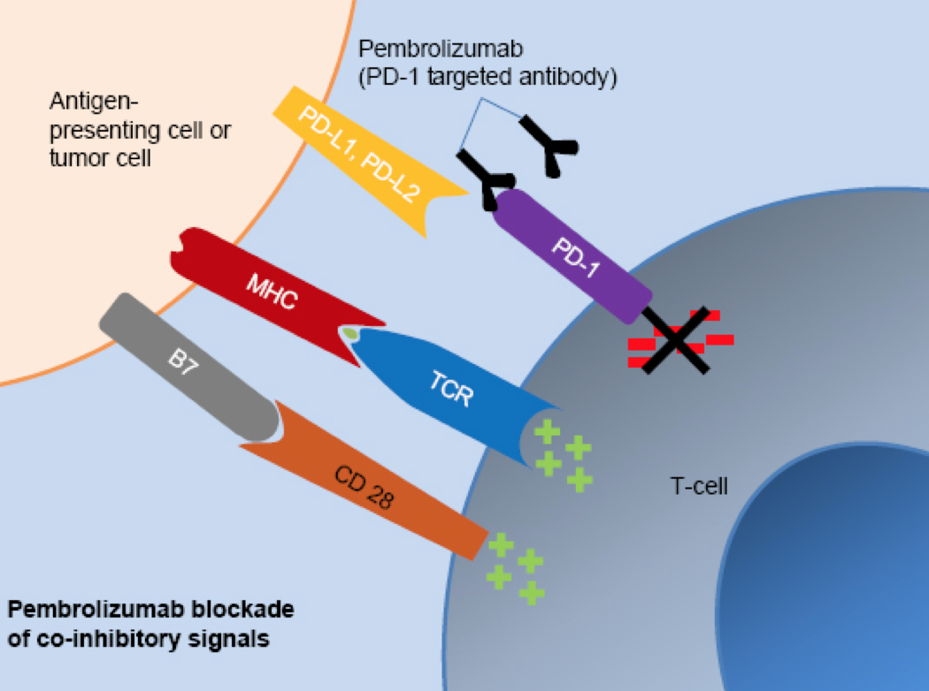

Slide 75
Treatment
Nephrectomy
Chemotherapy/ Targeted biologic therapy (Pembrolizumab, Nivolumab)

Slide 76
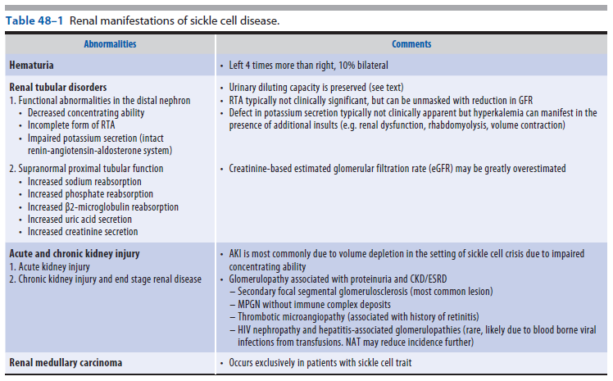

Slide 80
GENETIC MODIFIERS
Kidney dysfunction in SCD is affected by 2 major genetic modifiers:
Hgb F levels
α globin genotype

Slide 81
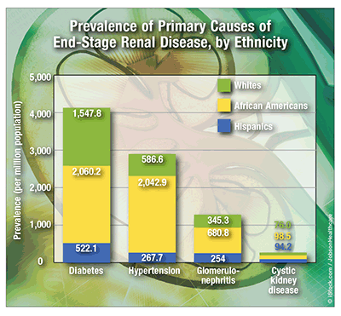
GENETIC MODIFIERS
Although not specifically related to SCD, the prevalence of CKD per se is recognized to be 2.5-5 times greater in people of African ancestry

Slide 82
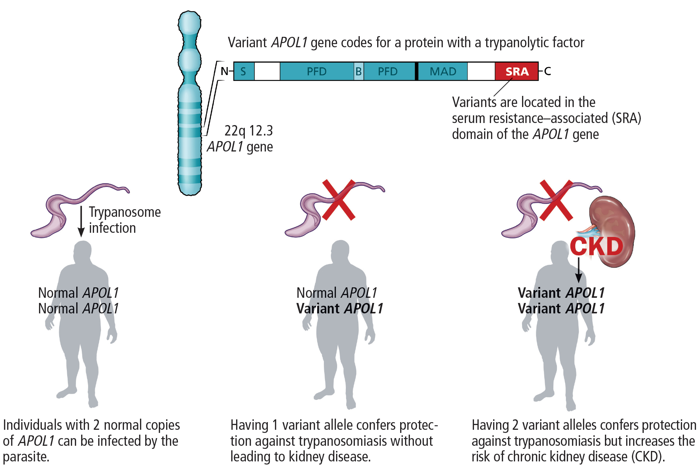
GENETIC MODIFIERS
Two genes in particular have been identified as having SNPs associated with CKD:
MYH9
APOL1
Notes:
If these SNPs represent true kidney disease-susceptibility factors and have a high prevalence in the genetic make up of those ethnic groups that also carry the burden of SCD, the it is possible that coinheritance could also lead to an increased kikelihood of developing SCN.

Slide 83
PREVENTION
An ounce of prevention is worth a pound of cure

Slide 84
PREVENTION
While screening is essential, high quality evidence is lacking to guide the optimal screening tests and intervals for testing
Routine evaluations are initiated by age 3-5 years
Routine visits
~ 2-3 x/ year for children
~ 4-6 x/ year for adults

Slide 85
PREVENTION
Assessment of blood pressure
Urinalysis with examination of the urine sediment and a spot urine microalbumin to creatinine ratio
Metabolic panel (Schwartz formula ?)
Renal imaging
For those with acute or chronic decline in renal function, significant hematuria or proteinuria, or signs of obstructive uropathy

Slide 86
PREVENTION AND TREATMENT

Slide 87
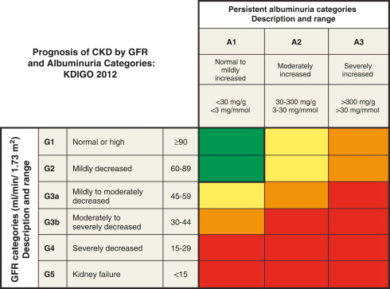
How are patients with CKD managed?
Anemia
Progression of CKD
ESKD
Hemodialysis
Peritoneal Dialysis
Kidney Transplantation

Slide 88
Goal hemoglobin: 10-10.5 g/dL
Higher hemoglobin levels and rapid correction (>1-2%/ week) may be associated with precipitating a vaso-occlussive crisis
Blood transfusions
Erythropoietin stimulating agents (ESAs)

Slide 89
Blood Pressure
Hypotension is more common in SCD than in the general population
Proposed mechanism: Prostglandin mediated changes in vascular tone and Na reabsorption
Impaired urinary concentrating ability predisposes to volume depletion

Slide 90
Blood Pressure
The incidence of hypertension in SCD is markedly lower than in the general population (2-6%)
All individuals with SCD should be closely monitored for the development of relative hypertension and masked hypertension
Risk Factors: Nocturnal hypoxemia as well as other risk factors in the general population (high BMI, high dietary Na intake)

Slide 91
Avoid Nephrotoxic medications
NSAIDs
Aminoglycoside antibiotics
Radiocontrast material

Slide 92
Hydroxyurea
Protective against many SCD complications and its use is appropriate in most individuals with SCD who have vaso-occlusive complications
Evidence for improvement in kidney function with hydroxyurea therapy comes from observational studies and indirect outcomes in randomized trials

Slide 93
ACE inhibitors Angiotensin Receptor Blockers
For those with hypertension and/ or urine protein excretion ≥ 300 mgs/ day
This is likely to slow progression of CKD and lower BP

Slide 94
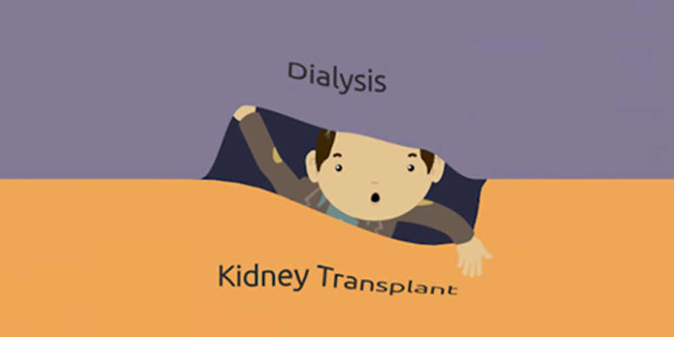

Slide 95
Dialysis
HEMODIALYSIS

Slide 96
Dialysis
HEMODIALYSIS
PERITONEAL DIALYSIS

Slide 97
Dialysis
Individuals with SCD and ESKD can be treated successfully with hemodialysis (HD) or peritoneal dialysis (PD)
Dialysis is generally initiated at a younger age (as compared to general population)
In one study, median age was 41 ± 4 years
The choice between HD and PD depends on clinical factors and patient preferences

Slide 98
Kidney Transplantation
Kidney transplantation offers the best outcome for individuals with ESKD from SCD and should be offered to all potential candidates
2009 case series:
10 year-survival
n = 237
KT recipients: 56%
No transplant: 14%

Slide 99
Potential explanations for lower rates of kidney transplantation
Racial bias?

Slide 100
Potential explanations for lower rates of kidney transplantation
Racial bias?
Concern about higher infectious risk?

Slide 101
Potential explanations for lower rates of kidney transplantation
Racial bias?
Concern about higher infectious risk?
Concern about blood group incompatibility?

Slide 102
Potential explanations for lower rates of kidney transplantation
Racial bias?
Concern about higher infectious risk?
Concern about blood group incompatibility?
Concern about pulmonary hypertension?

Slide 103
Potential explanations for lower rates of kidney transplantation
Racial bias?
Concern about higher infectious risk?
Concern about blood group incompatibility?
Concern about pulmonary hypertension?
Concern about side effects of immunosuppressive agents ?

Slide 104
Potential explanations for lower rates of kidney transplantation
✖ Racial bias
✖ Concern about higher infectious risk
✖ Concern about blood group incompatibility
✖ Concern about pulmonary hypertension
✖ Concern about side effects of immunosuppressive agents
None of these should be reasons
for avoiding tranplantation

Slide 105
SUMMARY
The clinical hallmarks of SCD are:
Hemolysis
Vaso-occlusion
Ischemia reperfusion
The underlying mechanisms of SC Nephropathy primarily relate to hypoxia and ischemia

Slide 106
SUMMARY
SC Nephropathy encompasses a wide range of kidney abnormalities that affects different segments of the nephron
Hypo- or isosthenuria
Hematuria and papillary necrosis
Renal Tubular Acidosis
AKI
CKD/ ESKD
Glomerular disease
Medullary Renal Carcinoma

Slide 107
SUMMARY
Goal Hgb should be no more than 10-10.5 gms/dL
Higher Hgb levels may precipitate a vaso-occlussive crisis
All forms of renal replacement therapy may be beneficial to patients with ESKD from SC disease.
Hemodialysis, Peritoneal Dialysis and Kidney Transplantation

