Slide 1
Sickle Cell Disease: The search for Cure
September 5, 2019

Slide 2
DISCLOSURES
California Institute for Regenerative Medicine (CIRM)-investigator
CSL-Behring Inc.-Investigator

Slide 3
Epidemiology
In the United States:
1 in 12 African Americans carry the trait
1 in 500 African Americans has the disease

Slide 4
Every year ~300,000 are born with SCD
The majority of births are in
Nigeria
Democratic Republic of Congo
India

Slide 5
Sickle Cell Disease
Affects ~ 100,000 in the United States

Slide 6
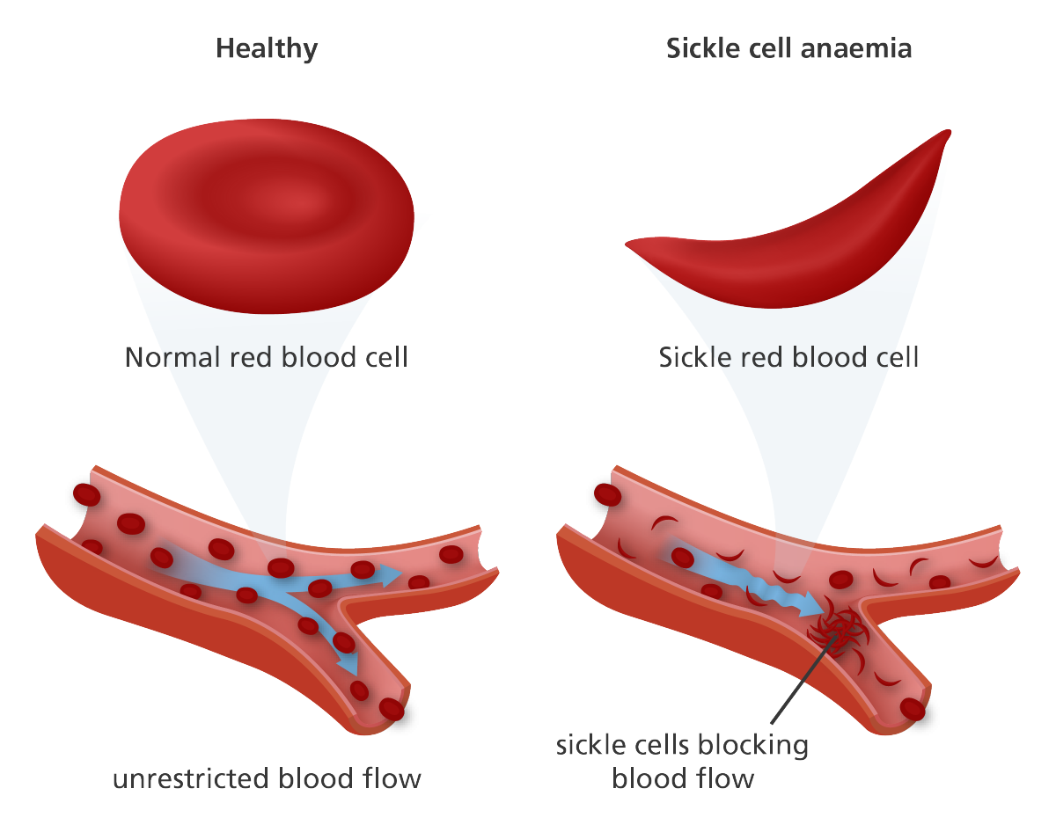
Red Blood Cells Are Affected In Sickle Cell Disease
Leads to:
recurrent & painful blood clotting crises
multiple organ failures
→ stroke, infections, acute chest syndrome,…
anemia (need of regular blood transfusions)
Poor quality of life, shorter lifespan
WE ARE DEDICATED TO FIND A CURE FOR THIS DEVASTATING CONDITION

Slide 7
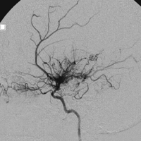
Long term organ damage in SCD
Neurologic
11% will have a stroke before age 18
1/3 will develop silent stroke by age 15
Transcranial doppler (TCD) predictive
Cognitive dysfunction
Pulmonary issues
Acute chest syndrome
Pulmonary hypertension 40% by age 40
Renal insufficiency
Infection risks
Vasocclusive crises = pain crises
Bone infarctions
Iron overload from chronic transfusion also causes end organ damage

Slide 8
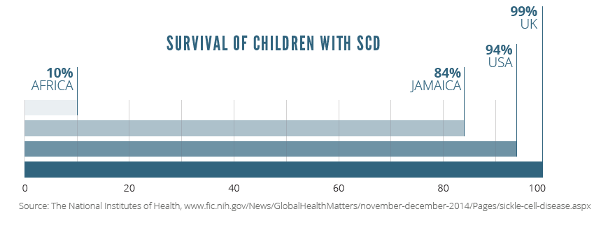

Slide 9
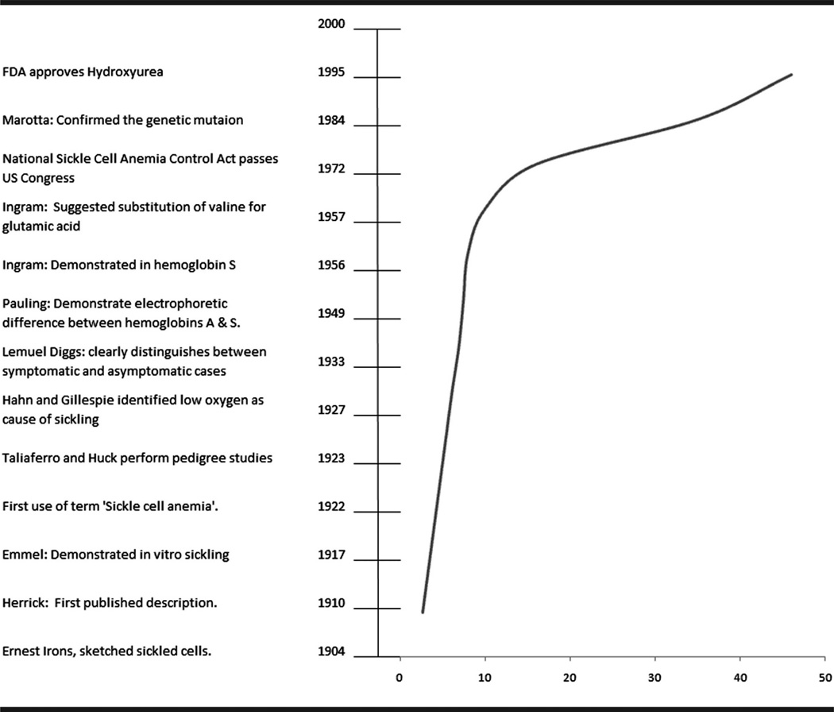
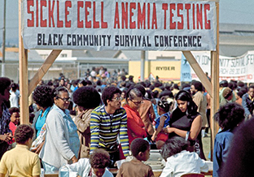

Slide 10
Probability of Surviving among Males and Females with Sickle Cell Anemia (SS), as Compared with Black Males and Females in the General Population
Black females
Black males
Females with SS
Males with SS
Platt et al. N Engl J Med, 1994

Slide 11
Life Expectancy and Sickle Cell Disease
1973: Life expectancy = 14 years
Now: Average life expectancy is 40-60 years
BUT, quality of life of patients living with SCD remains poor
Source: National Heart, Lung, and Blood Institute

Slide 12
How Can We Cure Sickle Cell Disease?

Slide 13
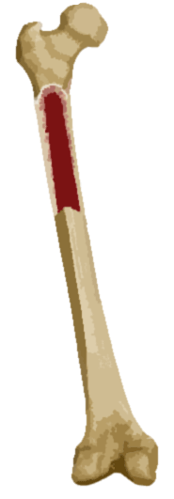
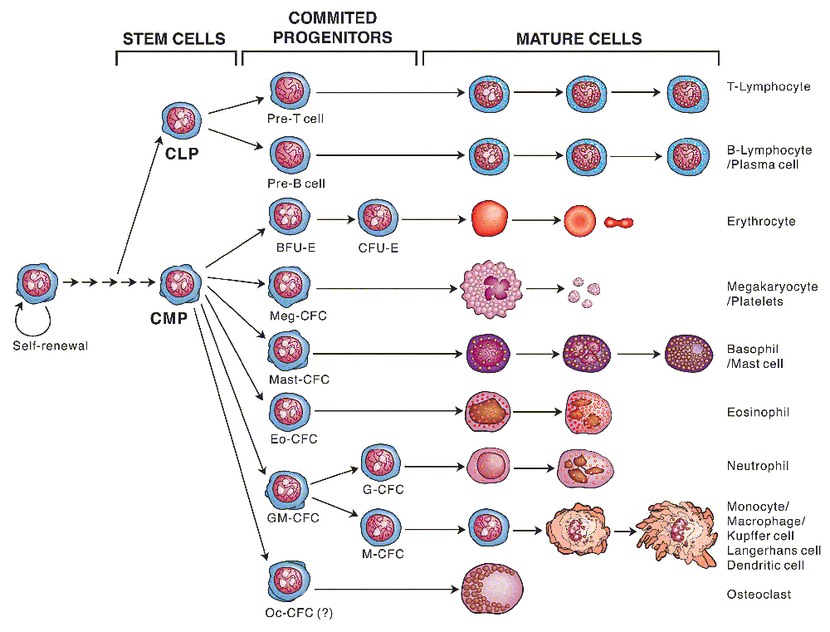
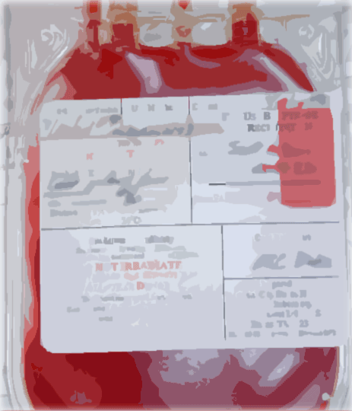
The blood forming system, a.k.a. hematopoietic system
Bone
Marrow
Peripheral blood stem cells
CD34⁺
Cord Blood

Slide 14
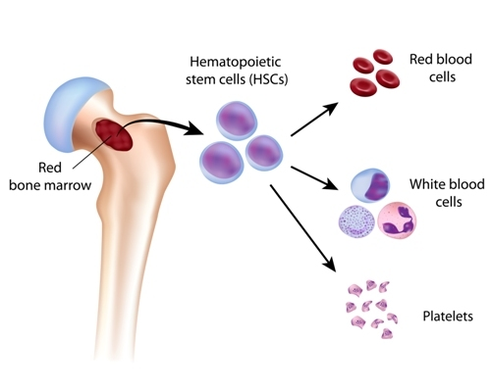
What are Stem Cells ?
“Mother” of all blood cells
To carry oxygen to your organs
To fight infections in your body
To make blood clot
Notes:
But this treatment is not done very often for sickle cell disease. That's because it has many side effects and can be done only if people meet certain conditions.

Slide 15
What Happen to the Stem Cells in a Person with Sickle Cell Disease?
The stem cells have a defect
Sickled cells are misshaped,
they don’t carry oxygen well to the organs in the body
To fight infections in your body
To make blood clot
Notes:
But this treatment is not done very often for sickle cell disease. That's because it has many side effects and can be done only if people meet certain conditions.

Slide 16
Where Can we Get Healthy Stem Cells?
From a healthy donor
From the patient himself
Blood stem cells with defect
Healthy blood stem cells
Healthy
donor
Sickle cell patient
Sickle cell patient
Healthy
donor
Correct the stem cells in a lab
Healthy blood stem cells
Stem Cell Transplantation
GENE THERAPY

Slide 17
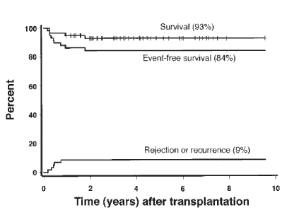
Transplant outcomes by donor type
Matched related donor
Other donor types

Slide 18
Challenges in Application of Stem cell Transplantation

Slide 19
Challenges in BMT for sickle cell disease
Donor identification is a problem
15% will have matched-sibling donor
60% will have HLA-matched unrelated donor (MUD)
>25% have no suitable MUD
Due to toxicities, BMT is reserved for those with severe disease
Recurrent chest syndrome
CNS event
Recurrent severe pain episodes
Impaired neuropsychological functioning with abnormal imaging

Slide 20
CITY OF HOPE’S EXPERIENCE WITH TRANSPLANT IN SICKLE CELL PATIENTS

Slide 21
Current questions
Can transplants be curative in older patient?
How can we minimize the risks associated with the treatment?
How can we overcome the barriers of finding suitable donors?
Are there potential alternatives to transplantation?

Slide 22
City of Hope Has Performed 36 Successful Transplants in Patients
12 children
10 teens
14 young adults

Slide 23
Pre-clinical
City of Hope Pipeline for Treatment of Sickle Cell Disease
Pilot/Phase I
Discovery
Pre-transplant Immunosuppressive Therapy for Haplo-identical Transplants
Induction of MHC-Mismatched Mixed Chimerism
First in human
Process Development – Cell Product Manufacturing
Mobilization of Autologous HSC with Plerixafor for Gene Therapy
Bone Marrow Niche Targeting
In Vivo Non-Nuclease Genome Editing

Slide 24
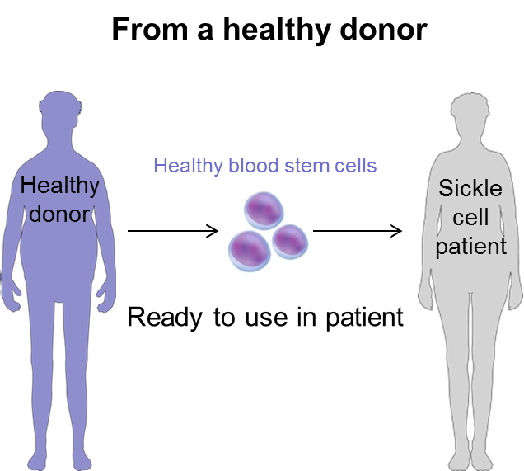
City of Hope: Current Clinical Trials with transplantation for Sickle Cell Disease
Two clinical trials for blood stem cell transplantation
Problem: It is hard to find fully compatible healthy donors for transplant
Goal: To transplant blood stem cells from a healthy donor who is not fully compatible with the patient
1 trial aimed for younger and healthier patients
1 trial aimed for older patients or those with higher burden of SCD

Slide 25
A Pilt Study of Pre-transplant Immunosuppressive Therapy for Haploidentical Transplants in Patients with Sickle Cell Disease
COH IRB#17136

Slide 26
Day
-68
-67
-66
-65
-64
-40
-39
-38
-37
-36
-12
-11
-10
-
8
-
7
-
6
-
5
-
4
-
3
-
2
-
Day
1
0
+3
+4
Dexamethasone 25 mg/m2/day
Fludarabine 40 mg/m2/day
Busulfan 130 mg/m2 x 1 test dose only
Busulfan 130 mg/m2/dose
ATG 1.5 mg/kg/day
Fludarabine 35 mg/m2/day
Rest day could be 1 to 3 days
Stem Cell Infusion (Monday-Friday)
Cyclophosphamide 50 mg/kg/day

Slide 27
Eligibility Criteria
Diagnosis: Patients with sickle cell disease at high risk for disease related morbidity or mortality, as defined by one of the following criteria of the disease status
Disease status:
Significant neurologic event (stroke) or any neurological deficit lasting > 24 hours; or increased transcranial Doppler velocity (>200 m/s).
History of one or more episodes of acute chest syndrome (ACS) in the 2-year period preceding enrollment despite the institution of supportive care measures (i.e. asthma therapy and/or hydroxyurea).
History of one or more severe vaso-occlusive pain crises per year in the 2-year period preceding enrollment despite the institution of supportive care measures (i.e. a pain management plan and/or treatment with hydroxyurea).
Recurrent priapism requiring medical therapy.
Osteonecrosis of two or more joints despite the institution of supportive care measures.
Prior treatment with regular RBC transfusion therapy, defined as receiving 8 or more transfusions per year for > 1 year to prevent vaso-occlusive clinical complications (i.e. pain, stroke, and acute chest syndrome)
Echocardiograph finding of tricuspid valve regurgitation jet (TRJ) velocity ≥ 2.5 m/sec.

Slide 28
Eligibility Criteria
Ages 1 to 30 years old.
Child Bearing Potential
Transplantation could be teratogenic and/or lethal to the developing fetus. For this reason, women of child-bearing potential and men must agree to use adequate contraception (hormonal or barrier method of birth control or abstinence) prior to study entry and for six months following duration of study participation. Should a woman become pregnant or suspect that she is pregnant while participating on the trial, she should inform her treating physician immediately.
Informed Consent/Assent: All subjects must have the ability to understand and the willingness to sign a written informed consent.
Protocol-Specific Criteria
The recipient must have a related donor who is genotypically haploidentical on HLA-A, B, C and DRB1 loci.
No HLA matched sibling or 10/10 matched unrelated donor is available.

Slide 29
Patients
Total 12 patients received transplant
5 patients underwent haplo transplant prior to the study opening
Transplant dates: 8/24/2016 – 11/8/2017 (2-3 y post-tx)
All 5 doing well
7 patients enrolled on study: 4/11/2018 – 5/29/2019
1 pt died (25 y old) due to fungal infection 7 m post transplant
1 secondary graft failure due to BK virus – engrafted after 2nd transplant
1 pts has mild myelosuppression due to BK 1 year post-transplant – no SCD symptoms

Slide 30
Correlation between the status of the bone marrow niche and HSC engraftment
In this protocol, we propose correlative studies to determine:
At which extent the damage of the bone marrow niche due to inflammation correlates with changes in HSC and progenitor function during stable disease (before transplant).
At which extent the recovery of the BM niche following transplant correlates with engraftment of donor cells.

Slide 31
COH IRB#16453 Supported by Cirm CLIN2-10847
A Pilot Study to Evaluate the Safety and Feasibility of Induction of Mixed Chimerism in Sickle Cell Disease Patients with COH-MC-17: a Non-Myeloablative, Conditioning Regimen and CD4+ T-cell-depleted Haploidentical Hematopoietic Transplant

Slide 32
What is chimerism?
A state in which donor-type lympho-hematopoietic system exists in a recipient
Complete Chimerism:
Donor-type lympho-hematopoietic system completely replaces the host-type in a recipient.
GVHD potential
Immuosuppressants needed for prevention of GVHD.
Therapy for hematological malignancies and hereditary hematological disorders.
Mixed Chimera
Mixed Chimerism:
Donor- and host-type lympho-hematopoietic system co-exist in a recipient.
No GVHD

Slide 33
Mixed chimerism: A curative therapy for severe sickle cell disease (SCD)
Classical HCT with myeloablative therapy/ reduced intensity conditioning
Complete chimerism, risk of GvHD
Some cases of mixed chimerism
With donor chimerism as low as 11%
Sufficient to eliminate signs and symptoms of SCD
Limited GvHD
Improves quality of life

Slide 34
A Phase I Pilot Study Evaluating Safety and Feasibility of Gene Therapy with autologous CD34+ hematopoietic stem/progenitor cells [HSPCs] transduced with lentiviral vector encoding the human γ -globin gene and sh734 In Adult Subjects with Severe Sickle Cell Disease
Clinical Protocol

Slide 35
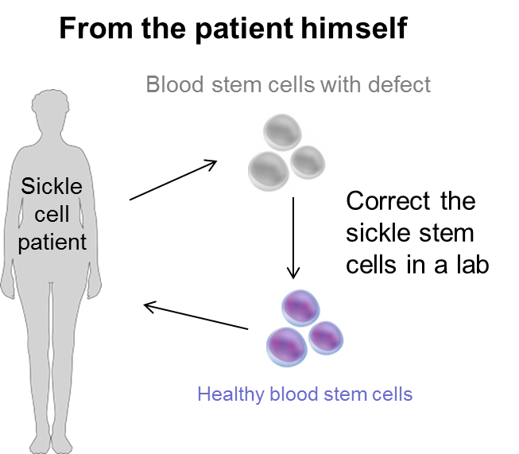
City of Hope: Current Clinical Trials with gene therapy for Sickle Cell Disease
One gene therapy-related clinical trial for adults with sickle cell disease
Problem: Gene therapy requires a lot of stem cells from the patient
Goal: To find a safe way to collect enough blood stem cells from adults with severe disease and see if we can correct their defect in a petri dish in a lab
Participants will NOT receive the corrected stem cells but will help doctors develop the future therapy

Slide 36
Hypotheses
It is feasible to mobilize autologous hematopoietic stem cells with plerixafor, and collect a sufficient number of CD34+ HSPC for transduction and transplant (ongoing PISMO trial)
A reduced intensity conditioning regimen with melphalan will enable a successful transplant and engraftment of autologous HSPC transduced with LVgGsh7
The lentiviral vector encoding the human γ-globin gene will result in high-level production of exogenous γ-globin in adult erythroid progenitor cells leading to efficient formation of fetal hemoglobin

Slide 37
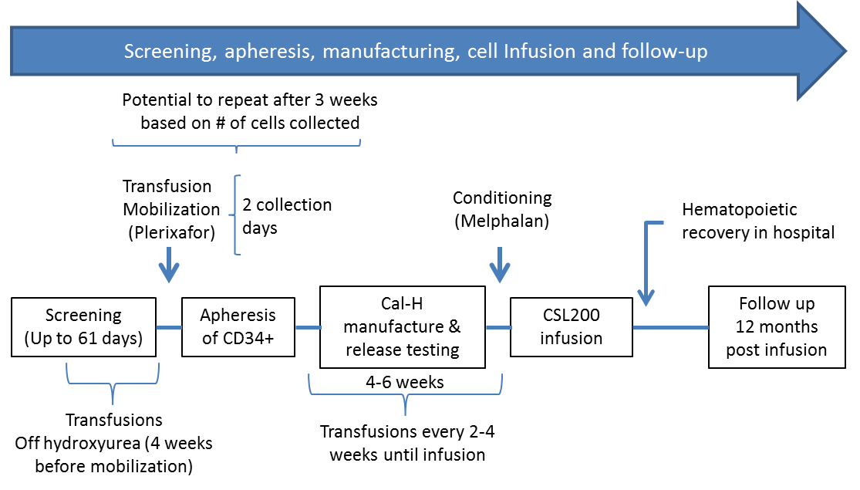
Study design: Pilot study with CSL200 (no 6-TG)
In 3 adults with SCD
A Phase 1/2 study with CSL200 + 6TG will follow this pilot study

Slide 38
Primary and secondary objectives of the pilot study
Primary Objectives
To evaluate the safety and feasibility of:
Collection of CD34+ cells by apheresis after mobilization with plerixafor
Reduced intensity conditioning with melphalan
Administration of CSL200 (gene-modified CD34+ HSPC)
Exploratory Objectives
To evaluate the potential to genetically correct Sickle Cell Disease via determination of the:
Contribution of gene modified cells to multi-lineage hematopoiesis and circulating red blood cells
Hematological and functional correction of the sickling phenotype

Slide 39
Do you Want to Learn More?
Joseph Rosenthal, MD: jrosenth@coh.org
Anna Pawlowska, MD: apawlows@coh.org
Teresa Kim, RN: teresakim@coh.org
Lisa Pullens, RN: lpullens@coh.org

Slide 40
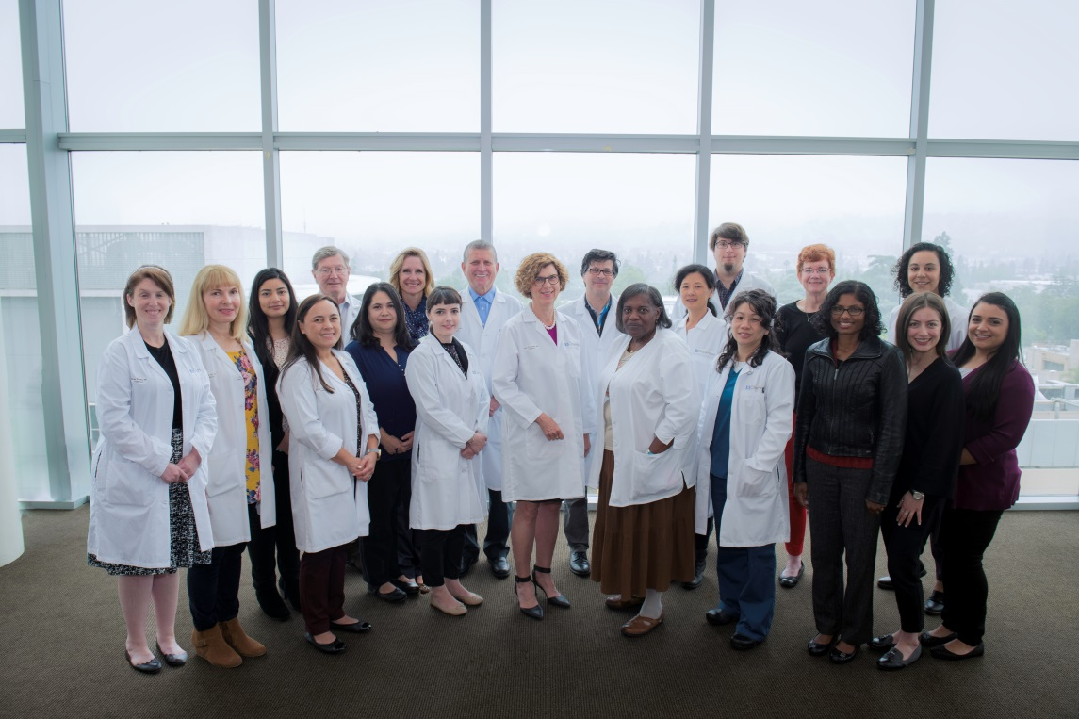
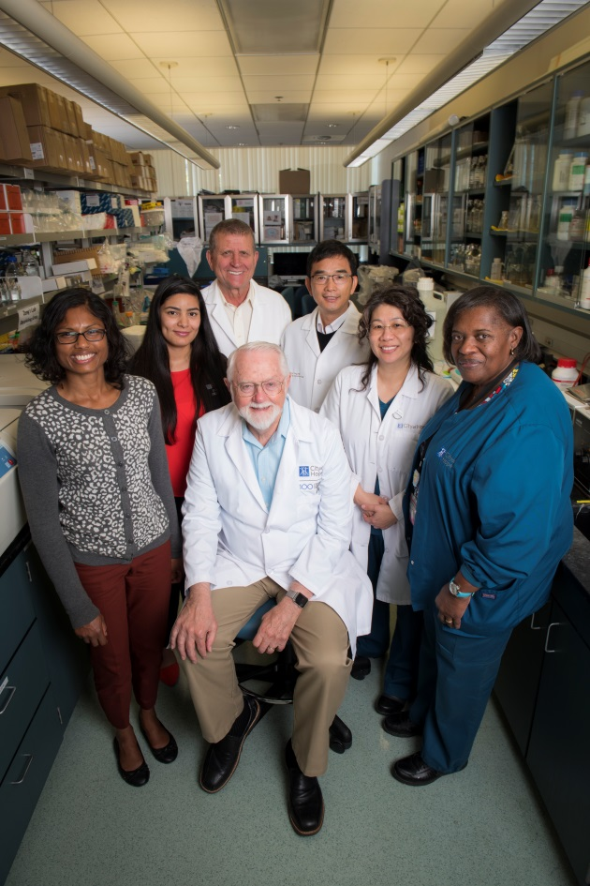
Our multi-disciplinary team
Insert picture of team

Slide 41
Questions?
THANK YOU!!!

