Slide 1
California Newborn Screening Program
Hb Trait Follow-up Services
Tracey Bishop
Cayenne 11th Annual Sickle Cell Disease Education Seminar
September 5, 2019
San Diego, CA

Slide 2
I do not have any relationships to disclose.

Slide 3
Newborn Screening (NBS)
Newborn Screening can identify babies with certain diseases so that treatment can be started right away. Early treatment can prevent disabilities, delayed growth and/or life- threatening illnesses.
NBS in CA is mandated state public health program that started in 1980 and is governed by Barclays Official California Code of Regulations.
Hb screening started in 1990.

Slide 4
Newborn Screening Expansion in California
2018 * Pompe Disease
* MPS I
2020 * Spinal Muscular Atrophy
2016 *ALD
2013 * Severe Combined Immune Deficiency
2007 *Cystic Fibrosis * Biotinidase Deficiency
2005 * Metabolic Disorders * Congenital Adrenal Hyperplasia
1999 * Hemoglobin H Disease
1990 * Sickle Cell Other Hb Disorders
1980 * PKU * Congenital Hypothyroidism * Galactosemia
Notes:
RICHARD

Slide 5
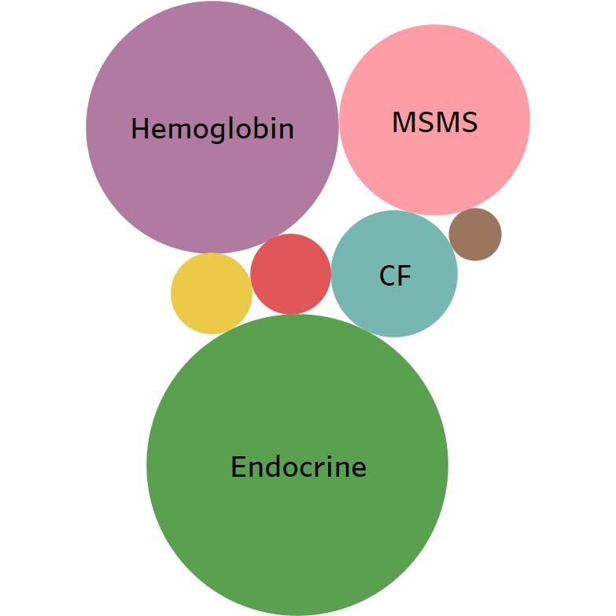
Hemoglobin disorders are the second most common group detected by NBS in California.
Incidence of Disorders Detected by NBS
2012-2016

Slide 6
Hemoglobinopathy Screening
The hemoglobin testing methodology is automated high pressure liquid chromatography (HPLC).
We identify around 200 newborns a year with Hb patterns that lead to further follow-up, including confirmatory testing and a referral to a California Children’s Services Hb Center.
Includes Sickle Cell and Thalassemias.

Slide 7
Hb Trait Follow-Up
Our testing also identifies Hb carriers (almost 5000/year).
Free telephone counseling and parent testing is available .
Information about program services is provided to the provider listed on the NBS Test Request Form and the family.

Slide 8
Hemoglobin Trait Carrier Rate by Race/Ethnicity in California Newborns (2010-2014)
Race/Ethnicity | Sickle Cell Trait Carrier Rate | Hb C Trait Carrier Rate | Hb D Trait Carrier Rate
Black | 1/14 | 1/47 | 1/3019
Native American | 1/96 | 1/419 | 1/2094
Hispanic | 1/192 | 1/1474 | 1/2169
Middle Eastern | 1/268 | 1/3560 | 1/542
White | 1/630 | 1/2962 | 1/2828
Asian Indian | 1/637 | 1/24221 | 1/234
Filipino | 1/855 | 1/3465 | 1/2772
East Asian | 1/6072 | 1/12903 | 1/25806
Southeast Asia | 1/1331 | 1/7763 | 1/2588
Pacific Islander | 1/185 | 1/555 | N/A
Other | 1/210 | 1/1037 | 1/1004
Multiple | 1/59 | 1/219 | 1/2429

Slide 9
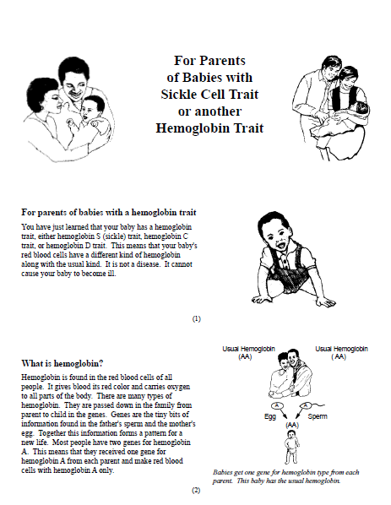
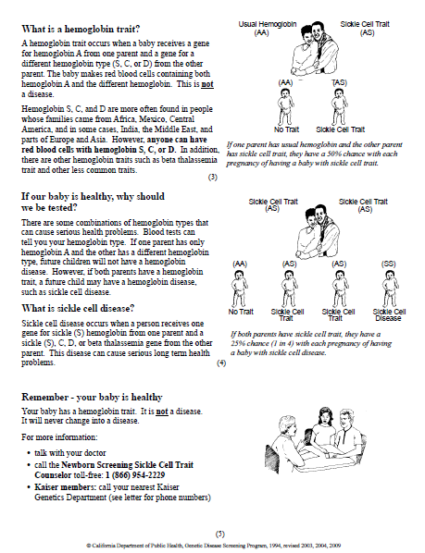
Sickle Cell Trait Pamphlet

Slide 10
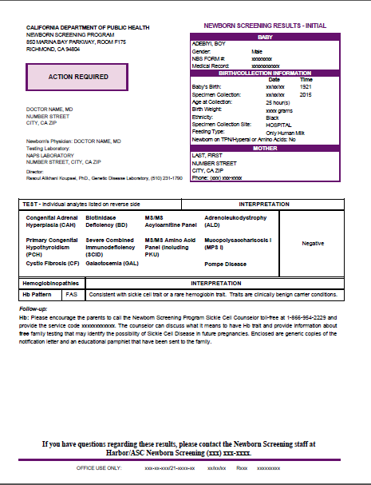
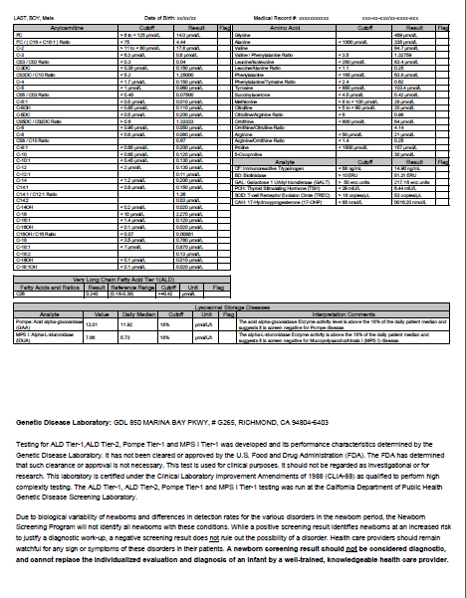
NBS Provider Result Mailer
Follow-up:
Hb: Please encourage the parents to call the Newborn Screening Program Sickle Cell Counselor toll-free at 1-866-954-2229 and
provide the service code xxxxxxxxxxxx. The counselor can discuss what it means to have Hb trait and provide information about
free family testing that may identify the possibility of Sickle Cell Disease in future pregnancies. Enclosed are generic copies of the notification letter and an educational pamphlet that have been sent to the family.
Notes:
RICHARD

Slide 11
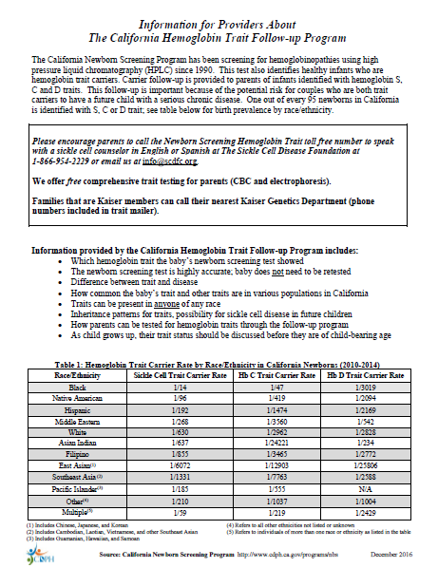
Provider Fact Sheet
Reminds of services the follow-up program offers.
Reminds that trait is found in all ethnicities.
Risk for child with disease if both parents are carriers.

Slide 12
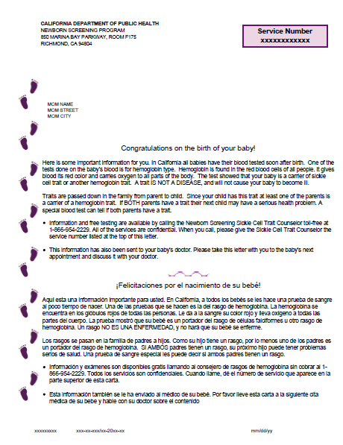
Hb Trait Letter to Family
Sent three days after Physician letter
Explains test results
Explains trait is not disease
Explains basic inheritance
Explains risk for SCD in future if both parents are carriers
Offers counseling and parent testing services

Slide 13
Hb Trait Counseling
Free telephone counseling and parent testing is available for the parents of infants identified with sickle cell trait, hemoglobin C trait and hemoglobin D trait.
The counseling is provided by our contractor: Sickle Cell Disease Foundation.

Slide 14
Counseling Session Information Includes
Which hemoglobin trait the baby’s newborn screening test showed.
Difference between trait and disease.
How common the baby’s trait and other traits are in various populations in California.
Inheritance patterns for traits, possibility for sickle cell disease in future children.
How parents can be tested for hemoglobin traits through the follow-up program.
As child grows up, their trait status should be discussed before they are of child-bearing age.

Slide 15
Hb Trait Counseling
Average counseling session lasts approx. 45 minutes.
Paperwork and consents are sent to parents and are returned with signature.
Lab authorization paperwork is sent to parents.
Parents take paperwork to a designated local Quest draw.
Quest performs blood draw, bills the CA NBS Program.
Results available within 2-4 weeks in the Quest portal.
Results counseling provided and copies of lab results sent to parents.

Slide 16
HB Trait Program
Currently, only an uptake rate of 8% and we are working on increasing the number
Numbers of Hispanic/Latinx calls increasing and they tend to have less information about Sickle Cell.
We have recently begun outreach to familes when the parent letter comes back to the program with an incorrect address.

Slide 17
Counseling Numbers FY 2018-19
Hb trait inquiry only | 276
Hb trait inquiry only - Spanish | 56
Trait/Carrier follow-up intake done | 362
Trait/Carrier follow-up intake done - Spanish | 61
Counseled by phone | 318
Non-English phone counseling done | 54

Slide 18
Parent Testing Numbers FY 2018-19
Lab kit sent | 219
Lab kit sent - Spanish | 29
Test results counseling done | 51
Test results counseling done - Spanish | 17
NCAA Request counseling | 3

Slide 19
Acknowledgements
Newborn Screening Staff
Sickle Cell Disease Foundation Staff
Quest Diagnostics Staff
Genetic Disease Laboratory Staff

Slide 20
Questions?
Tracey Bishop
tracey.bishop@cdph.ca.gov

